Slide 1

Getting Started with PBIS Rewards
Notes:
In this presentation, we will cover the basics of PBIS and how to utilize the PBIS Rewards system.

Slide 2

Hello! I’m [Insert Name]
Your title
Years at current school/district
Your Twitter or Instagram username
Contact information
Add a picture or Bitmoji
A fun fact about me is…
[Add your fun fact here]
Notes:
Start off the session by introducing yourself to your audience and connecting with them. You might say, “I started using PBIS Rewards in _____” or “I first learned about PBIS Rewards from _____.” You might want to tell a quick story about a way you used PBIS Rewards with students and how it made a difference in your classroom or school.
Get an idea about your audience by taking a quick survey – participants can raise their hand if they have used PBIS Rewards before.
On this slide you can add a picture of yourself, a Bitmoji, and your contact information. Use the prompts above to help you craft this page, and if you don’t use social media or have a blog, feel free to remove those bullets.

Slide 3
Expectations for Training
EXPECTATION | BEHAVIOR
Be Respectful | Be open to new ideas Actively listen while others are sharing
Be Responsible | Silence all other devices Gather materials (paper, writing utensil) Share the air
Be Safe | Share relevant information and ideas in chat Stay engaged - use non-verbal feedback Don’t be afraid to ask questions
Notes:
Set the tone by establishing expectations for the training.
If you are training virtually, you may need to make adjustments to the expectations. You will also need to adjust expectations to align with those on your school matrix.
Just as we set expectations with our students, we want to do the same as adults.
"Cheers" Norms Matter Video Link: https://www.youtube.com/watch?v=Pdyf9ZRjda8&feature=youtu.be

Slide 4

Welcome and Training Agenda
PBIS Foundations
Why PBIS Rewards?
Logging-In to PBIS Rewards
Rewarding Students
  Groups Page
  PBIS Staff App
Redeeming Points
  Store
  Events
  Raffles
Helpful Features
  ID Badges
  Parent Messaging
PBIS Rewards Support
Notes:
Review the agenda for training. They are separated into a few basic categories and you can add additional information that is needed for your school.
Remember not to overwhelm a staff with too much information.
You may want to wait and cover the ‘Helpful Features’ at a later date. It is best to set small, attainable goals and then provide additional training when everyone has mastered those skills with PBIS Rewards.

Slide 5

PBIS Foundations
Notes:
This section will focus on the basic foundations of PBIS. This will include basic definitions and the impact of PBIS on a school campus.
What is PBIS Video Link: https://www.youtube.com/watch?v=ayYwHDxs318

Slide 6
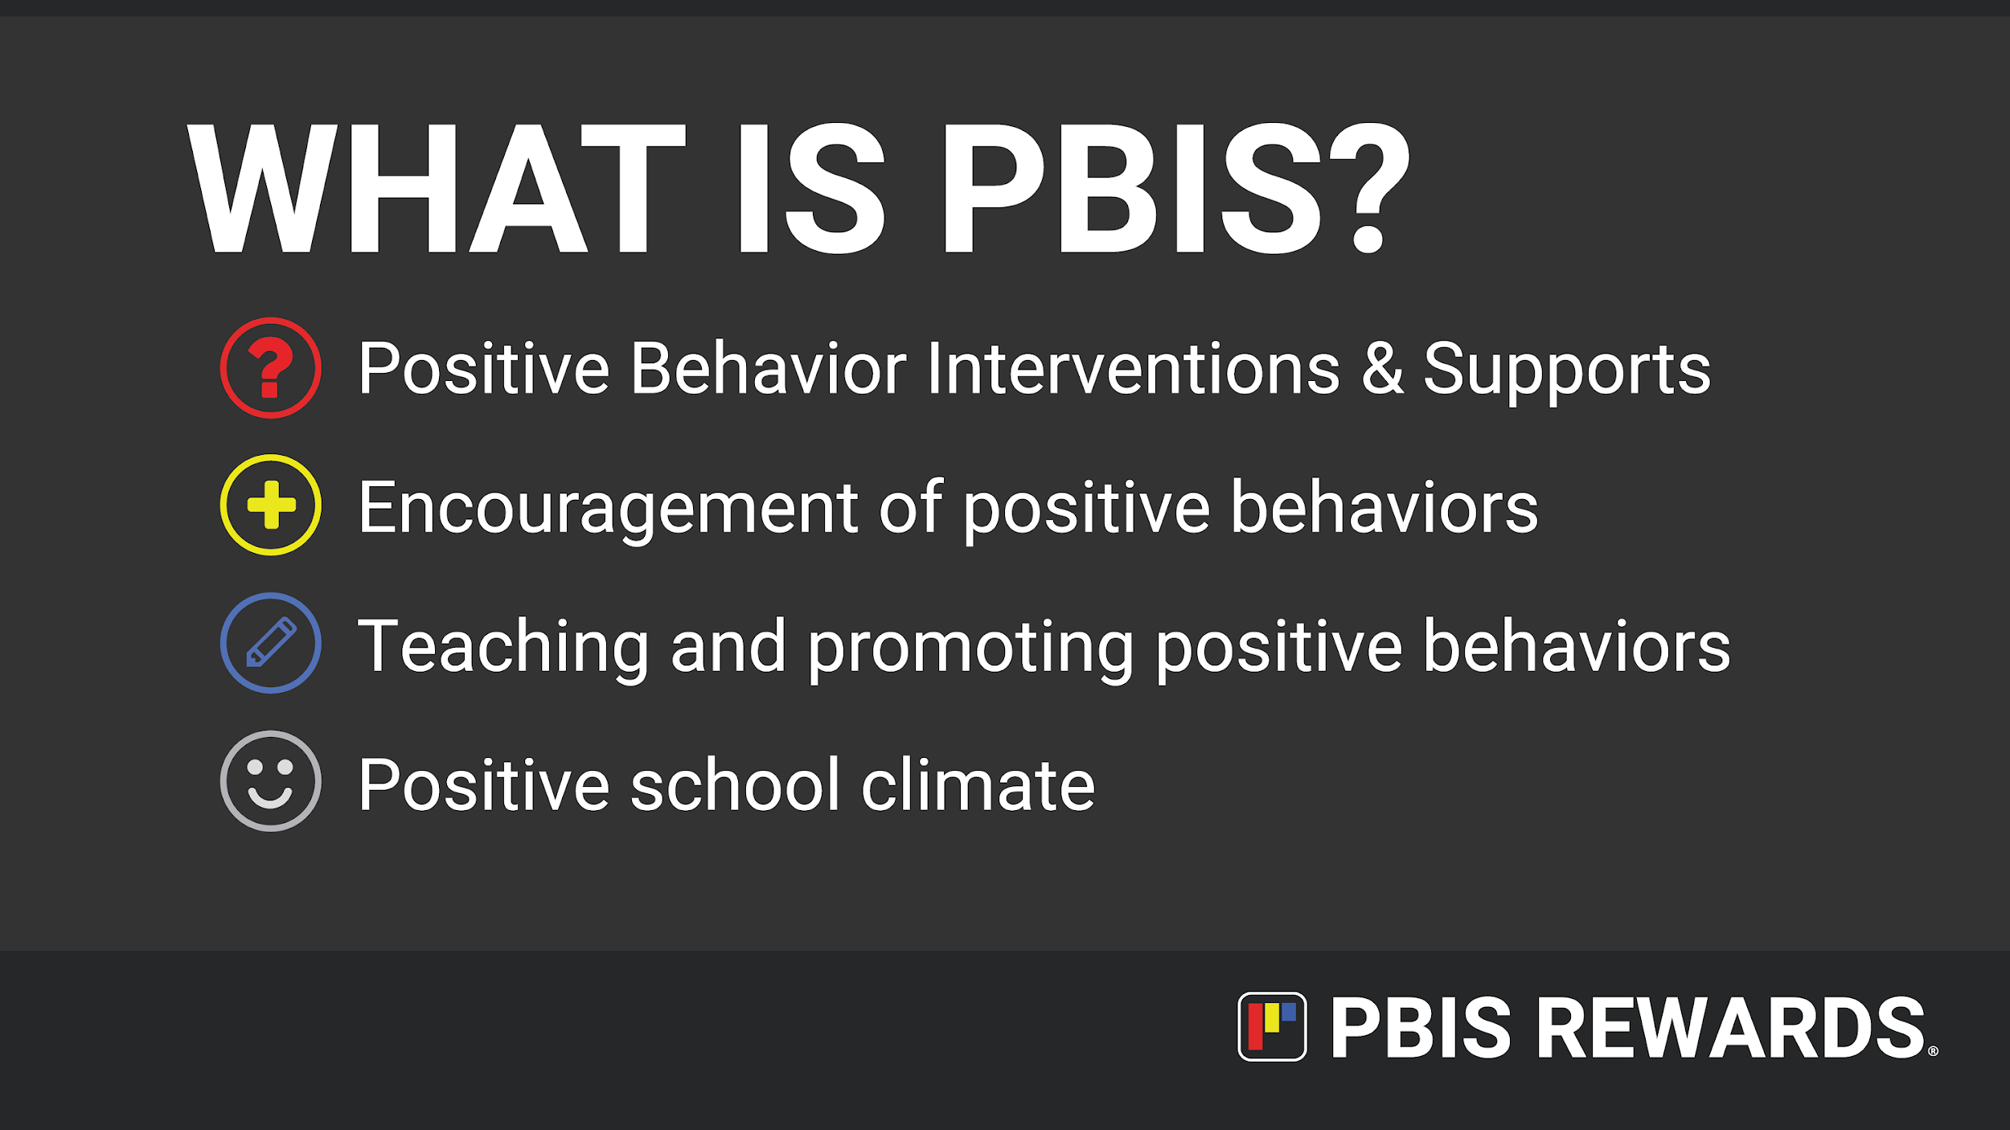
Notes:
Overview of PBIS
Let’s all start with understanding what the letters stand for: PBIS
As a school or district with PBIS, you will need to be able to easily explain what PBIS is in an efficient manner.
This slide gives a few talking points Coachs could create an “Elevator Speech” about PBIS. Use this information to create that speech and practice with other staff members.

Slide 7

Impact of PBIS
Students:
Increased academic achievement, SEL competencies and confidence
Decreased absences
Staff:
Improved relationships and positive communication
Student-Teacher
Teacher-Teacher
School:
Decreased Office Discipline Referrals and Suspensions
Safer school environment
Increased Student Exposure to Classroom Instruction
Notes:
Where can we see the impact of PBIS?
Buy back instructional time!

Slide 8
Cost of Office Referrals
5 ODRs
x
180 school days
900 ODRs a year
15 minutes each:
Teacher
Student
Admin
45 minutes
x
900 ODRs
40,500
Minutes
675 hours
96 school days
PBIS reduces time out of class, buying back quality instructional time
Notes:
Median number of ODRs for an average school could have a great range.
Teachers often say they don’t have time. PBIS is the way to earn back that time in the classroom. We know this is the best place for our students to be.

Slide 9
Why PBIS Rewards?
Notes:
PBIS Rewards offers so many features that are great benefits to schools, Coachs and students!
Let’s explore all the benefits!

Slide 10

PBIS Rewards to the Rescue
Saves time
Reduces Office Referrals
Increases Instructional Time
All Grade Levels
Increases Positive Relationships
Schoolwide
Builds Positive School Culture
Notes:
Schoolwide – Any staff member can reward any student at any time.
All Grade Levels – PBIS Rewards can be used for early childhood through adults! Everyone wants to be recognized for their hard work and PBIS Rewards is here to help make it easier!
Saves Time – Stop wasting time cutting out tickets and paper money! PBIS Rewards saves so much time by collecting all that information and increasing the fidelity of your PBIS implementation.
Reduces Office Referrals – Schools that use PBIS Rewards have seen at least a 30% decrease in their ODRs, allowing students to stay in the instructional setting.
Increases Instructional Time – Utilizing PBIS Rewards increases instructional time, allowing students to increase their academic and social emotional achievements.
Increases Positive Relationships – By rewarding points and increasing positive interactions between staff and students, positive relationships are fostered across your school.
Builds Positive School Culture – The increase in positive interactions, relationship building and increased instructional time will all equate to building a positive school culture and climate.
Short Training Demo: https://support.pbisrewards.com/guides/short-training-demonstration/
What is PBIS Rewards Student Video (K-6): https://support.pbisrewards.com/guides/student-support-video-k-6-pbis-rewards/
What is PBIS Rewards Student Video (7-12): https://support.pbisrewards.com/guides/student-support-video-7-12-pbis-rewards/
What is PBIS Rewards Parent Video: https://support.pbisrewards.com/guides/parent-support-video/

Slide 11
Logging into PBIS Rewards
Notes:
In this section, we will discuss how to log into the PBIS Rewards system
New Account Password Set-up, Staff App Download and Auth Code Sign-in Video Link: https://support.pbisrewards.com/guides/new-account-set-up-video/

Slide 12

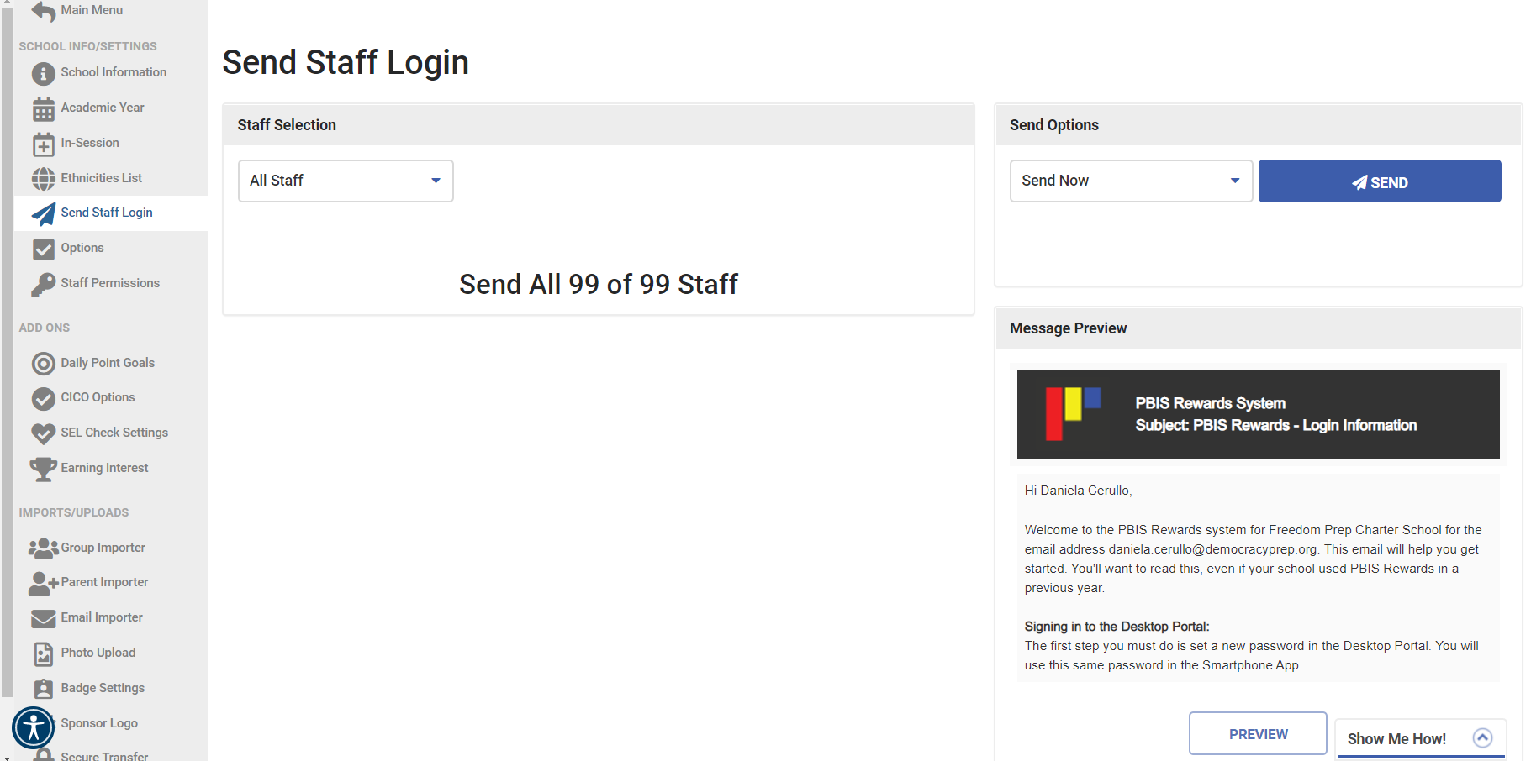
(Trainer Slide) Sending Staff Log-In Email
Hide slide when presenting to staff
Notes:
If admin with permissions want to send staff login info to all staff or selected staff members, navigate to the Settings on the Main Menu and then click on Send Staff Login.
Use this if new or previous staff members are having issues logging in
Will guide staff through process of getting into web portal
Can authorize through email link (sent through app) or authorize themselves in web portal

Slide 13
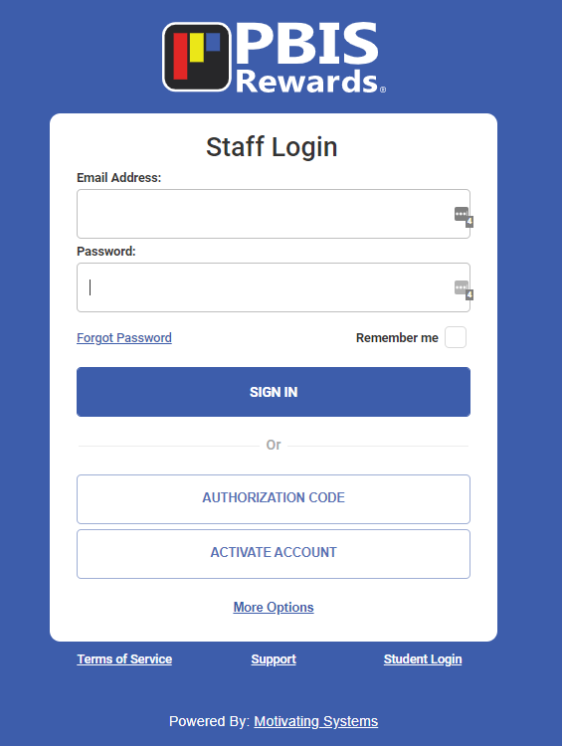
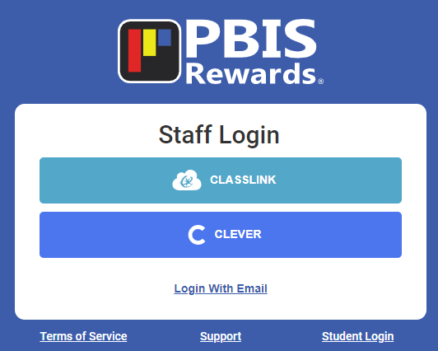
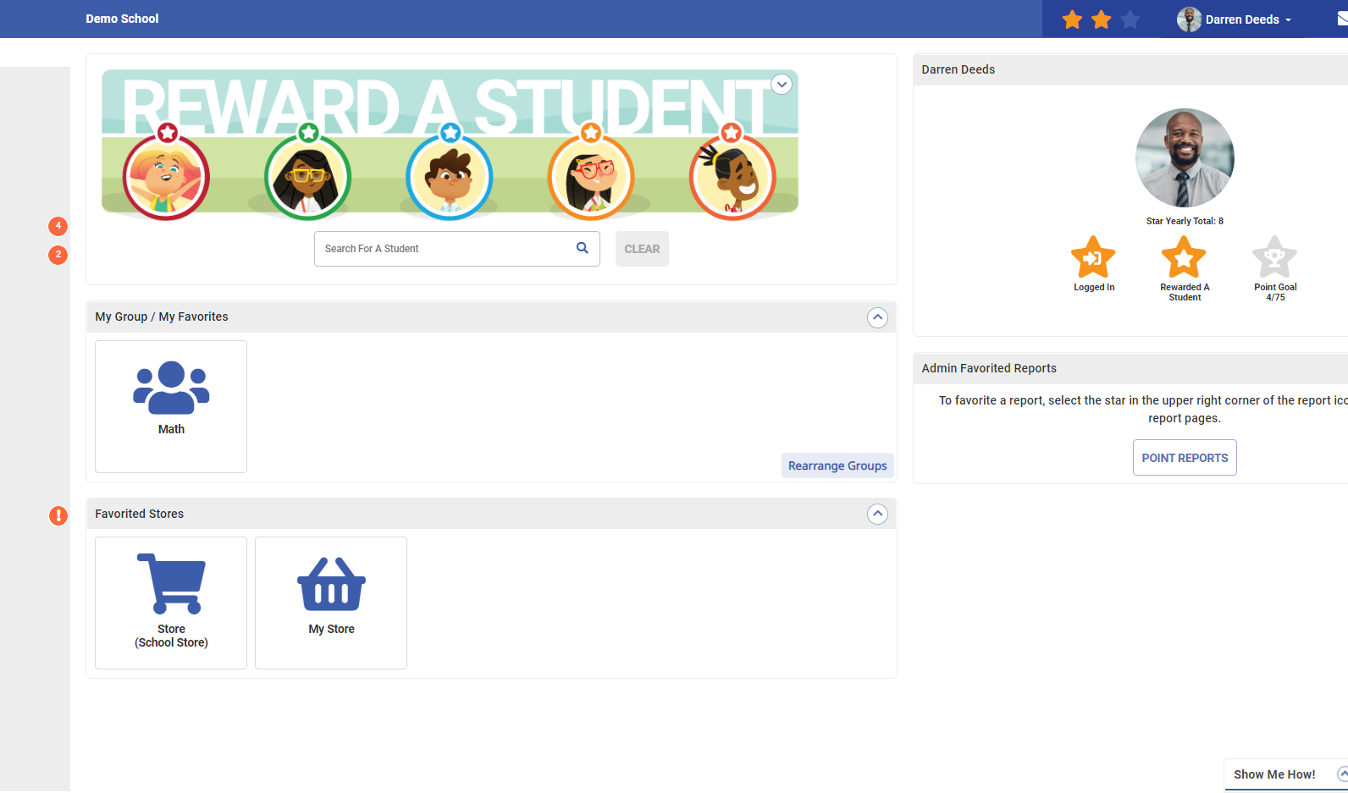
Step 1: Web Portal Log In
App.pbisrewards.com
Notes:
Web Portal Login: https://support.pbisrewards.com/guides/new-account-set-up-video/

Slide 14
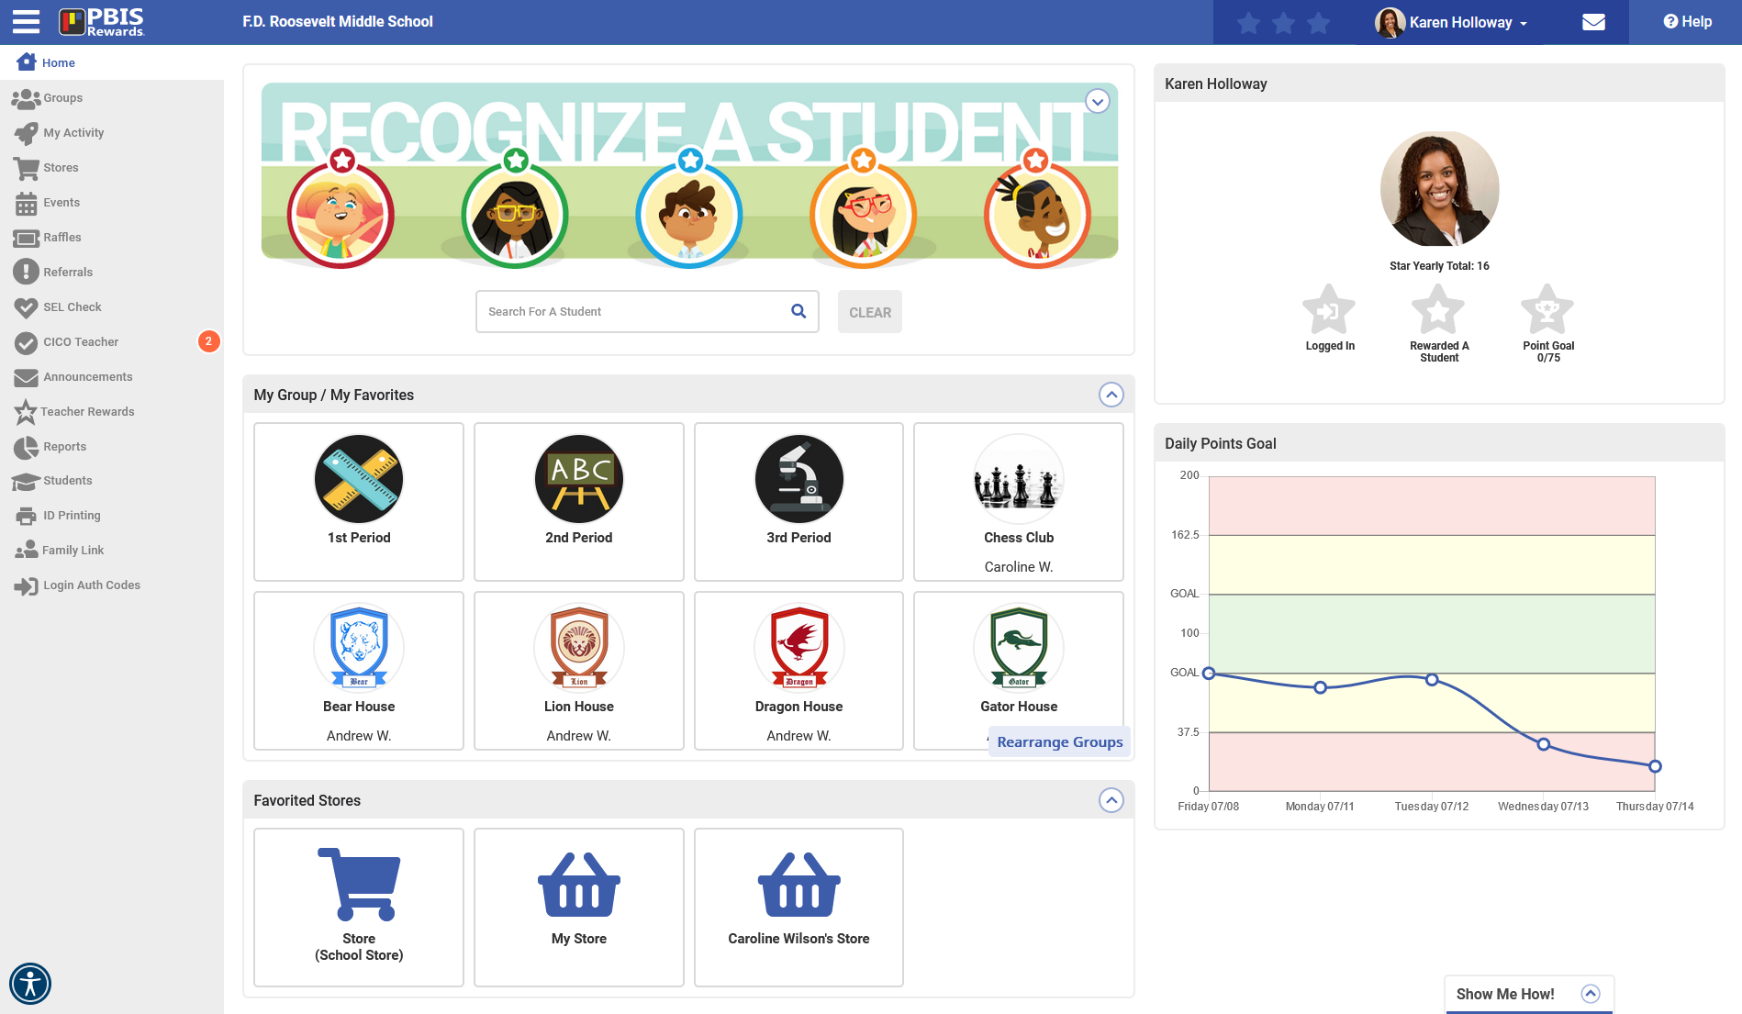
Step 1: Web Portal Log In
App.pbisrewards.com
Notes:
Web Portal Login: https://support.pbisrewards.com/article/web-portal/

Slide 15
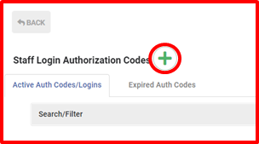
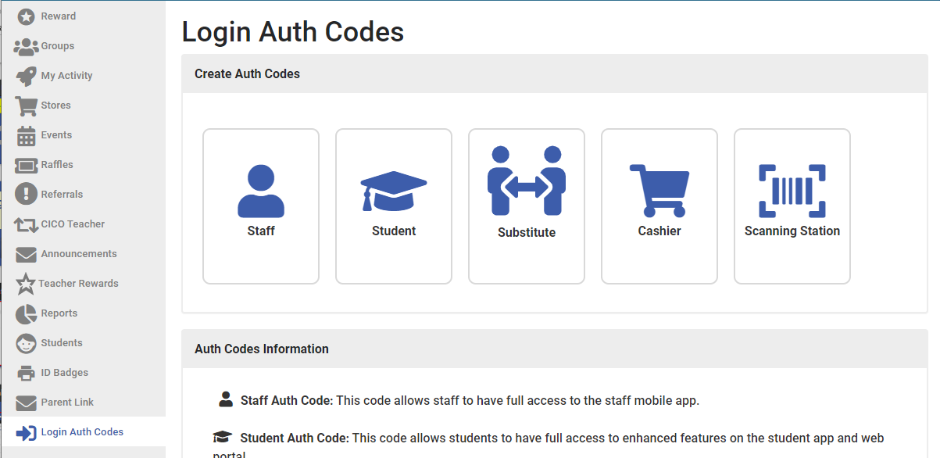
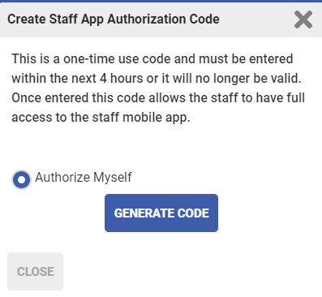
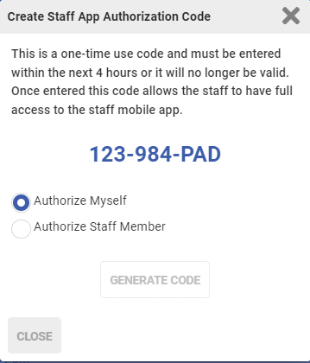
Rewarding/Acknowledgement System
Step 2: Authorize Yourself - Staff App
Start in Web Portal
Notes:
PBIS Rewards Web Portal
Guide: https://support.pbisrewards.com/guides/staff-auth-code/
Go to Login Auth Codes from the main page of PBIS Rewards
Click on Green + sign to get a new Authorization Code
Select ‘Authorize Myself’ to generate the code each staff member will need in the app

Slide 16
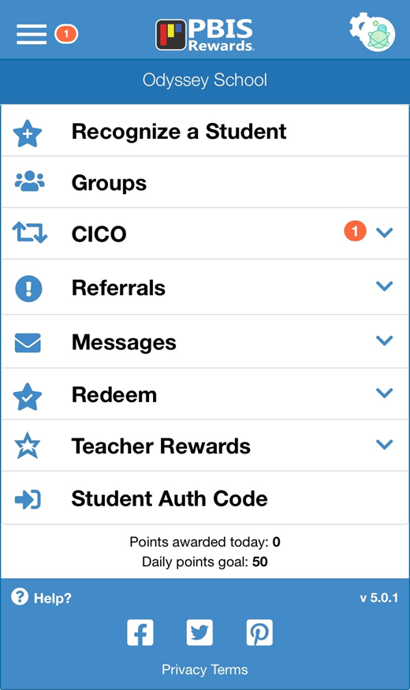
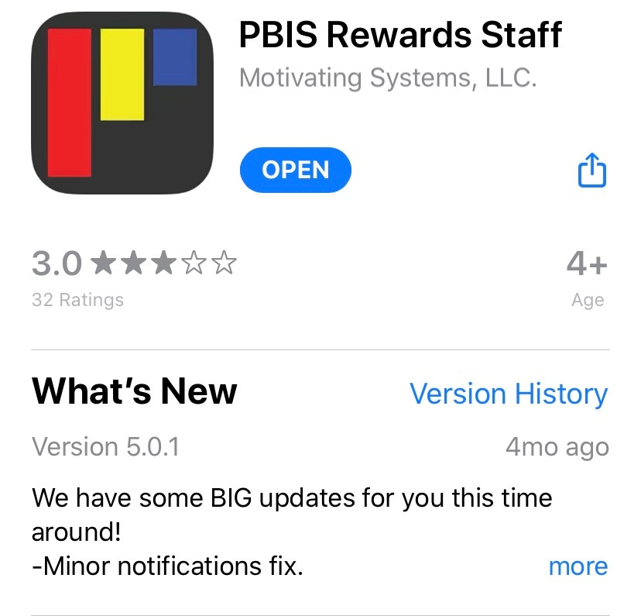
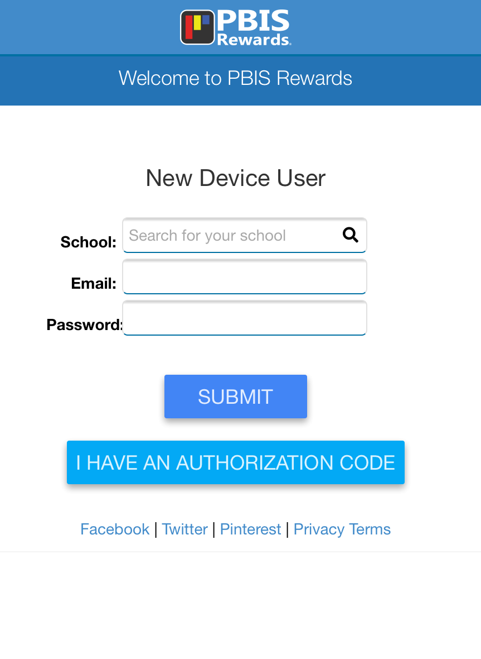
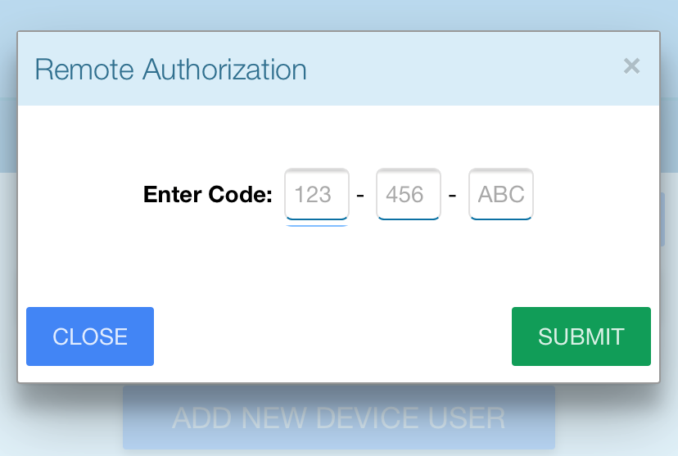
Step 3: Staff App Log In
Notes:
Staff App Login: https://support.pbisrewards.com/guides/staff-app-download-and-auth-code-sign-in/

Slide 17
Rewarding Students
Notes:
In this section, we will not only acknowledge students efficiently but learn how to group students and reward them simultaneously – saving you so much time!!
Forget about cutting out tickets and laminating them!! Those days are over!
PBIS Rewards will give you so much time back!!
Reward Students From Anywhere Video Link: https://www.pbisrewards.com/resources/videos/reward-any-student-anywhere/

Slide 18
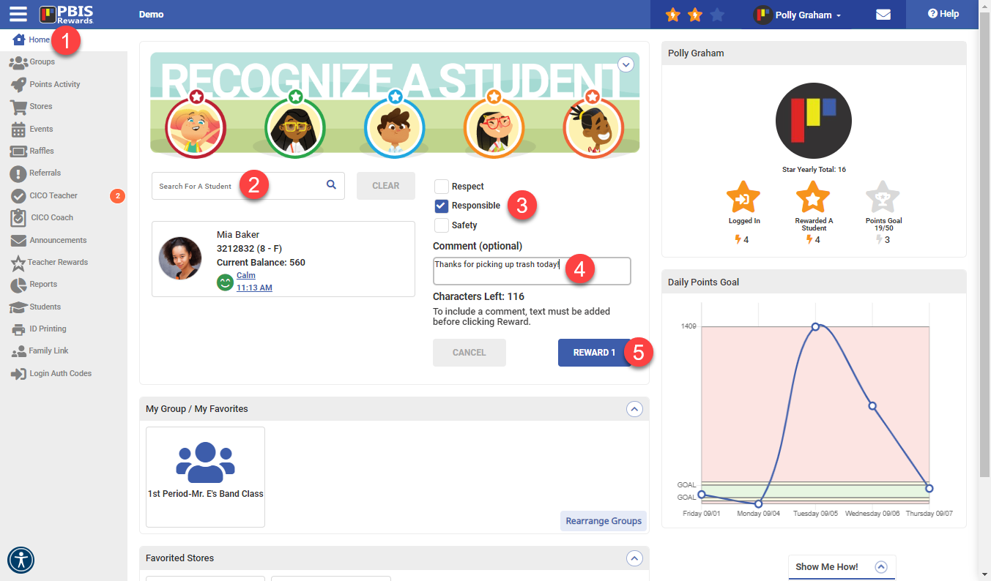
Rewarding/Acknowledgement System
Rewarding/Acknowledgement System
Notes:
- PBIS Rewards Web Portal
Follow the numbered steps to reward/acknowledge
When giving points – give behavior specific praise to build positive adult-student relationships
Comments optional – example: if you see a student picking up trash across gym @ pep rally. You can give those points and a comment so the student knows why they received that point.

Slide 19
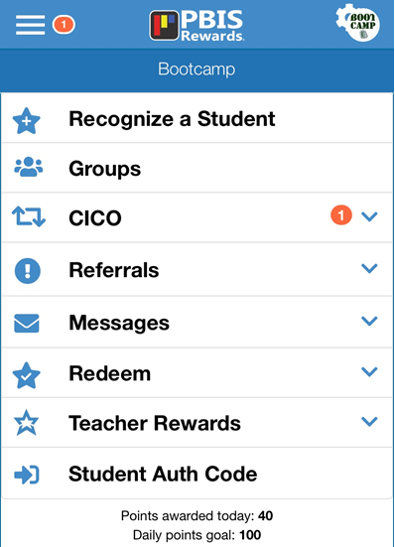
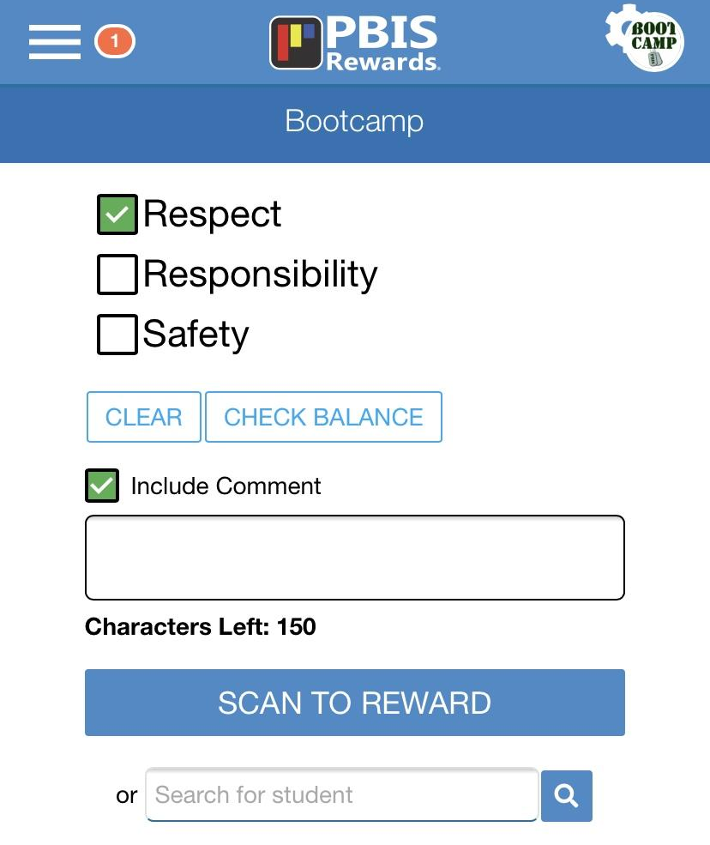
Acknowledgement on App
Notes:
- PBIS Staff App
Review steps to reward/acknowledge
When giving points – give behavior specific praise to build positive adult-student relationships
Comments optional

Slide 20

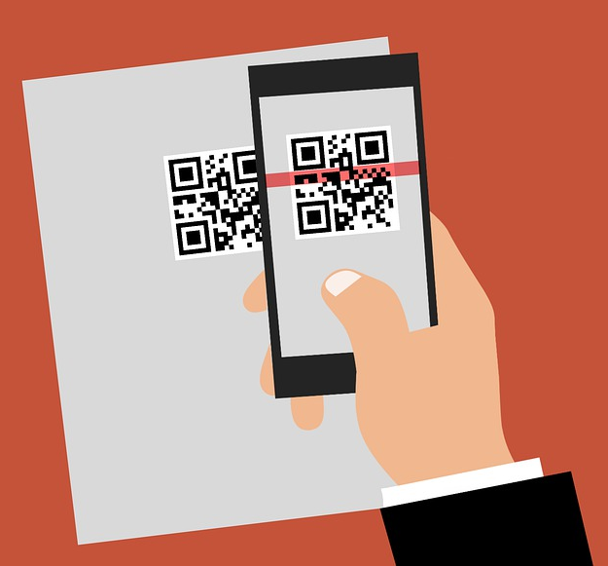
Rewarding
Acknowledge Students with Points and Comments When Students:
  Follow school/classroom expectations
  Check In (SEL)
  Arrive on time for class
  Exhibit independent learning in the classroom
  Participate in classroom discussions
  Complete and submit classroom assignments on time
  Work cooperatively with others in the classroom or in a group
  Exhibit digital citizenship
  Complete an activity or project that was not assigned
  Participate in a Spirit Day activity
  Set a personal daily point goal and achieve that goal
Create a Reward Event: Host a Reward Event where students can earn points for participation

Slide 21
Groups Page
Notes:
Focus on Groups page functions
In this section, we will not only acknowledge students efficiently but learn how to group students and reward them simultaneously – saving you so much time!!
PBIS Rewards will give you so much time back!!
Groups Page Features Article Link: https://support.pbisrewards.com/guides/group-screen-features/
Create a Group to Reward Points Video Link: https://support.pbisrewards.com/guides/create-a-group-to-award-points/

Slide 22

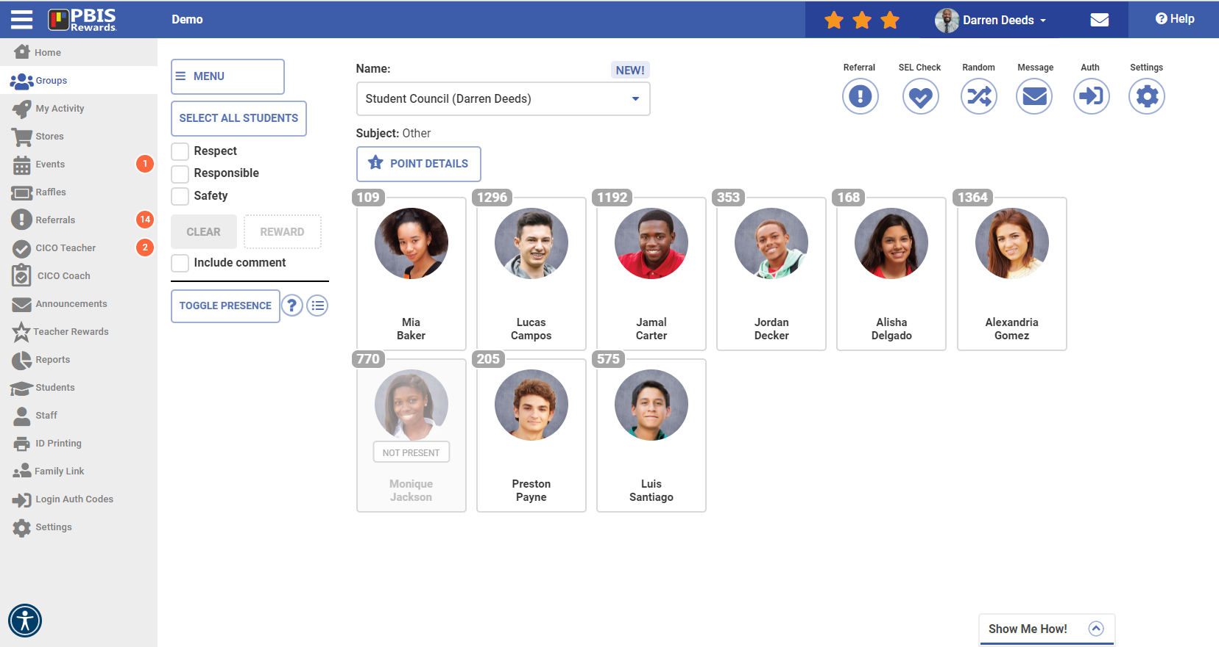
Group Screen
“If you want to stay in the loop, stay in the Group”
Notes:
Groups: https://support.pbisrewards.com/guides/group-screen-features/
FAVORITE GROUPS by clicking on the star in the upper right of the group's card!
Groups page is your homebase!
You can control so many things here:
Rewarding students/groups
Selling items in the store
Enrolling students in events and raffles
Referrals – major and minor (if have ARS)
Settings – sounds, editing groups, RANDOM button
Group Print Pages

Slide 23
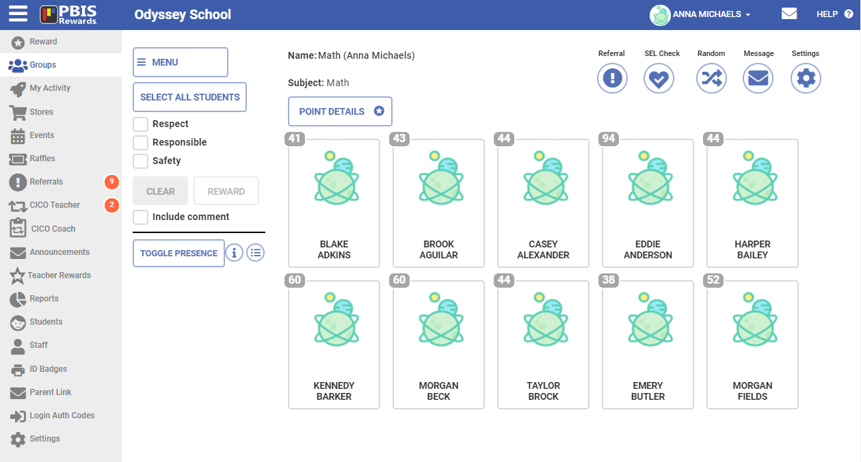
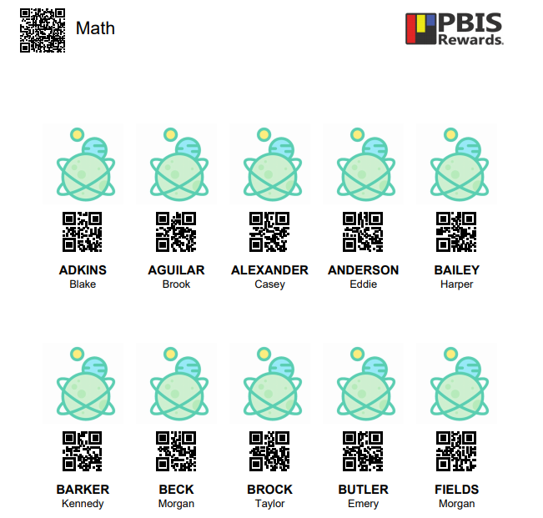
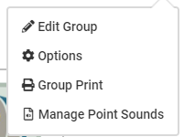
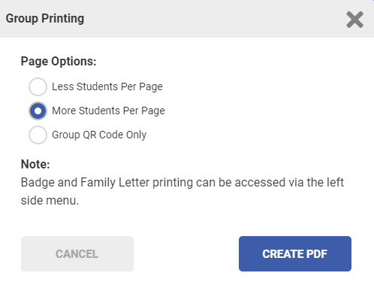
Rewarding on the Go – Groups
Notes:
These steps allow a teacher to print off QR codes for each student and scan them with their phone. This work particularly well when the teacher is busy on the computer but still wants to reward points to students.
Group Print page on their desk
Scan easily to reward points
Uses for this page:
Send to Specialist teachers – they don’t have a roster of your students. Can easily give points
Hang up in classroom – Visitors or Admin. can easily scan to reward points
Leave for a sub – can scan and reward points. Focus on the positive behavior and not negative
Small group instruction – have this paper at teacher table to scan and reward points

Slide 24
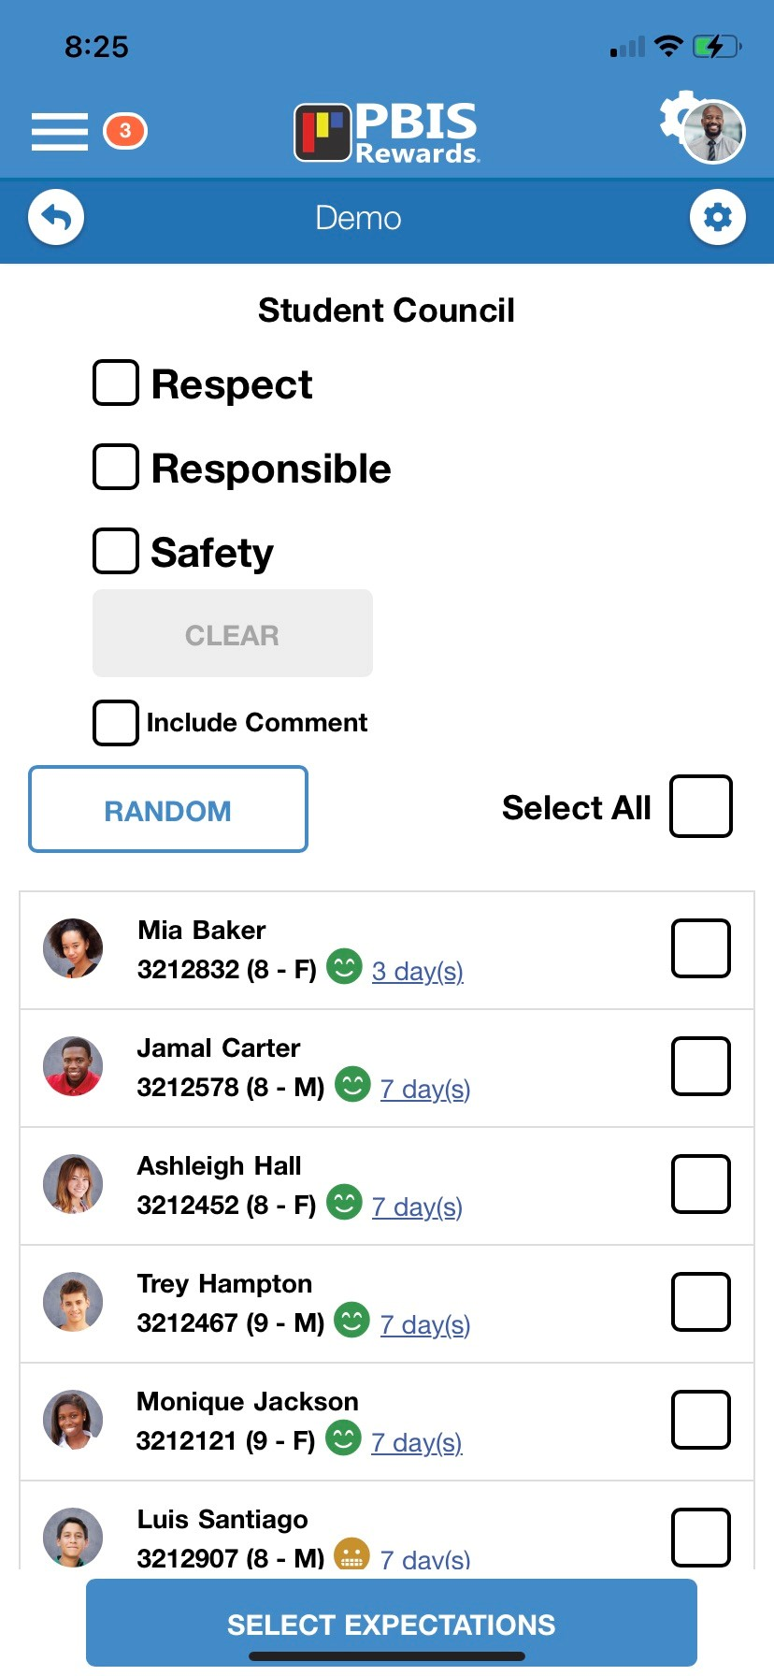
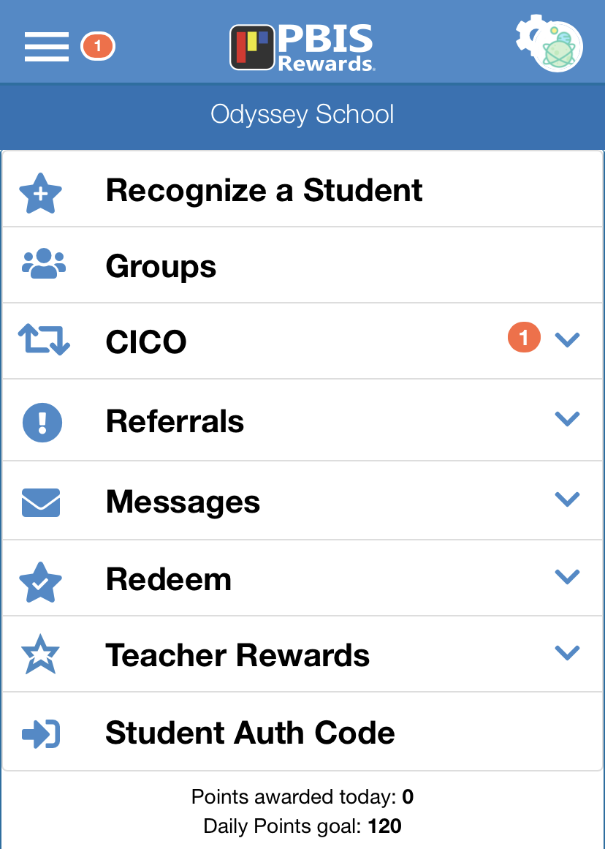
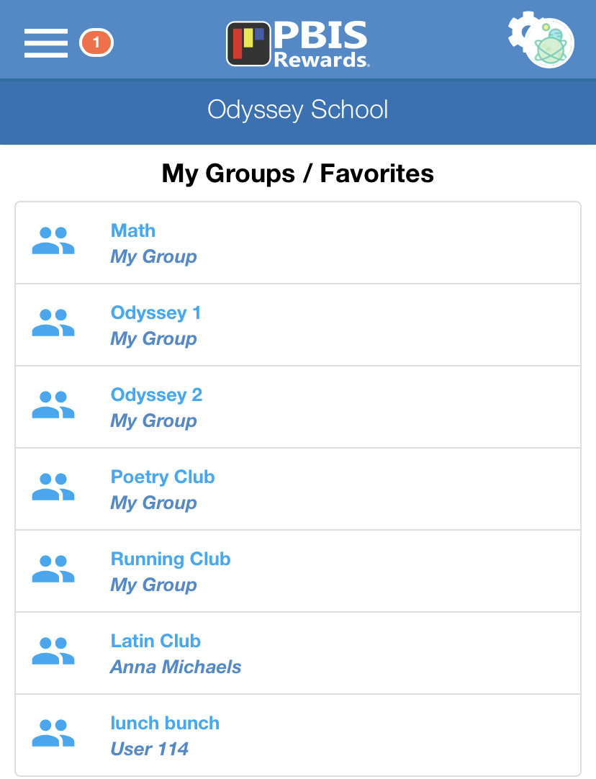
Groups on the App
Notes:
PBIS Rewards Staff App
“My Groups / Favs” on App - only those groups that are made a Favorite on the Groups page in the Web Portal or are assigned to a staff member will show up on the app.
Use the app to award group points

Slide 25
Groups Page in PBIS Rewards
Notes:
Go into the PBIS Rewards web portal and demonstrate how to:
Acknowledging students
Use the Groups page – Show rewarding by Selecting ALL students, toggle presence (on and off), Messaging.
Consider showing – Messaging feature, Menu for Redeeming from Store, Events, Raffles
Don’t overwhelm your staff with too many details!

Slide 26
Let’s Log In
Go to:
app.pbisrewards.com
Enter email:
mb@pbisr.com
School Name: Demo
Enter password: PBISR2022*
Notes:
Website: https://app.pbisrewards.com/login.php
Email: mb@pbisr.com
Password: PBISR2022*
School: Demo

Slide 27
Let’s Log In
Go to:
app.pbisrewards.com
Enter email:
dd@pbisr.com
School Name: Demo School
Enter password: PBISR2023*
Notes:
Website: https://app.pbisrewards.com/login.php
Email: dd@pbisr.com
Password: PBISR2023*
School: Demo School

Slide 28

Rewarding/Acknowledgement System
(Trainer Slide) Stop Here: Part 1
Hide slide when presenting to staff
Great stopping point for training
after PBIS Foundations, Logging In, Rewarding and Groups

Slide 29

First Steps Favorites
Step 1 - Reward
-Reward Students using web portal
-Download Staff App and use to Reward students with Group Print page
-Use Random button in Groups
Step 3 – Redeem
-Sell 5 items in the Store (privilege/free)
-Complete an Event or Raffle
Step 2 – Reward with App
Notes:
Step 1:
Younger students need visual reminders of their points. May need to earn points as a class. Marbles in a jar to show points
Easily assessable for all students to earn those rewards in the beginning.
Step 2:
Event – Pet Parade – all kids love it! Even if they don’t have a live pet, they could bring stuffed animal
Tik Tok dance party
Step 3:
Giving points value. Need to give points away with specific goals/rewards
Pick a day of the week to open the store – not every day!

Slide 30
Redeem:
Store, Events, & Raffles/Drawings
Notes:
In this section, we will discuss how to redeem points in various ways – the store, events and raffles.

Slide 31
Store
Notes:
In this section, we will discuss how to utilize the School Store and My Teacher Store.
My Store Set Up Video Link: https://support.pbisrewards.com/guides/my-store-setup/
Purchase From a Store in a Group Video Link: https://support.pbisrewards.com/guides/incentives-in-the-group-screen/
School Store Set Up Video Link: https://support.pbisrewards.com/guides/school-store-setup/

Slide 32

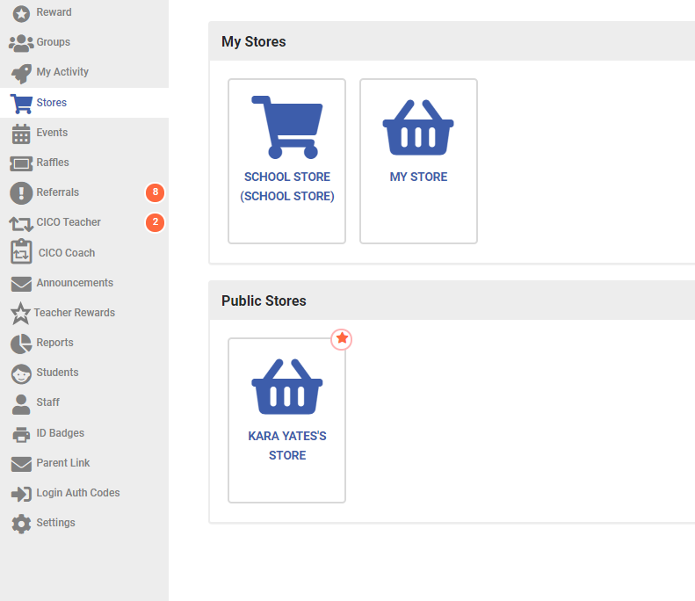
School Store vs. My Store
-Visible to ALL staff members
-ALL staff members can sell items from School Store
-Students can purchase from School Store (if that feature is turned on)
-Visible to TEACHER ONLY
-TEACHER ONLY can sell items from My Store
-Students can purchase from My Store (if that feature is turned on)

Slide 33
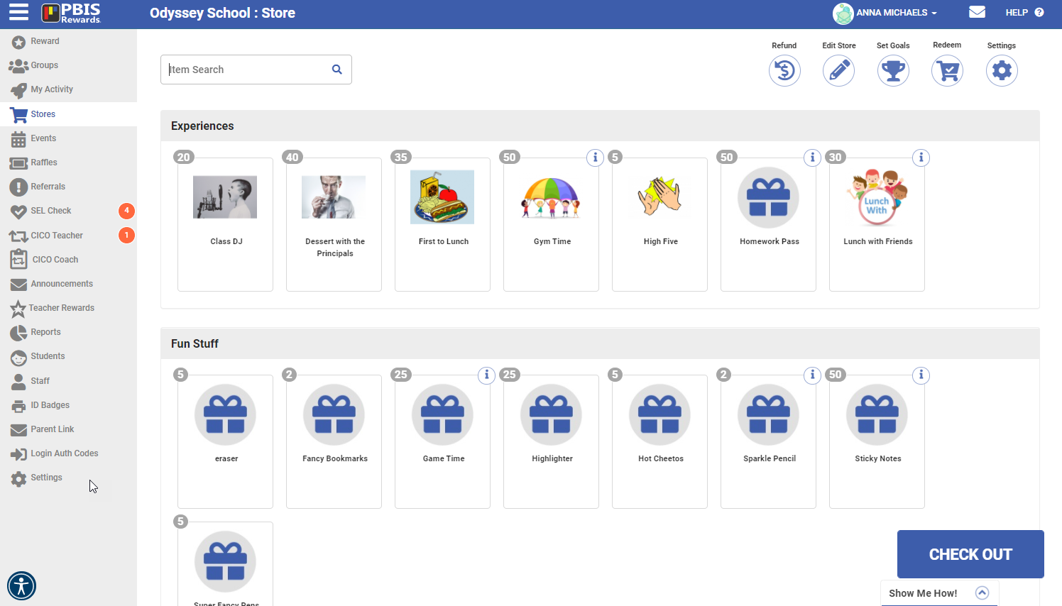
Store Set-Up
Notes:
Categories – with items in them
Pictures added to each item (great for pre-reading students to shop)
Edit Store – add categories and items
Check out from this page and from Groups page (redeem menu)
My Store runs the same way as the School Store.

Slide 34
Events
Notes:
In this section, we will discuss how to utilize the 3 types of events.
Create a School Event and Register Students Video Link: https://support.pbisrewards.com/guides/create-a-school-event/
Create a My Event and Register Students Video Link: https://support.pbisrewards.com/guides/create-a-my-event/

Slide 35



Redeem = Cost Points
3 Types of Events
Qualify = Point Goal
Reward = Earn Points
Notes:
Redeem – This event costs points from the student point total to attend. EX: Movie During Lunch is 25 points.
Qualify – This event does NOT cost points. Students EARN their way into the event by earning points over a specified period of time or for meeting a specific expectation. EX: Respect Bingo – Students with 25 Respect points this grading period can come play Bingo.
Award – This event will ADD points to their total if they attend event. EX: Attending Open House, Honor Roll
Events will not roll from year to year

Slide 36

Elementary EVENT IDEAS....
Popcorn Party
School Dance
Student vs Teacher Game
(volleyball, kickball, dodgeball, etc.)
Holiday Party
Family Night
Field Day
Movie
Painting Party
Dress up Day
(Superhero, PJ's, Princess, Book Character)
Hat Day
Crazy Sock Day
Carnival
Snow cone day
Talent Show
Special Lunch
(Chick fil A, McDonalds etc.)
Stuffed Animal Day
PBIS Olympic Games
Award Events:
Parent Meeting
School Sporting Event
Safety Training
Afterschool Tutoring
BOY Paperwork

Slide 37
Secondary EVENT IDEAS....
Admission to school events
(school dance or sporting event)
                Dodge Ball Tournament
                Teachers vs. Students basketball game
                Afternoon movie
                Homework pass
                Bingo Game for prizes
                Cell phone charging time
                Lunch with teacher or coach
                Tardy removal
Decorate a ceiling tile
Class DJ (play music for first 5 min.)
Use headphones in class
Drop lowest grade
Duct tape teacher/admin. to wall
Gift cards to local restaurants
Off campus lunch
Teacher car wash
Award Events:
Parent Meeting
School Sporting Event
Safety Training
Afterschool Tutoring

Slide 38
Raffles/Drawings
Notes:
In this section, we will discuss how to utilize Raffles.
Create and Run a Raffle Video Link: https://support.pbisrewards.com/guides/my-raffles/

Slide 39
2 Types of Raffles/Drawings
Redeem = Points to Enter
Qualify = Points Earned
Notes:
Redeem – This event costs points from the student point total to attend. EX: Movie During Lunch is 25 points.
Qualify – This event does NOT cost points. Students EARN their way into the event by earning points over a specified period of time or for meeting a specific expectation. EX: Respect Bingo – Students with 25 Respect points this grading period can come play Bingo.
Award – This event will ADD points to their total if they attend event. EX: Attending Open House, Honor Roll
Events will not roll from year to year
If you have time, Run a Raffle from the Raffles page – making sure that the ‘Animate’ box is checked. So fun with confetti and drum roll!

Slide 40
RAFFLES/DRAWINGS IDEAS....
Admission to school events
(school dance or sporting event)
                Gift Cards
                Store memberships
                Subscriptions
                Family Movie Pass
                Tablet
                eReader
                Cell phone chargers
                Gaming system
                Video games
Principal for the day
Lego sets
Gift baskets
Notes:
Use raffles for Big Ticket Items that your school may only have one or two of
Ask participants to put addition raffle ideas in the chat.
Ultimate List of Incentives: https://www.pbisrewards.com/pbis-incentives/
Create Raffles Guide: https://support.pbisrewards.com/guides/raffles/

Slide 41


Incentives Jackpot!
Notes:
Ultimate Incentives List: https://www.pbisrewards.com/pbis-incentives/
Distance Learning Incentives: https://www.pbisrewards.com/blog/pbis-incentives-distance-learning/

Slide 42
Redeeming in PBIS Rewards
Notes:
Go into the PBIS Rewards web portal and demonstrate how to use:
The Store (School or My Store) - Add an item to the store
Events - Create an event
Raffles - Create and run a raffle from the webportal

Slide 43
Rewarding/Acknowledgement System
(Trainer Slide) Stop Here: Part 2
Hide slide when presenting to staff
Great stopping point for training
after Redeeming: Store, Events and Raffles

Slide 44
Helpful Resources
Notes:
In this section, we will discuss how to utilize several helpful features.
This section may be saved to discuss at future trainings, trying not to overwhelm your staff.

Slide 45

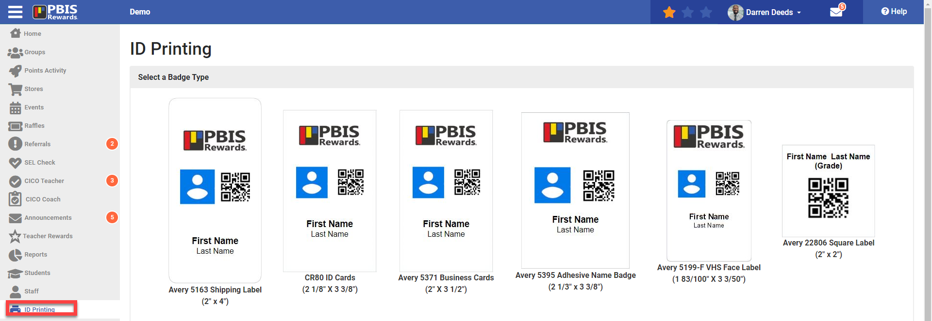
Printing Badges
Within PBIS Rewards
Notes:
Printing within PBISR ID badges
Type
Contents
Users
create file
open or save
print

Slide 46



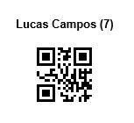
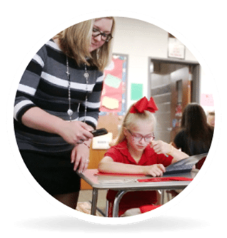
Think Outside the Badge!
Using Labels and Badges in Creative Ways.
Use a QR sticker on a student’s folder or agenda for easy access to give points when they turn in homework and assignments.
Have ID on students’ desks for easy scanning as you walk by, have group QR code posted inside or outside the classroom for easy access for others.
If your students are 1:1 with devices, use a label to identify the computer as well as give easy access for badge scanning while they are working.
Notes:
Think outside the badge, show examples, allow participants to share out examples.
Show folder example

Slide 47

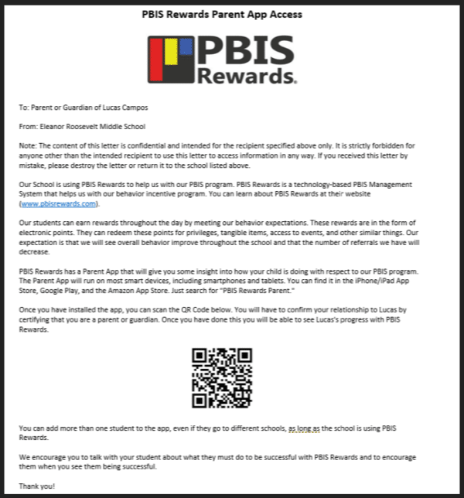
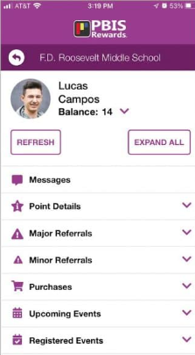
Family Access – App only
The PBIS Rewards family app includes point details, referrals (if applicable), purchases, upcoming events, registered events, list of teachers with contact info, and parent messaging.
Notes:
Family App Article: https://support.pbisrewards.com/article/parent-view/
The PBIS Rewards Family App only allows access to student information specific to the QR code scanned or link opened. This information includes: points balance, points details, including comments if applicable, messages from school staff, check-In/check-out information, referrals – date, time, staff, and cause (Major and Minor), purchases, upcoming events and, registered events.
There is only an app for parents, not a web portal.
Access and edit the family letter from the family link in the Staff Web Portal. Send home a family letter via email, text or a hard copy. Parents scan QR code with the app or click the link to access their child’s info.
Staff can message parents/caregivers from the Staff Web Portal or App to App
The Family App can be translated into over 15 different languages.

Slide 48
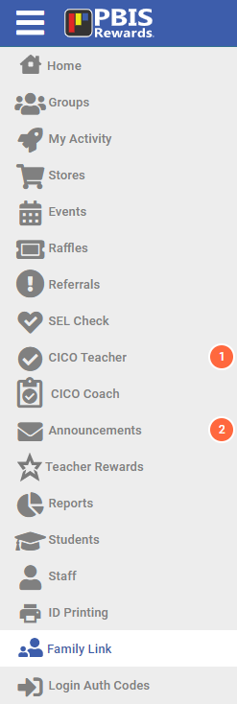
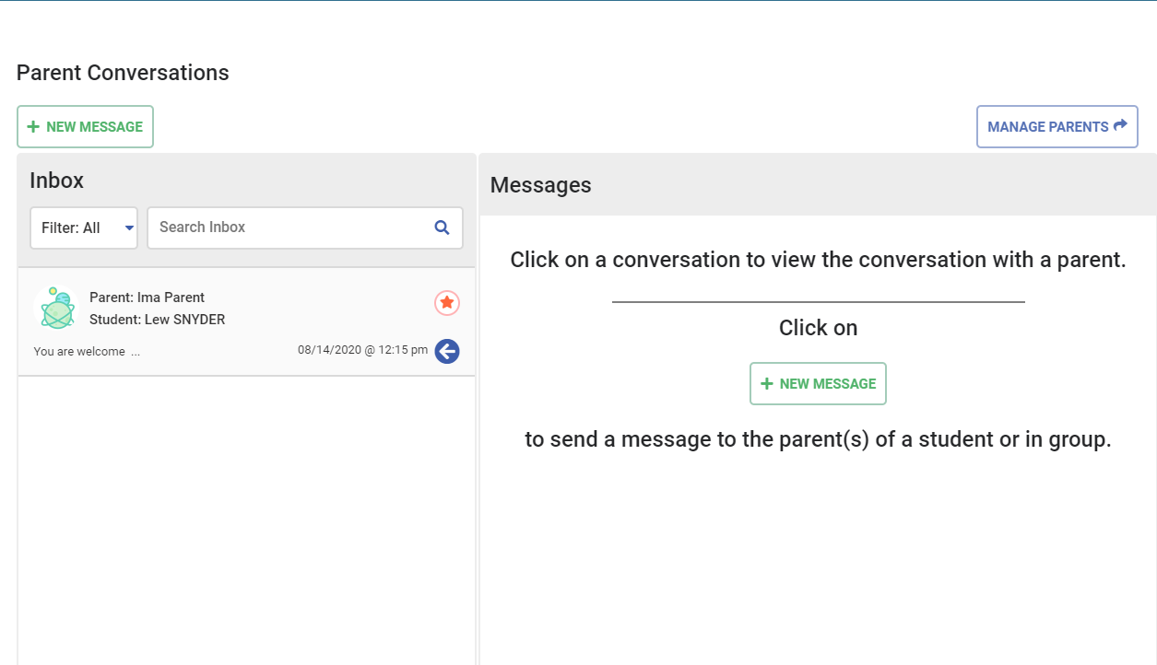
Messaging - Staff Web Portal
Notes:
Family Link Article: https://support.pbisrewards.com/article/parent-link/
Access and edit the family letter from the family link in the Staff Web Portal. Send home a family letter via email, text or a hard copy. Parents scan QR code with the app or click the link to access their child’s info.
To edit and send/print the letters, click on Manage Parents, Edit Parent Letter – make it specific to your school, then print or email/text letter. Print letters out, send home or BEST WAY is to complete at Parent-Teacher Conference
You can also see which parents have installed the app (check marks).

Slide 49
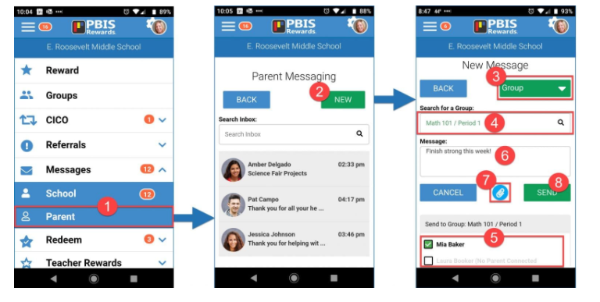
Messaging - Staff App
Notes:
Manage Parents
Edit Parent Letter – make it specific to your school
Print letters out, send home or BEST WAY is to complete at Parent-Teacher Conference
Show options to print letter
Show parents that have app installed (check marks)
Parent Conversations -
How do parents see their child’s info? From the parent app. You as the school send home a parent letter either via email, or a hard copy. Parents scan QR code and have access. Print parent letter from the parent link. Once parents are set up they can message, see points, referrals if applicable.

Slide 50
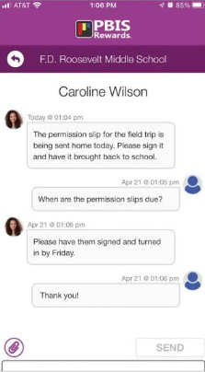
Messaging - Family App
Notes:
Once parents are set up they can message, see points, referrals if applicable.

Slide 51

ARS
Advanced Referral System:
Staff Focus
Copyright © 2023 Motivating Systems, LLC dba PBIS Rewards. All Rights Reserved

Slide 52
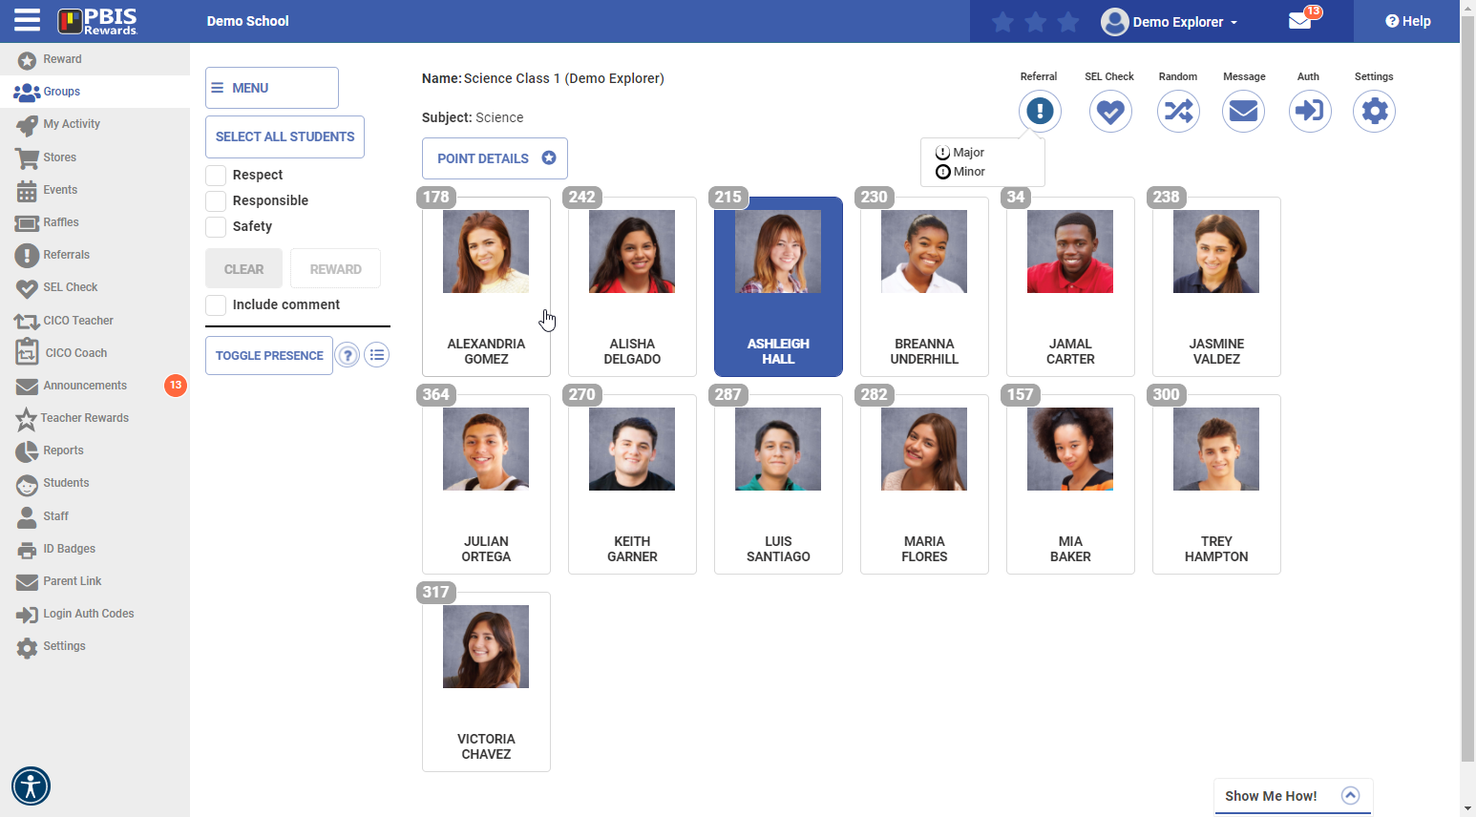
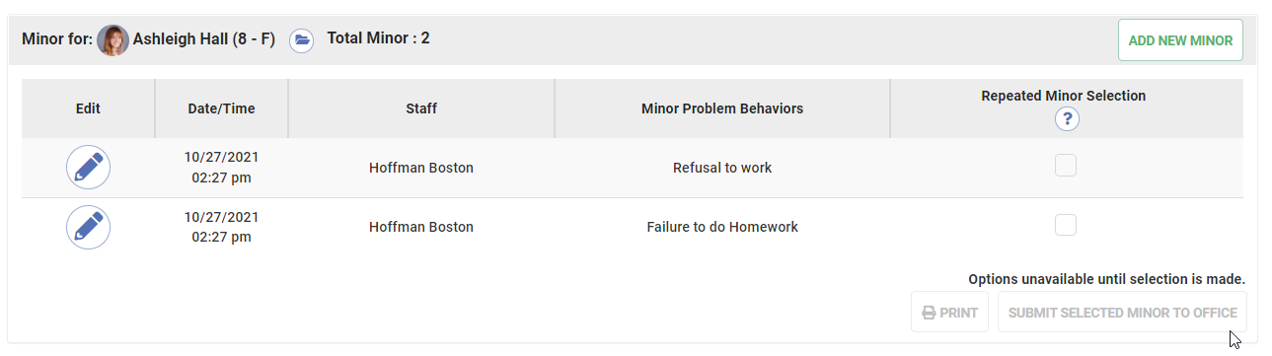
Writing Minor Referral
Notes:
Click-Choose a student
Click-Choose major or minor
Click-Minors for each student will show up like this
Click-Repeated minors
Click-Add new minor
Select types of referrals for staff*
If select ‘minors only’ – they will have Major as an option but only if Minors are rolled into a Major referral
Go through writing a Minor referral

Slide 53
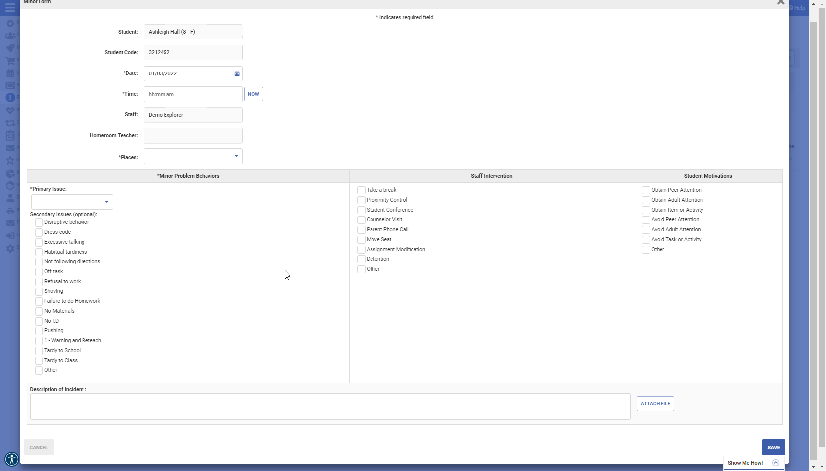

Some fields automatically filled
Primary MINOR Issue
Secondary MINOR Issue(s)
Notes:
Entering details of minor (classroom managed)
Admin. will only be notified if minor form if that setting is turned on. (they will receive an email and message in system when students have a specific number of minor forms)

Slide 54
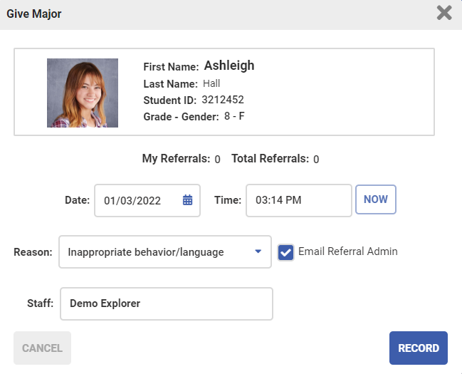
Writing Major Referral
Notes:
Select types of referrals for staff – Major
Short form – starting basics of Major form

Slide 55
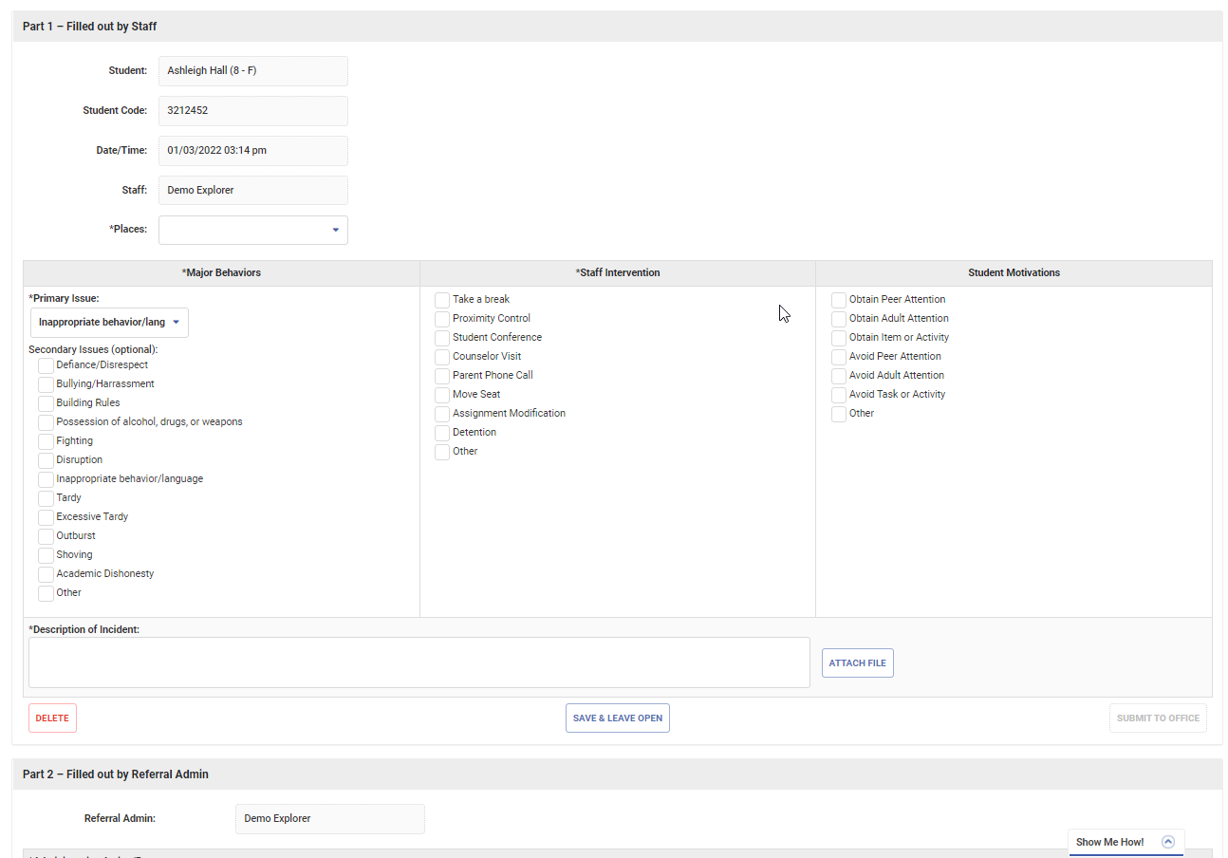

Rewarding/Acknowledgement System
Some fields automatically filled
Primary MAJOR Issue
Secondary
MAJOR
Issue(s)
Notes:
Similar form appearance to minor but fields contain different behaviors/issues
Abbreviated information sent to parent app with major and minor forms.
Major form – sent to parent when admin. completes form

Slide 56
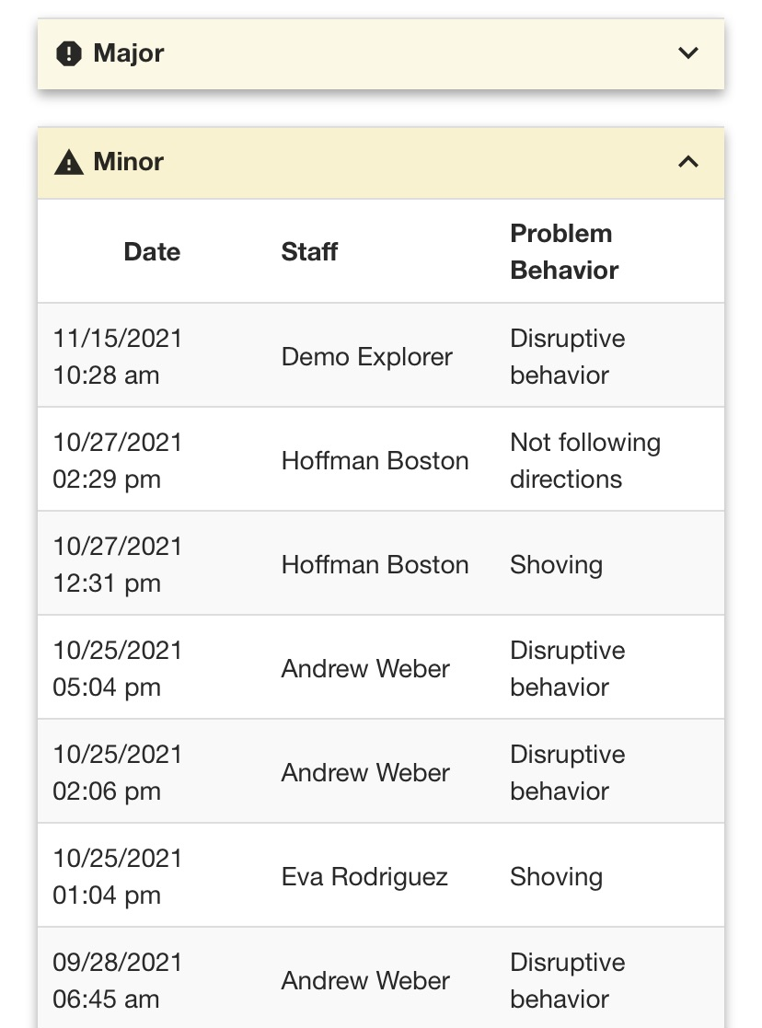
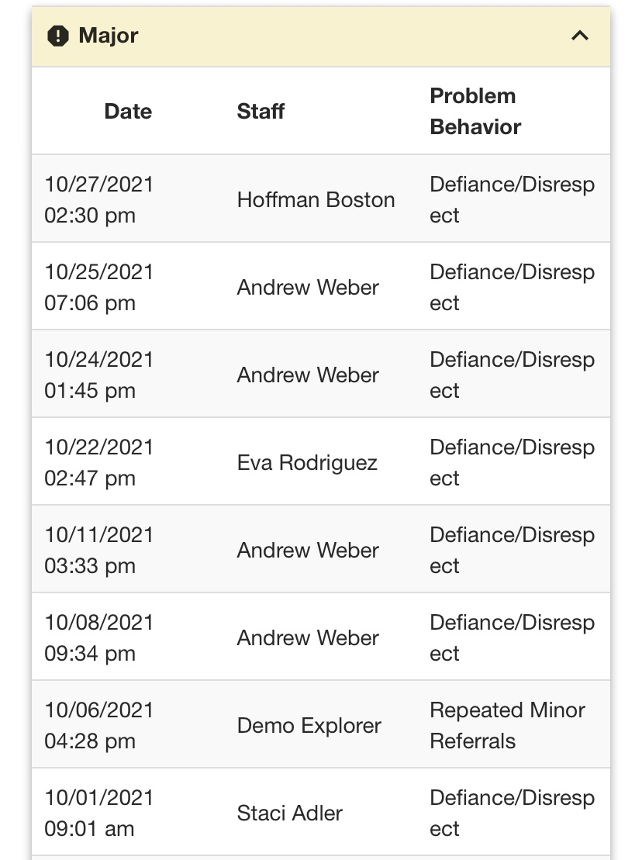
Parent/Family Notification with ARS
The Family App Can Be Translated Into Several Languages!
Notes:
Abbreviated information sent to parent app with major and minor forms.
Minor form – sent to parent when staff member clicks Save
Major form – sent to parent when admin. completes form
Forms can be printed as PDF and sent home as paper copy or emailed home

Slide 57

THANK YOU!
Copyright © 2024 Navigate360, LLC dba PBIS Rewards. All Rights Reserved

