Slide 1
PBIS Rewards Presents Building Student Buy-In

Slide 2
How to increase student engagement?
Include students on your PBIS Team
Allow students to be mentors
Survey you students
Allow students to make deliveries
Allow students to be cashiers
Allow students to be PBIS Reward Trainers
http://wvpbis.org

Slide 3
Include students on your PBIS Team
*Consider adding student representatives on your PBIS Team.
*Create a committee of students to act as an advisory council for the PBIS Team.
http://wvpbis.org

Slide 4
Allow students to be mentors
*Have teachers nominate students to serve as CICO mentor buddies.
*Utilize your students in upper grade levels to serve as mentors to students in lower grade levels.
http://wvpbis.org

Slide 5
Survey your students
*Put a suggestion box in the front office.
*Provide a time and have the school complete an inventory.
*Have students complete student surveys.
http://wvpbis.org
Notes:
Student Survey: https://docs.google.com/forms/d/e/1FAIpQLSfMhtwnK34UkCJ7jcWmz-fucXqNI-AJ_8CtP09vZjqpM9GtNg/viewform

Slide 6
Allow students to make deliveries
*Select a representative from each homeroom or grade level to pick up the item list for their class.
http://wvpbis.org

Slide 7
Select students to be cashiers
*Allow a student to run the cash register for the school store.
*Student can pay to be the cashier, or the teacher can make this a reward for a “star” student.
http://wvpbis.org

Slide 8
Select students to be PBIS Rewards Trainers
*Allow students to assist with trainings
*Have students provide demos on how to use PBIS Rewards for other students
http://wvpbis.org

Slide 9
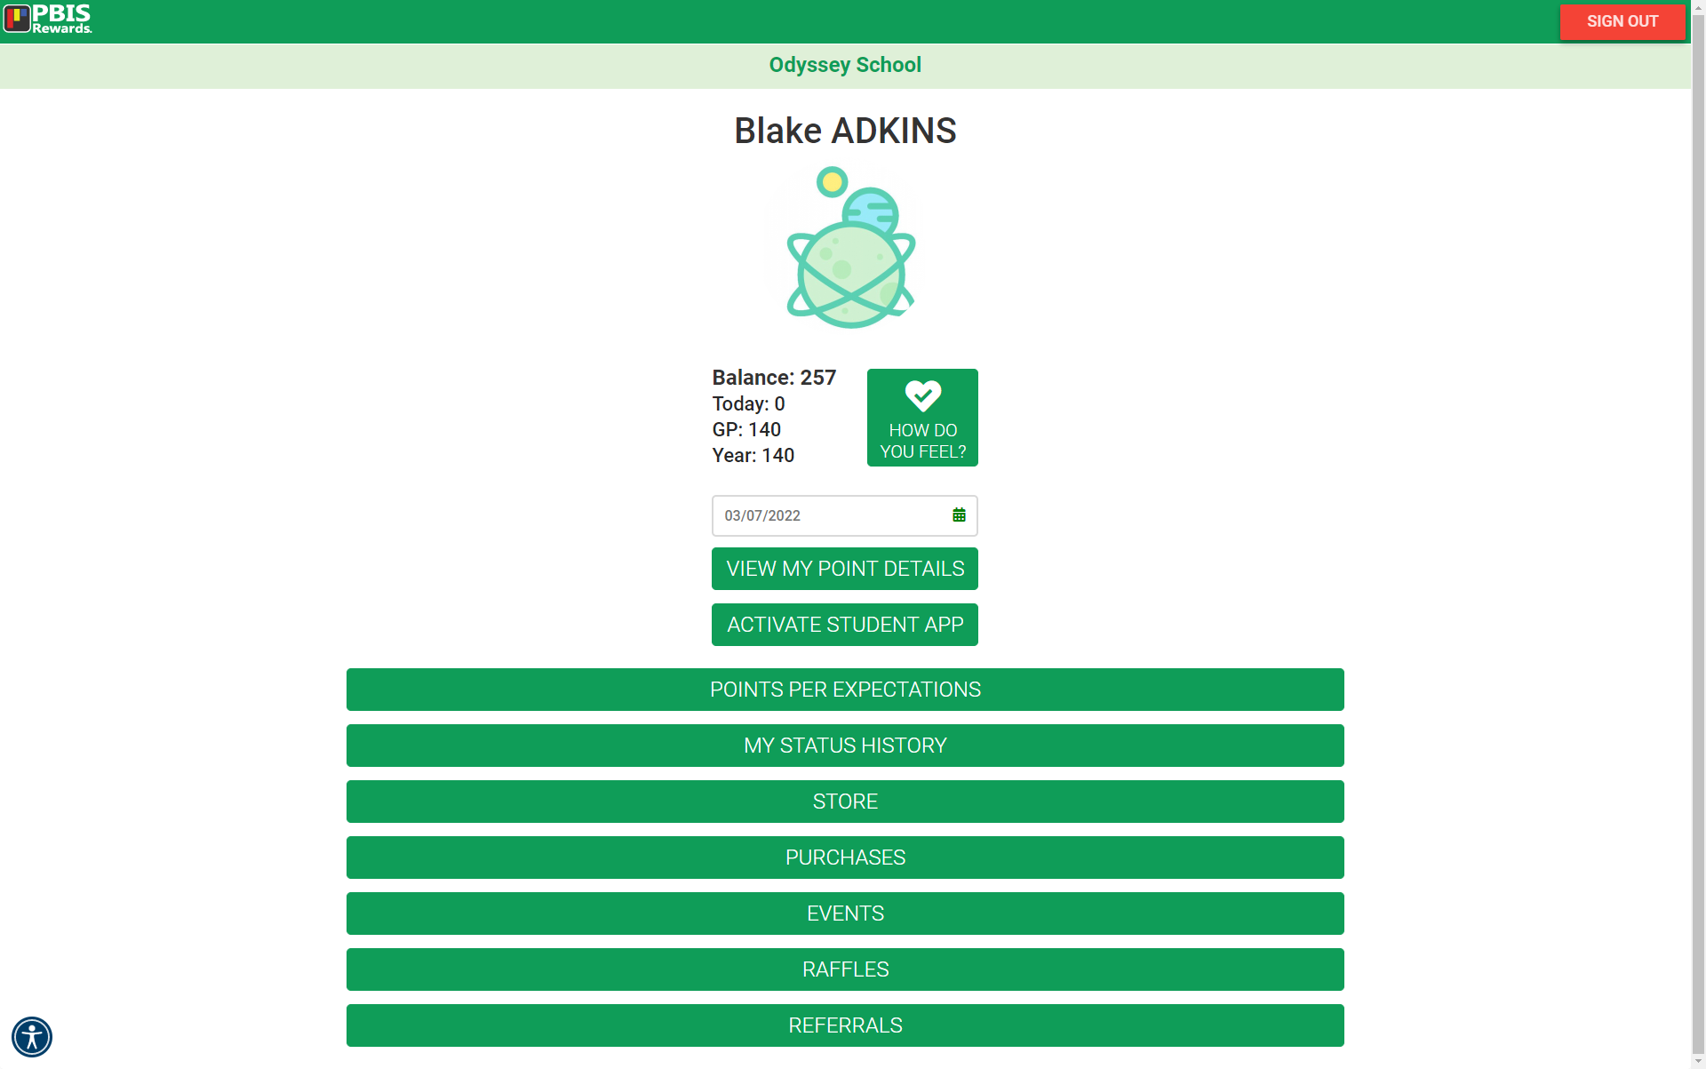
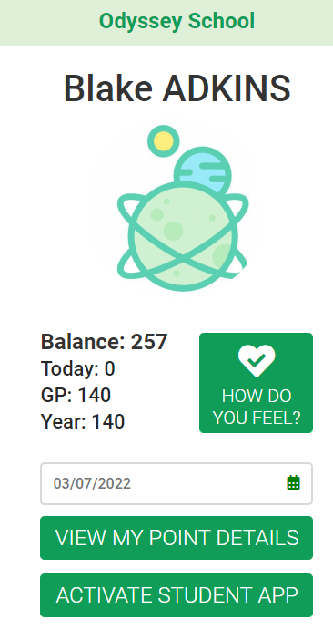
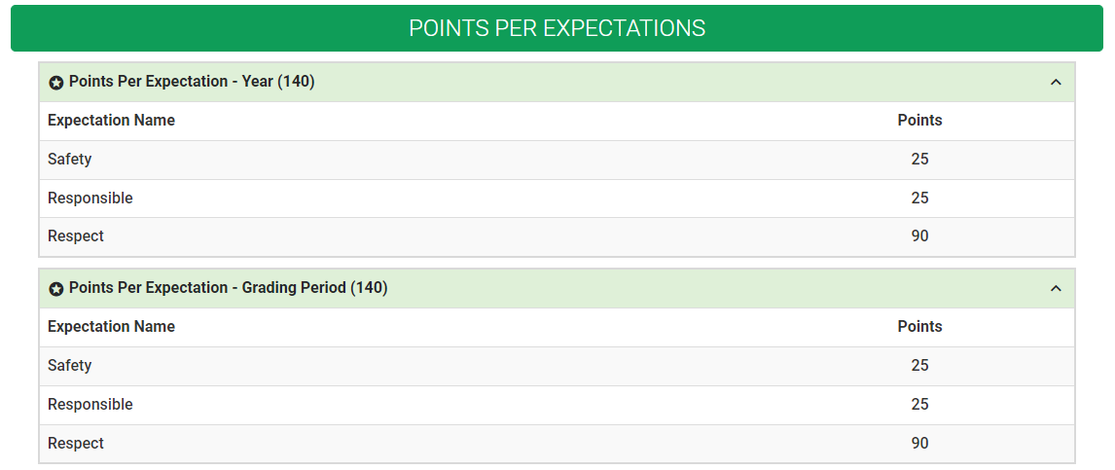
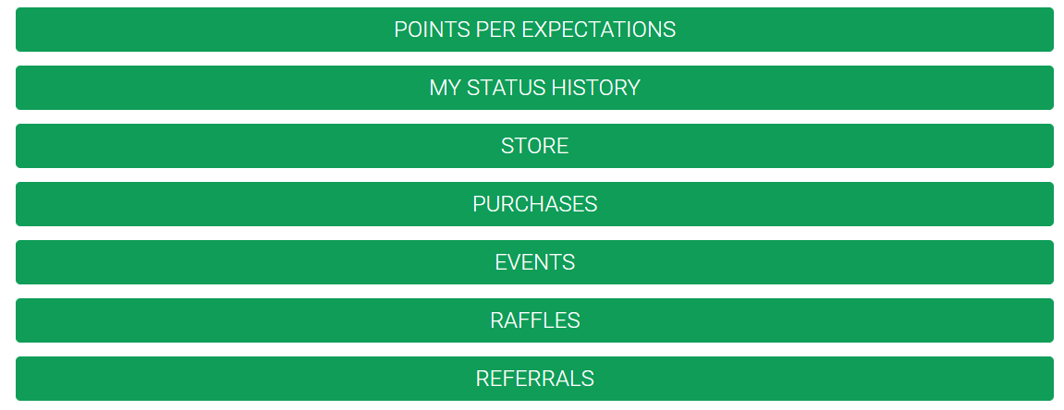
Student Web Portal
http://wvpbis.org

Slide 10
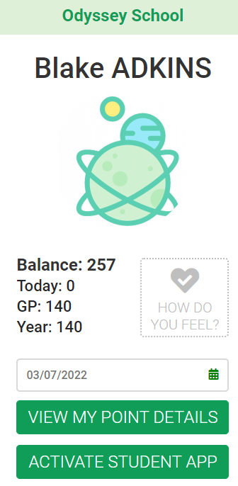
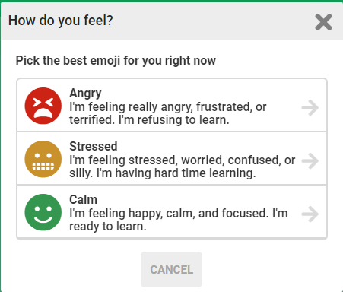
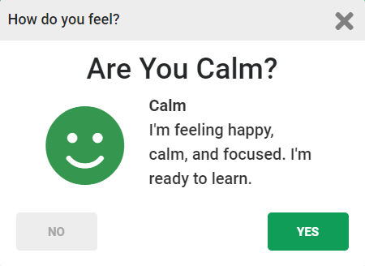
Student Web Portal
http://wvpbis.org

Slide 11
Wrap-Up and Resources

Slide 12
Include students on
your PBIS Team
Student Mentors
Survey your students
Student
Delivery
Student Cashiers
Student Trainers
Notes:
Student Resource PDF: https://drive.google.com/file/d/1U1n8Px37-hhwAjhc1mEGMo4uuJlYbpf6/view?usp=sharing

Slide 13
Incorporating Students into
Include Students
Student
Mentors
Survey your
Students
Student Delivery
Student Cashiers
Student Trainers
on your
PBIS Team
*Consider adding student representatives on your PBIS Team.
*Create a committee of students to act as an advisory council for the PBIS Team.
*Have teachers nominate students to serve as CICO mentor buddies.
*Utilize your students in upper grade levels to serve as mentors to students in lower grade levels.
*Put a suggestion box in the front office.
*Provide a time and have the school complete an inventory.
*Have students complete student surveys.
*Select a representative from each homeroom or grade level to pick up the item list for their class.
*Allow a student to run the cash register for the school store.
*Student can pay to be the cashier, or the teacher can make this a reward for a “star” student.
*Allow students to assist with trainings.
*Have students provide demos on how to use PBIS Rewards for students.
Copyright © 2022 Motivating Systems, LLC dba PBIS Rewards. All Rights Reserved
Notes:
Student Resource Breakdown PDF: https://drive.google.com/file/d/1U1n8Px37-hhwAjhc1mEGMo4uuJlYbpf6/view?usp=sharing

Slide 14
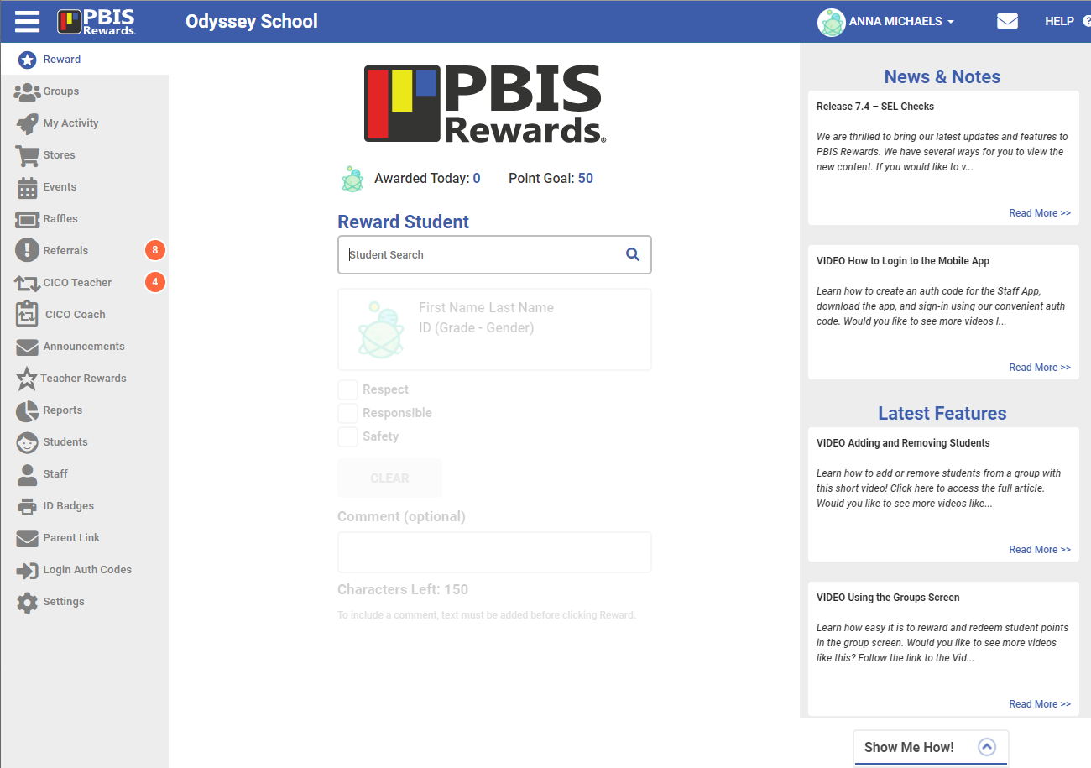
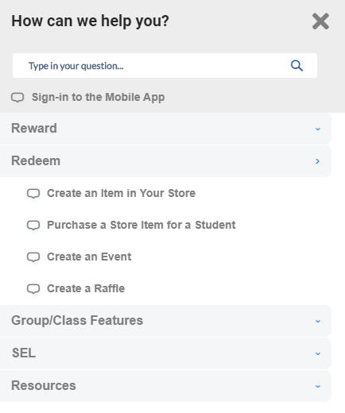
Show Me How

Slide 15
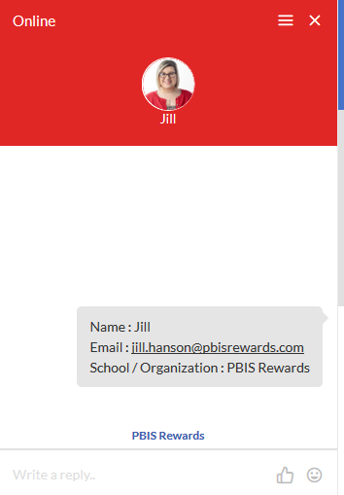
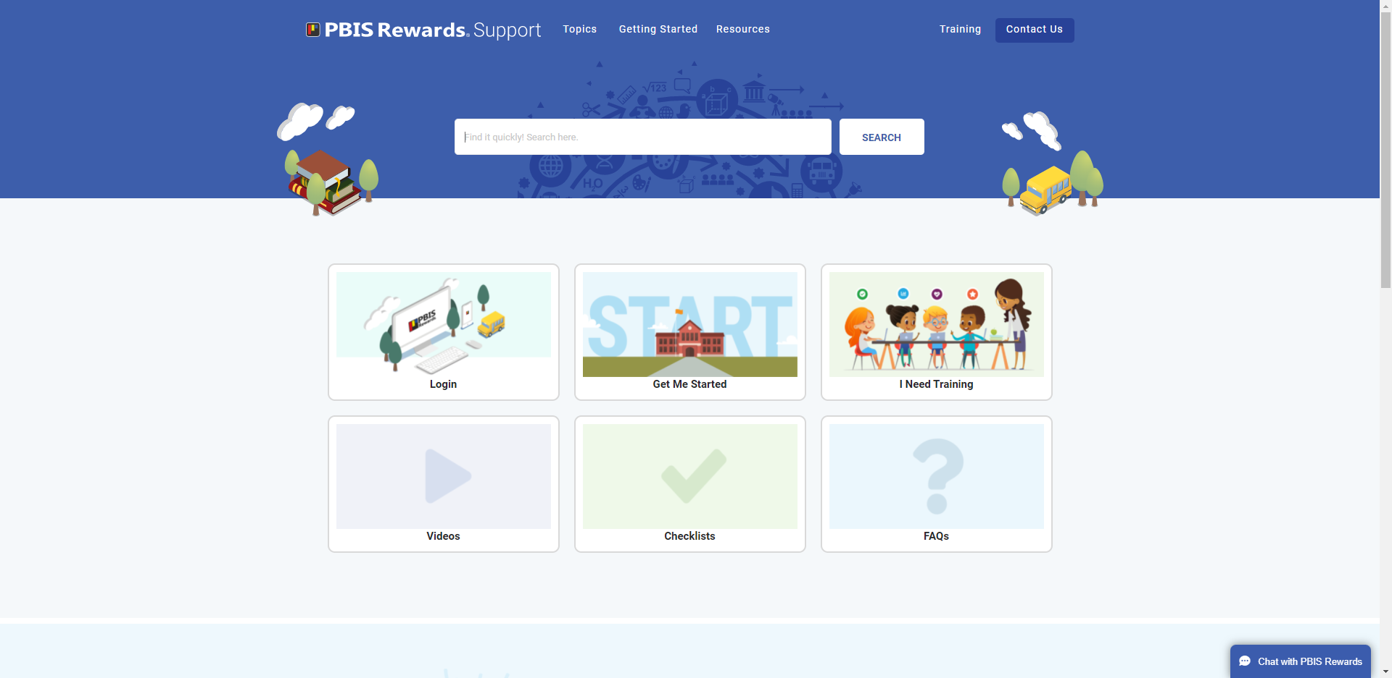
Need Help? We got you covered!
https://support.pbisrewards.com
Notes:
PBIS Rewards Support Page: https://support.pbisrewards.com/

Slide 16
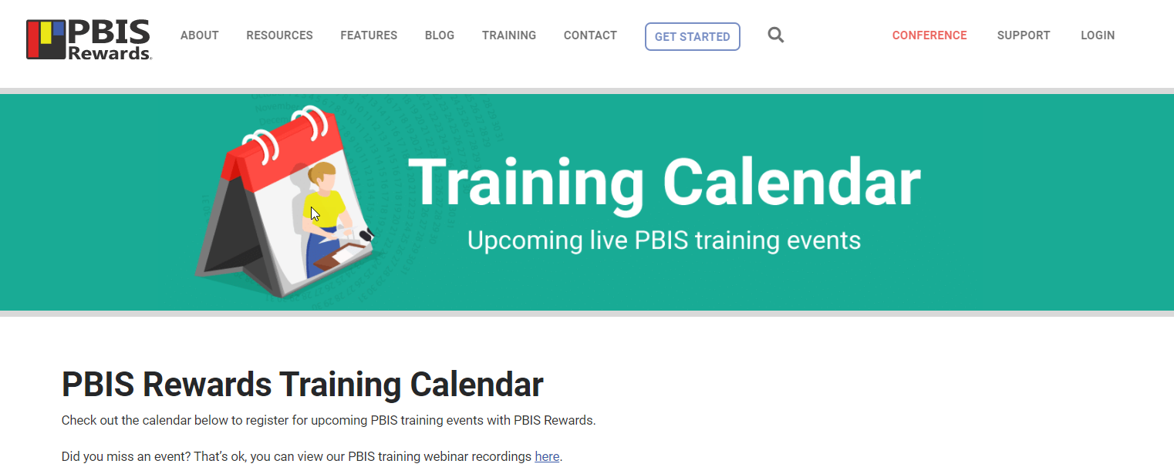
More Training to Come!
https://www.pbisrewards.com/training/calendar
Notes:
PBIS Rewards Training Calendar: https://www.pbisrewards.com/training/calendar

Slide 17
Stay Connected With Us!
Please answer 3 questions to join
Notes:
FaceBook Group Link: https://www.facebook.com/groups/pbisbreakroom

