Slide 1
We ❤
Communication
Hello! 👋 We are glad you are here!😎
Please share where you are from in the Chat.
Copyright © 2022 Motivating Systems, LLC dba PBIS Rewards. All Rights Reserved

Slide 2
“At the end of the day, the most overwhelming key to a child’s success is the positive involvement of parents.” -Jane D. Hull
Notes:
One of the main goals for schools and educators is to help children lead successful and productive lives. Please type in the chat some of the keys to a child’s or student’s success. According to former Arizona Governor, Jane Hull, the most overwhelming key to a child’s success is the positive involvement of parents.

Slide 3
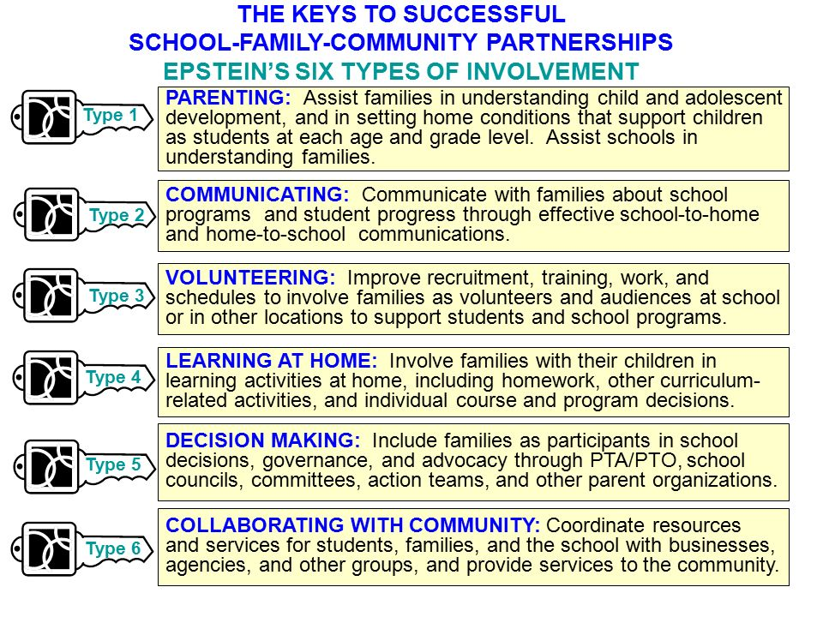
Notes:
According to professor and author, Joyce Epstein (School, Family and Community Partnerships), there are 6 types of involvement that are keys to successful school, family, and community partnerships. These keys include parenting, communicating, volunteering, learning at home, decision making, and collaborating with community. PBIS Rewards can help with several of these keys including, collaborating with community, decision making, volunteering, and communicating.

Slide 4
Communicating
Use the PBIS Rewards Parent App to share important school and student information.
Notes:
Use the PBIS Rewards Parent App to share important school and student information.
Parent Access: https://support.pbisrewards.com/guides/parent-access/

Slide 5
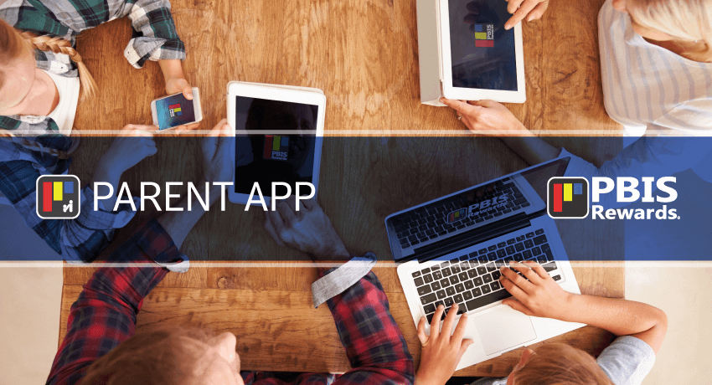
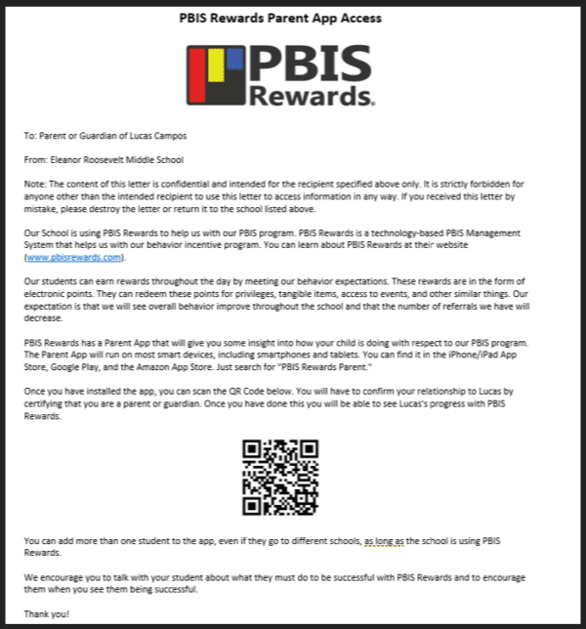
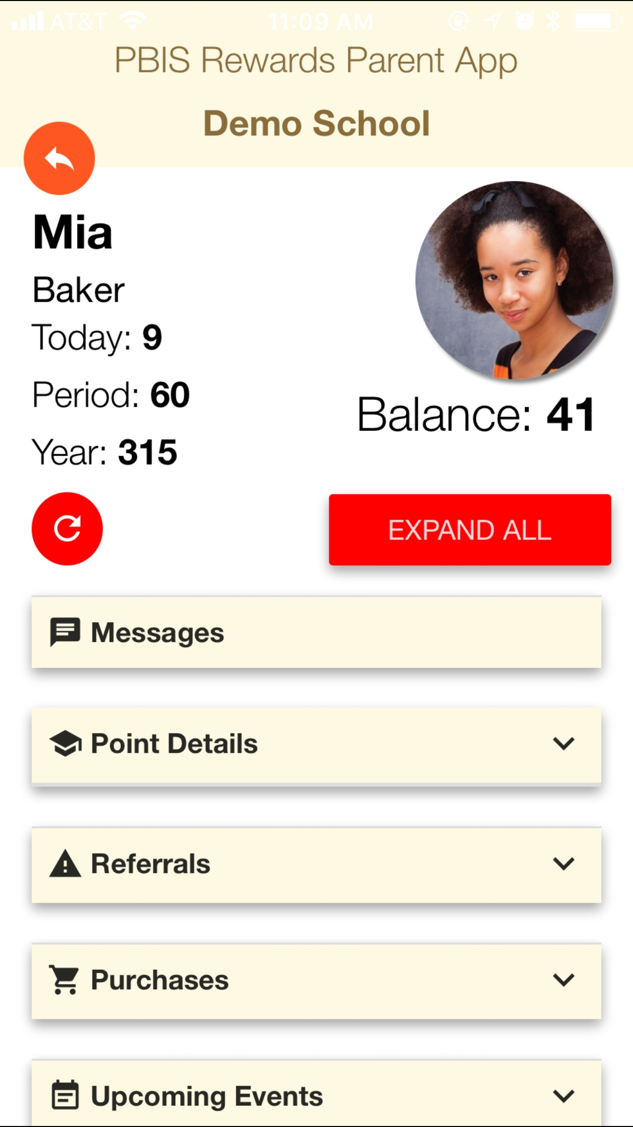
The PBIS Rewards Parent App
The PBIS Rewards parent app includes point details, referrals (if applicable), purchases, upcoming events, registered events, list of teachers with contact info, and parent messaging.
Notes:
Parent App: https://support.pbisrewards.com/guides/parent-access/
How do parents see their child’s info? From the parent app.
There is only an app for parents
Access and edit the parent letter from the parent link in the Staff Web Portal.
Send home a parent letter either via email, text or a hard copy. Parents scan QR code and have access.
Once parents are set up they can message, see points, referrals if applicable.
Now – messaging parents from Web Portal or App to App!

Slide 6
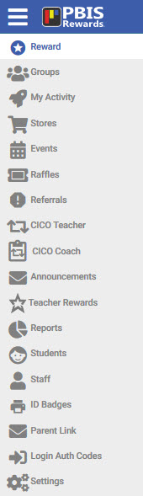
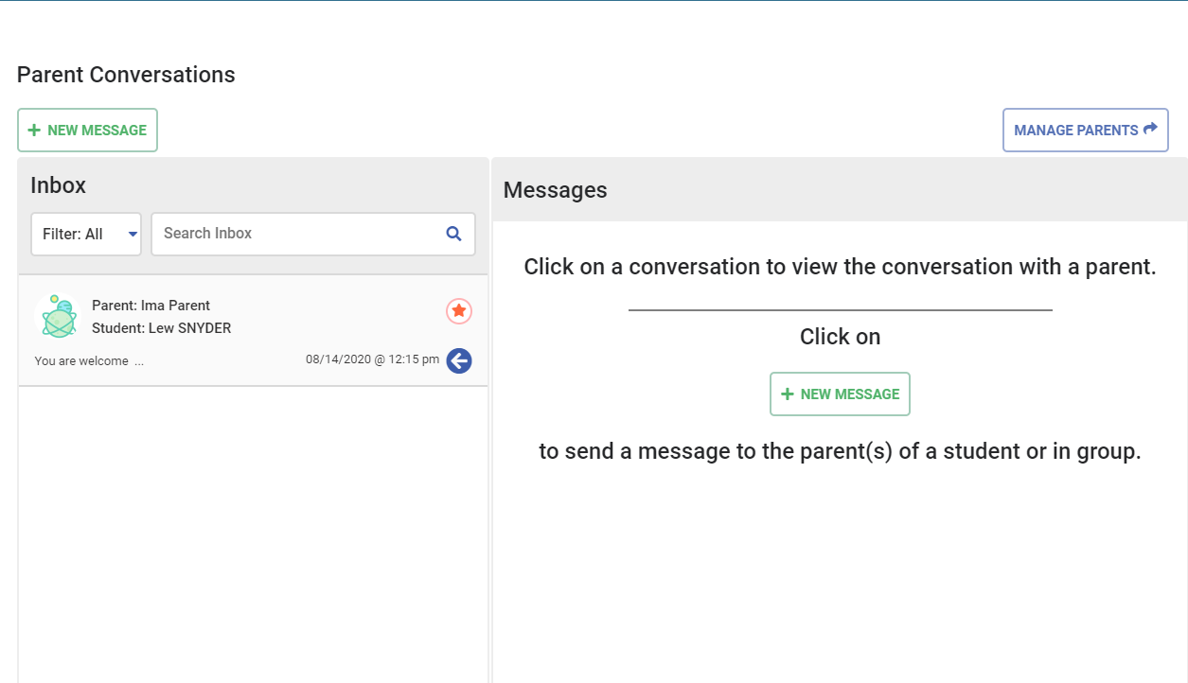
Messaging – Staff Web Portal
Notes:
Parent Conversations: https://support.pbisrewards.com/guides/two-way-parent-communication/
Send Parent Letters: https://support.pbisrewards.com/guides/send-parent-letters/
Manage Parents
Edit Parent Letter – make it specific to your school
Print letters out, send home or BEST WAY is to complete at Parent-Teacher Conference
Show options to print letter
Show parents that have app installed (check marks)
Parent Conversations Article Link: https://support.pbisrewards.com/guides/two-way-parent-communication/
How do parents see their child’s info? From the parent app. You as the school send home a parent letter either via email, or a hard copy. Parents scan QR code, and have access. Print parent letter from the parent link. Once parents are set up they can message, see points, referrals if applicable.

Slide 7
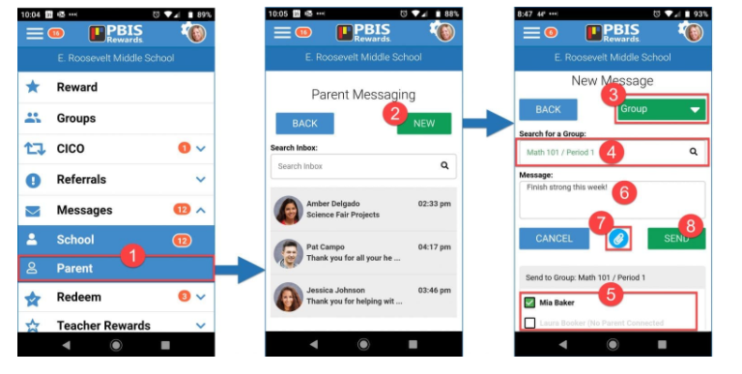
Messaging – Staff App
Notes:
Parent Conversations: https://support.pbisrewards.com/guides/two-way-parent-communication/

Slide 8
Setting Up Parent Connections in the Staff Web Portal: LIVE
Notes:
Guide us live through Admin settings (Options), Parent Link, and sending a message from a Group in the Staff Web Portal.

Slide 9
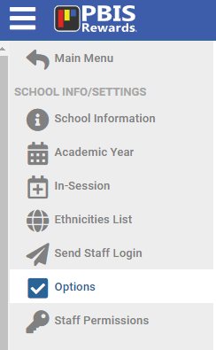
Parent App Settings – Admin.

Slide 10
Parent App
Notes:
Parent View YouTube Video: https://www.youtube.com/watch?v=6gO5c9KGZjE

Slide 11
Wrap Up and Helpful Resources
Notes:
Give praise and give points!

Slide 12
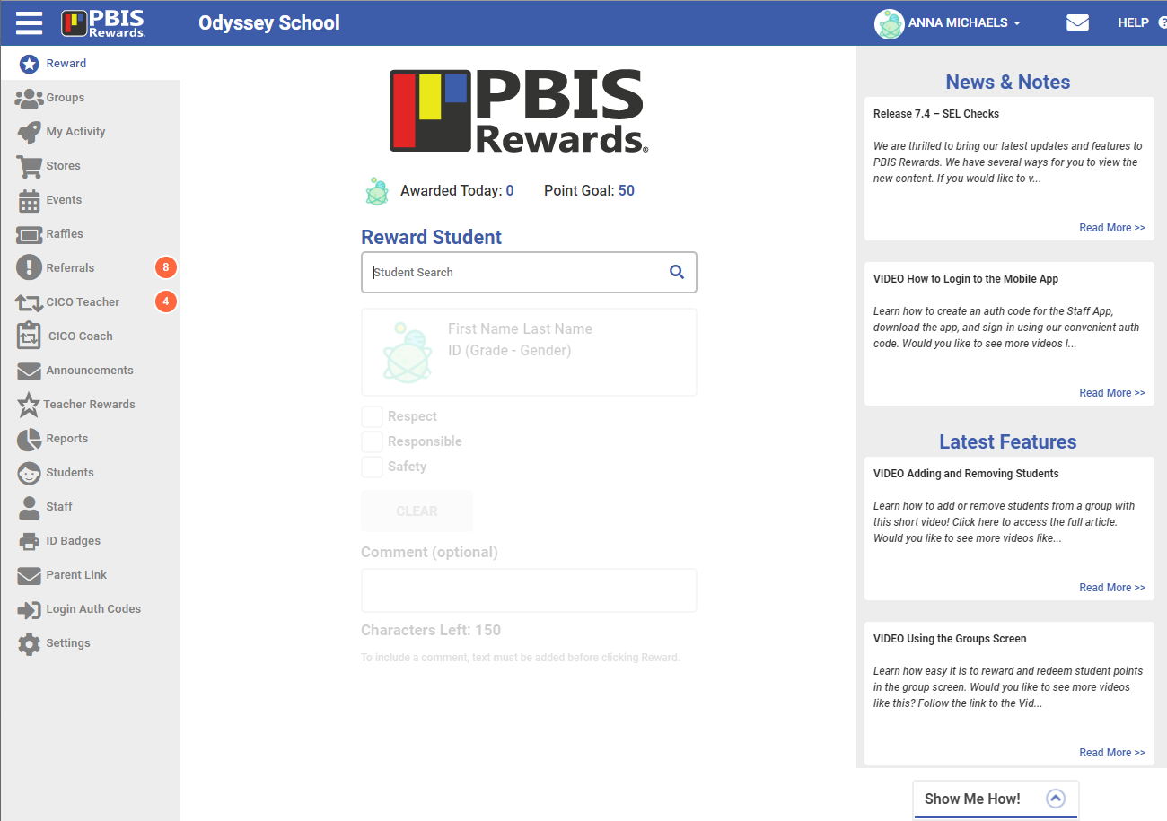
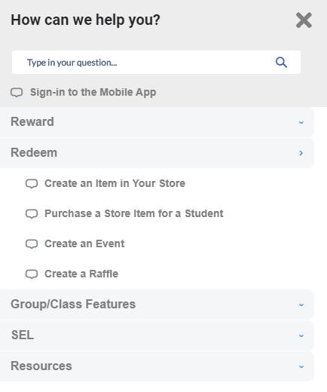
Show Me How

Slide 13
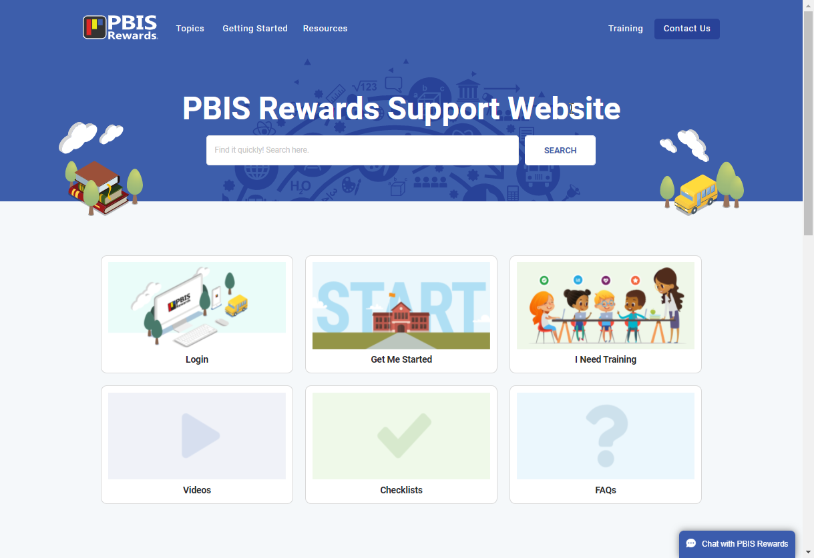
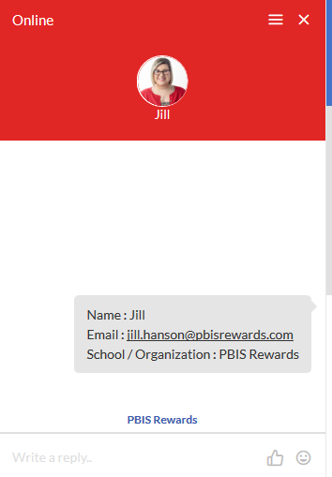
Need Help? We got you covered!
https://support.pbisrewards.com
Notes:
Support Page: https://support.pbisrewards.com/

Slide 14
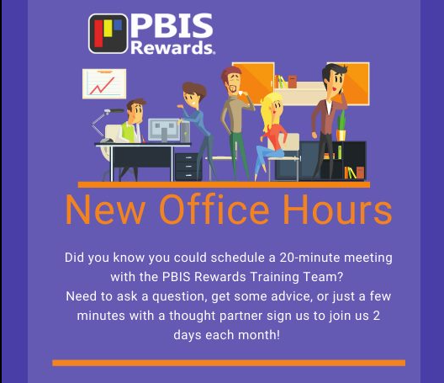
Training Calendar
Most sessions are FREE!
pbisrewards.com/training/calendar/
Notes:
https://www.pbisrewards.com/training/calendar/

Slide 15
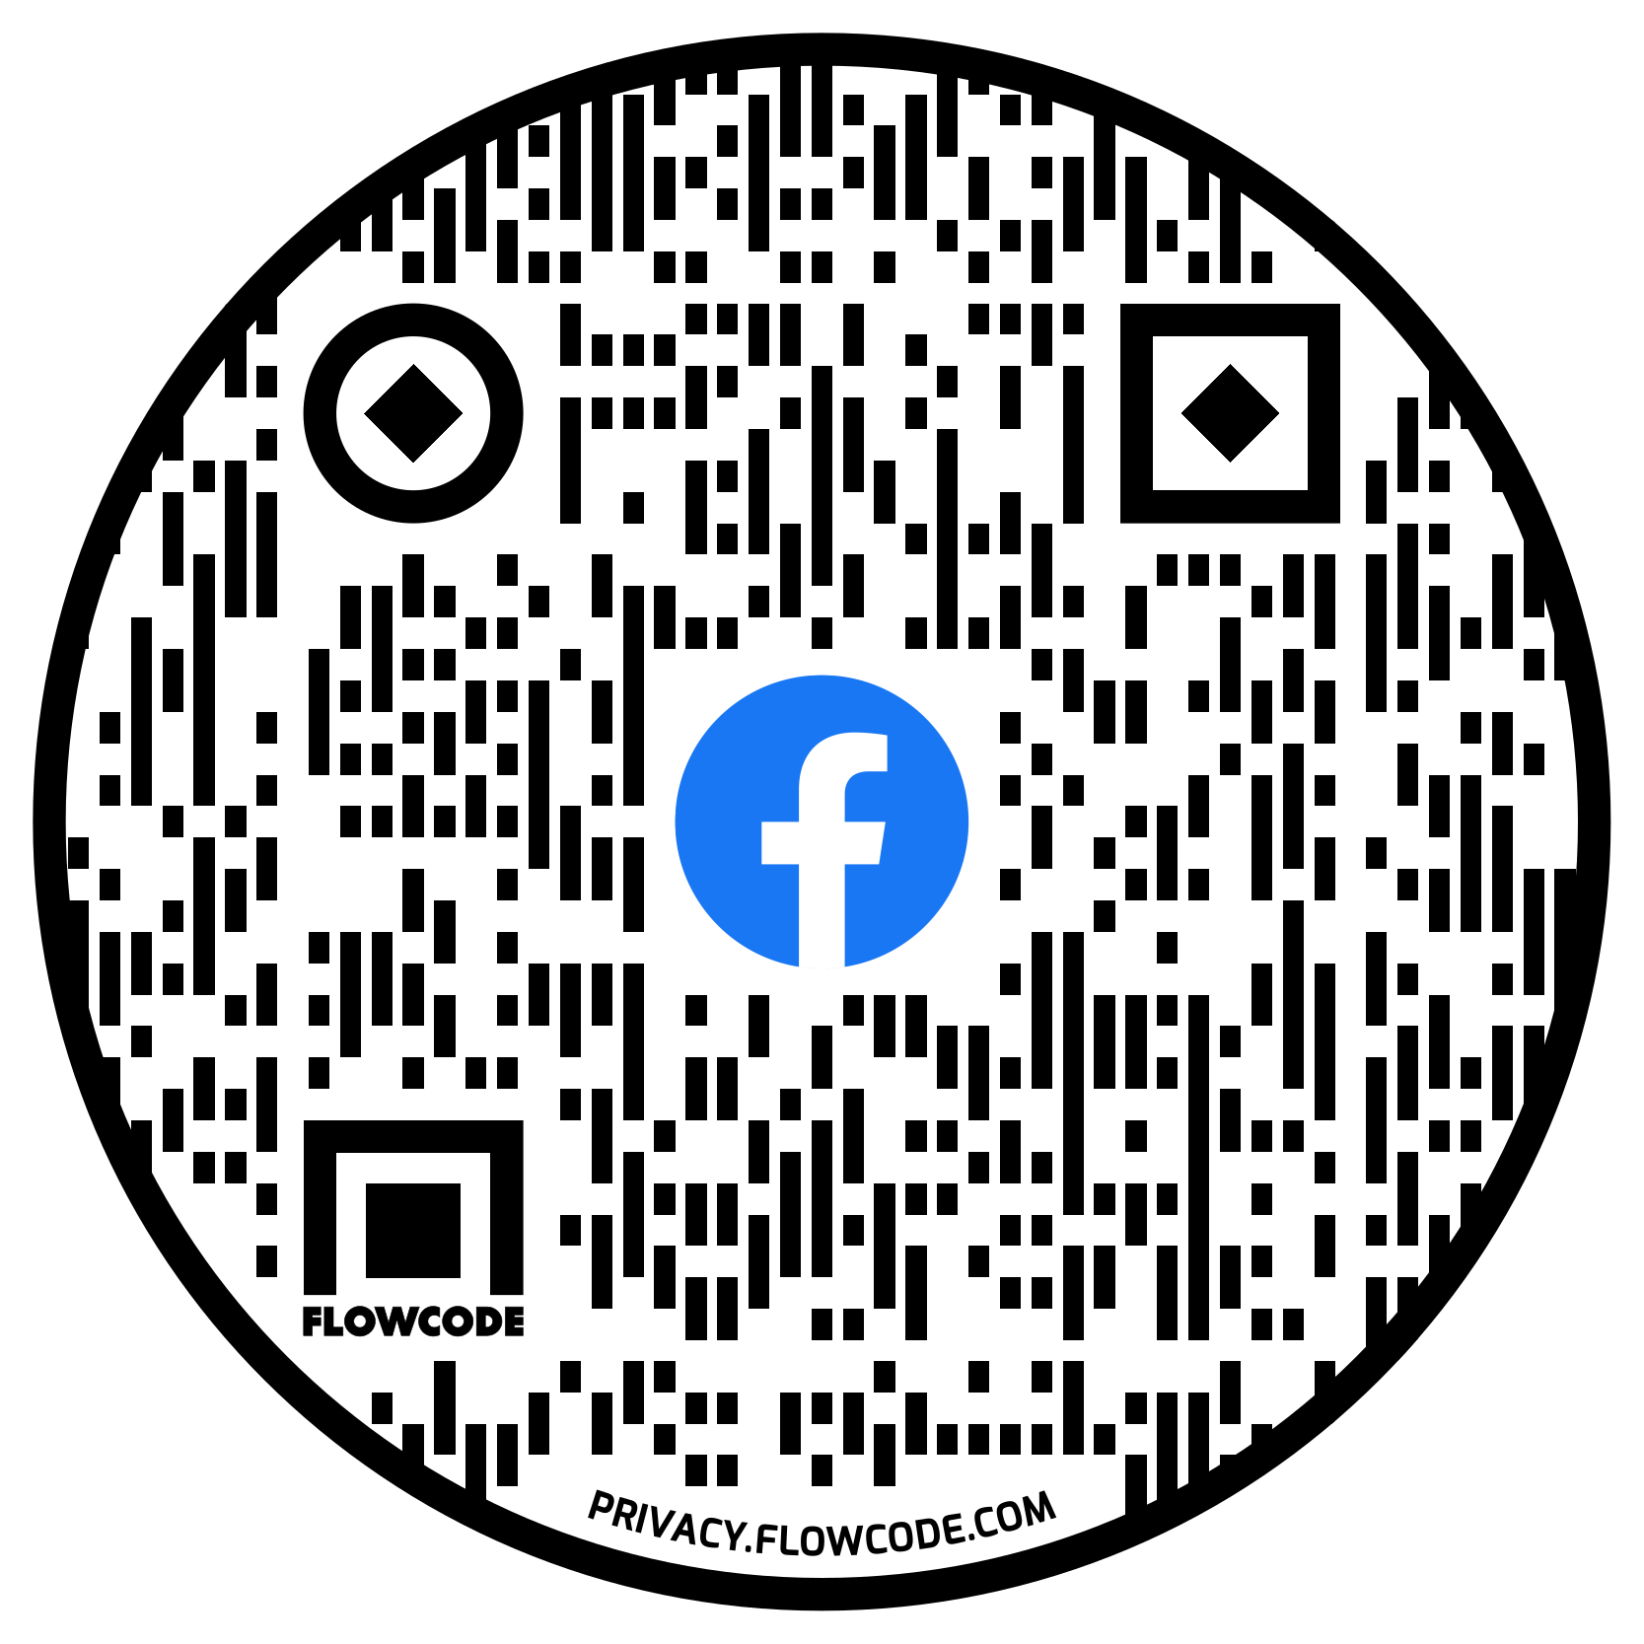
Stay Connected With Us!
Please answer 3 questions to join
Notes:
User Group Link: https://www.facebook.com/groups/pbisbreakroom

