Slide 1
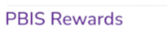
Getting Started with PBIS Rewards
Part 1
Notes:
In this presentation, we will cover the basics of PBIS and how to utilize the PBIS Rewards system. This will be the beginning slide of the deck we share with you in the session quick links in the follow-up email.

Slide 2
Introduction Slide
Your title
Years at current school/district
Why is PBIS Rewards important for you and your school?
Contact information or social media details
Add a picture or
Bit Moji
A fun fact about me is…
[Add your fun fact here]
Notes:
Start off the session by introducing yourself to your audience and connecting with them. You might say, “I started using PBIS Rewards in _____” or “I first learned about PBIS Rewards from _____.” You might want to tell a quick story about a way you used PBIS Rewards with students or how you think this can make a difference in your classroom or school.
Get an idea about your audience by taking a quick survey – participants can raise their hand if they have used PBIS Rewards before.
On this slide you can add a picture of yourself, a Bit Moji, and your contact information in case they need assistance in the future. Use the prompts above to help you craft this page, and if you don’t use social media or have a blog, feel free to remove those bullets or get creative and add some of your own!

Slide 3
Expectations for Training
EXPECTATION | BEHAVIOR
Be Respectful | Be open to new ideas Actively listen while others are sharing Engage with the presenter
Be Responsible | Have only PBIS Rewards content up on screen Silence all other devices Gather materials (paper, writing utensil) Share the air
Be Safe | Share relevant information and ideas in chat Stay engaged - use non-verbal feedback icons Don’t be afraid to ask questions
Notes:
Set the tone by establishing expectations for the training.
If you are training virtually, you may need to adjust the expectations. You will also need to adjust expectations to align with those on your school matrix.
Just as we set expectations with our students, we want to do the same for adults.
Here is a comical video you can play for your staff before going into your expectations.
"Cheers" Norms Matter Video Link:
https://www.youtube.com/watch?v=Pdyf9ZRjda8&feature=youtu.be

Slide 4
Today’s Agenda
2 Hour – Navigate360 PBIS Rewards Train the Trainer
5 Minutes | Welcome & Introductions
15 Minutes | PBIS Foundations
10 Minutes | Login Processes (Web Portal & App) Teacher Login Process Student Login Process
10 Minutes | Home Page Navigation
15 Minutes | Groups Page Features
10 Minutes | Attendance & Hall Passes
15 Minutes | Redeeming in PBIS Rewards
10 Minutes | Teacher Rewards
15 Minutes | Behavior Referral System
5 Minutes | Helpful Resources
10 Minutes | Wrap-Up and Questions
Notes:
Review the agenda for training. They are separated into a few basic categories, and you can add additional information that is needed for your school, if necessary.
Feel free to adjust the times for these activities as well.
Remember not to overwhelm a staff with too much information.
Try to do this in chunks. Throughout the presentation we have stop signs in helpful places to stop and allow your staff time to practice the skills they learned using test students in your school.

Slide 5
PBIS Foundations
Notes:
RESOURCE TO SHARE: https://support.pbisrewards.com/article/pbis-fundamentals/

Slide 6
What is PBIS?
Notes:
Before you begin understanding how to use PBIS Rewards, it is important to first understand the fundamentals of PBIS.
Begin by understanding what the letters, PBIS, stands for.
PBIS is Positive Behavior Interventions and Supports.
While it is important to create an acknowledgement system to recognize and encourage positive behaviors, it is also important to remember PBIS assists students who are struggling with the general framework with Tier 1 systems. This is where interventions and supports come in handy. PBIS offers a tiered system to assist students who may need more assistance with understanding schoolwide expectations.
PBIS follows the belief that behavior is learned. Since behavior is learned, behaviors should be taught. Student can learn behaviors in 2 ways, through explicit, direct teaching or through experience. It is the goal of PBIS to teach students behaviors proactively.
We promote those behaviors using PBIS Rewards by providing points to students who are meeting expectations.
It is important to note that we should also provide students with behavior specific praise. Students need to know how they have earned that point to encourage that behavior to continue.

Slide 7
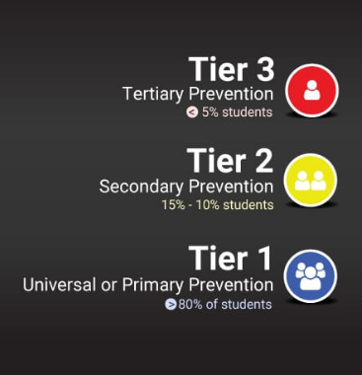
Understanding the Tiered Structure
Notes:
All students receive CORE/UNIVERSAL Tier 1 – only effective on 80%. This is where this training will focus today, on Tier 1 (The primary level of prevention).
10-15% will need TARGETED Tier 2 interventions and supports – small group counseling, behavior charts in classroom, CICO
5% will need INDIVIDUAL/INTENSIVE Tier 3 interventions and supports – CICO, Custom Interventions, FBA, BIP,
Spicy Food Example (mouthwash cup of water (Tier 1), bottled water (Tier 2-providing more of what you have already provided), glass of milk and a bottle of tums (Tier 3 -something completely different)
PBIS Rewards offers Tier 2/3 interventions through Check-In/Check-Out, SEL Checks, and Student Dashboards Custom Interventions

Slide 8
If a child doesn’t know how to read, we teach. If a child doesn’t know how to swim, we teach. If a child doesn’t know how to multiply, we teach. If a child doesn’t know how to drive, we teach. If a child doesn’t know how to behave, we…teach?...punish? Why can’t we finish that last sentence as automatically as the others? Tom Herner NSDE President, 1998
Notes:
If you asked most American these questions, most of them would get this response…WE TEACH!
If you would ask most Americans, if a child doesn’t know how to behave, they would say we punish instead of teach students how to behave.
Behavior is learned and should therefore be taught to students, so they understand our expectations.

Slide 9
Teaching Expectation Cycle
DEFINE simply
MODEL
with clear examples and nonexamples
PRACTICE
Multiple examples in natural settings
Supervise, ACKNOWLEDGE, and reteach
ADJUST
Instruction based on progress
Research indicates that you can improve behavior by 80% just by pointing out what someone is doing correctly.
Notes:
For a child to learn something new, it needs to be repeated on average 8 times
For a child to unlearn an old behavior and replace it with a new behavior, the new behavior must be repeated on average 28 times (Harry Wong)
Teaching expectations follows this flow chart:
Define – define school-wide expectations as simply as possible (just as you would present new content – starting with definitions). Simplify per grade level. Front-loading with behavior instruction will gain back academic instructional time
Model - Clear examples and nonexamples should be shown (teachers being silly to show nonexamples or student leadership groups can make videos of modeling each expectation in each setting)- lead with the non-examples vs. examples. Remind teachers, students will always watch you and they tend to do what you do rather than what you say so let’s be sure we are showing the behaviors we expect to see!
Activity: Follow my finger example
Practice – Just like any skill, practicing behavior makes perfect. It is best to teach this in the location/setting for that expectation to make connections between the action and expectation and/or procedure to follow. (examples include walking in the hallway, changing classes, dismissal, etc.)
Acknowledge – This is where PBIS Rewards helps! As you supervise and acknowledge students with points. Re-teaching can happen with an entire class or with individuals, reviewing those expectations and getting students back on track with positive, meaningful redirections.
80% Research bubble: Research shows us that people improve their behavior by 80% when someone acknowledges them for performing correctly. This is where we get the most bang for our buck!
Supervise – Just like within our curriculums, we consistently supervise our students and provide them with interventions, when needed.
Reteach – As teachers, we often must reteach skills and/or review concepts with our students even after they have mastered it. This is true with behavior as well. Can you think of some time you may need to reteach student expectations (after a long weekend, after a long break from school, holidays, or during a full moon)?
Adjust – As teachers, many of us have created a lesson plan that may not have worked out as well as we planned. Does this mean we don’t teach that concept or objective? Of course not, we adjust the delivery of that lesson, and we try again. The same is true with behavior, we will need to adjust how we teach these expectations and find ways to connect those expectations with the students in our class/school.

Slide 10
Addressing Negative Behaviors
Pre-Corrections
Rewarding others
Re-teaching expectations
Consequences
Notes:
Along with teaching behavior comes addressing inappropriate behaviors – read the 4 ways to address it
Discussion about addressing negative behaviors
Pre-correct Example: Before entering the hallway, say to your students: “Boys and Girls, as we enter the hallway, lets remember we will be on a voice level of zero with our hands in our pockets. We will travel in the second block and will face forwards
Rewarding Others – look for students following expectations and reward them, motivating others around them to follow expectations, especially when using the PBISR App – it makes a sound. This is a way to focus on the positives rather than allowing the negatives to overtake your classroom.
Re-Teaching Expectations – If more than half of your class is not following expectations, stop, re-teach expectations and return to content. Allows more focused time on content and less on behavior distractions. There are specific times you may know that you need to reteach (after a long break, any disruption in the daily schedule, etc.)
Consequences – There are natural consequences for your actions. Some states may require specific consequences that tie in with problem behaviors. It is okay to make sure students aware of these consequences.

Slide 11
Why Use PBIS Rewards
Saves time
Reduces Office Referrals
Increases Instructional Time
All Grade Levels
Increases Positive Relationships
Schoolwide
Builds Positive School Culture
Notes:
Schoolwide – Any staff member can reward any student at any time.
All Grade Levels – PBIS Rewards can be used for early childhood through adults! Everyone wants to be recognized for their hard work and PBIS Rewards is here to help make it easier!
Saves Time – Stop wasting time cutting out tickets and paper money! PBIS Rewards saves so much time by collecting all that information and increasing the fidelity of your PBIS implementation.
Reduces Office Referrals – Schools that use PBIS Rewards have seen at least a 30% decrease in their ODRs, allowing students to stay in the instructional setting.
Increases Instructional Time – Utilizing PBIS Rewards increases instructional time, allowing students to increase their academic and social emotional achievements.
Increases Positive Relationships – By rewarding points and increasing positive interactions between staff and students, positive relationships are fostered across your school.
Builds Positive School Culture – The increase in positive interactions, relationship building and increased instructional time will all equate to building a positive school culture and climate.
Resources
What is PBIS Rewards Student Video (K-6): https://youtu.be/ByemrmJyQ9s
What is PBIS Rewards Student Video (7-12): https://youtu.be/zcG9uJ2FS2U
Student Access: https://support.pbisrewards.com/article/student-access/
What is PBIS Rewards Parent Video: https://www.youtube.com/watch?v=wZLyt6uPVy8

Slide 12
Logging into PBIS Rewards
Notes:
In this section, we will discuss how to log into the PBIS Rewards system for staff and students
Have staff go through this process with you and be sure they can log in to PBIS Rewards
RESOURCE TO SHARE:
Login Page: https://pbisr.navigate360.com/login.php
Log in to the Web Portal Resource: https://support.pbisrewards.com/article/web-portal/
Log in to the Staff App Resource: https://support.pbisrewards.com/article/app-login/

Slide 13
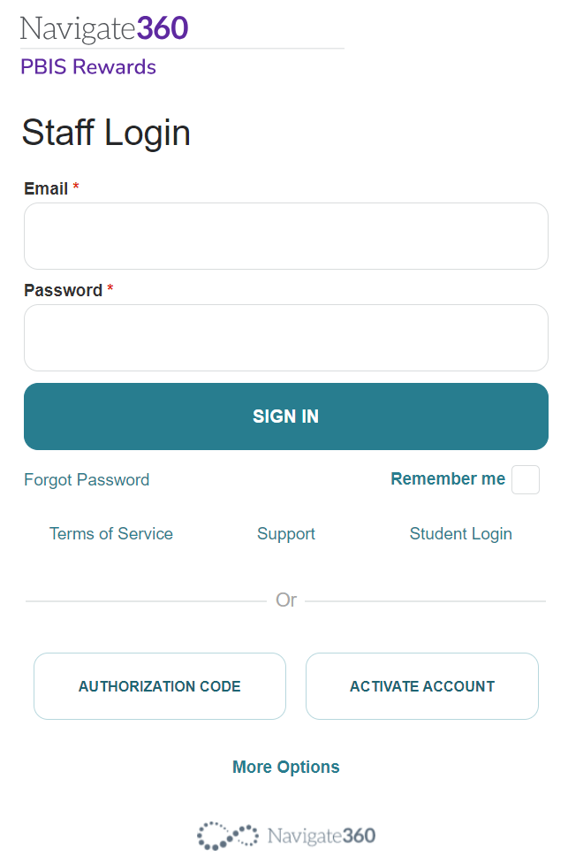
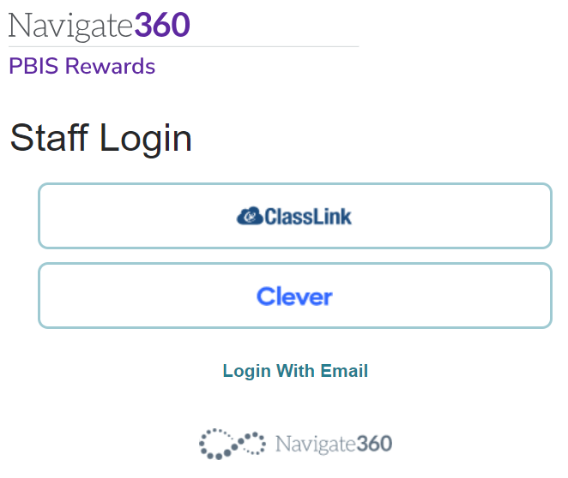
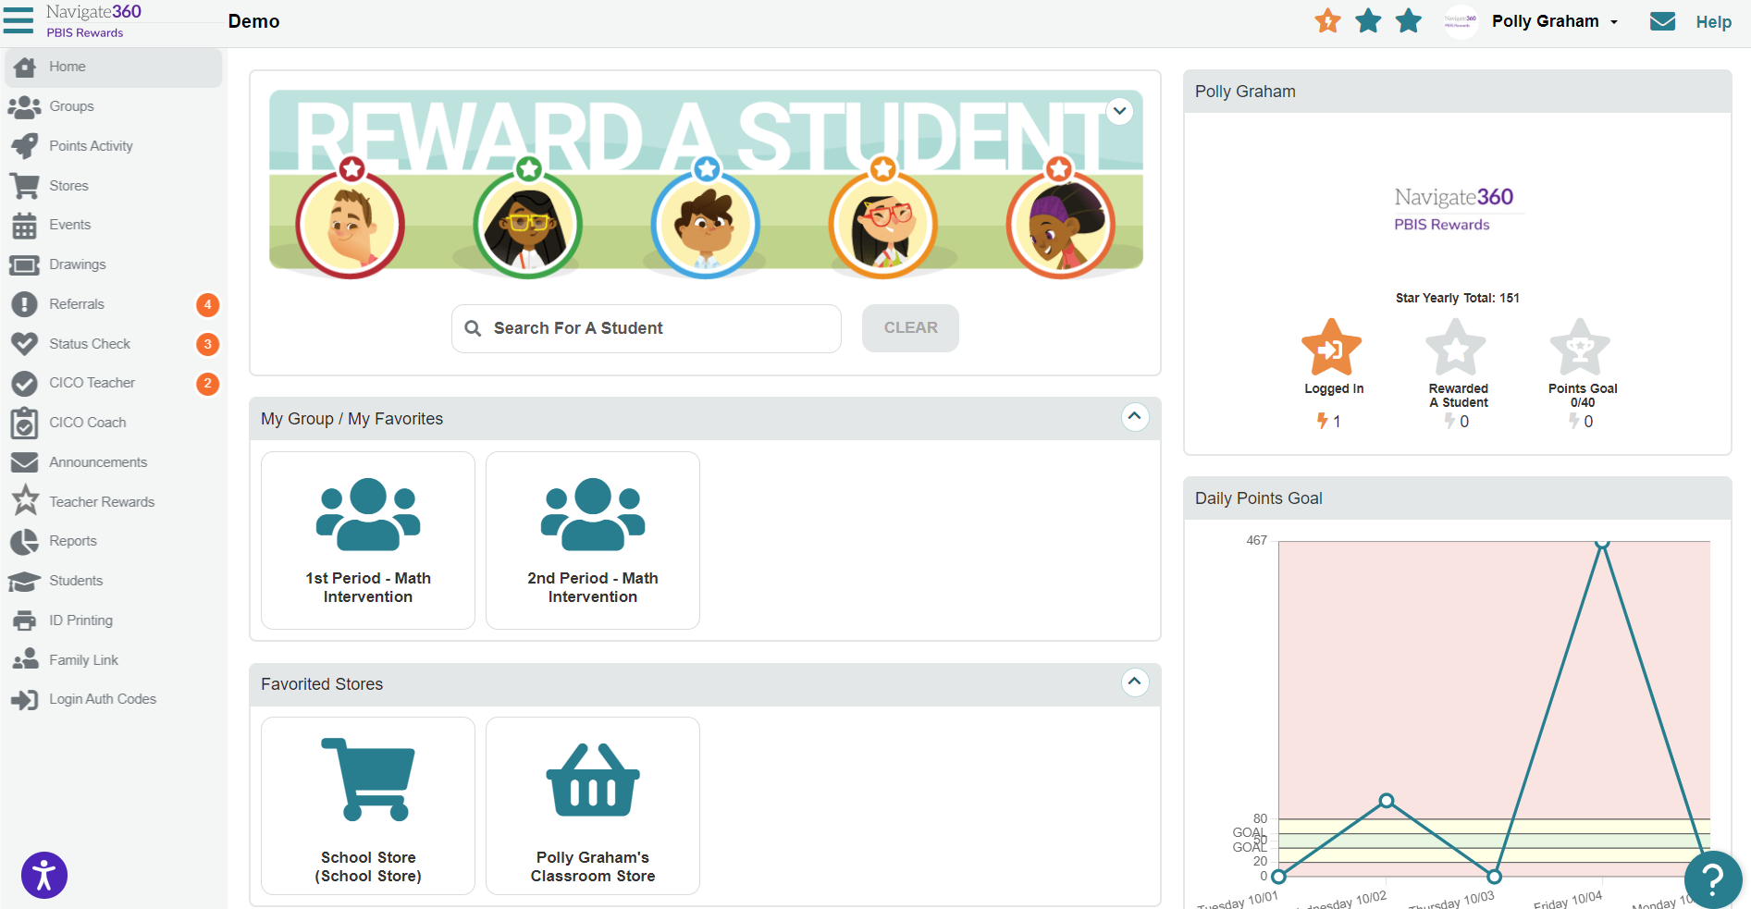
Step 1: Accessing the Web Portal
https://pbisr.navigate360.com/login.php
Notes:
USE THIS SLIDE FOR CLEVER OF CLASSLINK
When you are logging in, go to our home page or your Clever/Classlink Portal (https://pbisr.navigate360.com/login.php).
Since your school is a Clever or ClassLink school, staff members will then click more options for single sign-on options.
CLICK
We can now see those Single Sign On options, staff members will then elect their single sign on option, and it will log them into the PBIS Rewards system.
CLICK
This will log them into your school and open the home page for PBIS Rewards.
Resource:
Log in to the Web Portal Resource: https://support.pbisrewards.com/article/web-portal/

Slide 14
Step 1: Accessing the Web Portal
https://pbisr.navigate360.com/login.php
Notes:
Use this slide for schools that are manually uploaded (NO CLEVER OR CLASSLINK)
You may first need to activate your account. {CLICK}
You can do that from the login email sent by their administrator. {CLICK}
After that, you will be able to login using your email address and password. {CLICK}
This will bring you to your homepage in PBIS Rewards.
Resource:
Log in to the Web Portal Resource: https://support.pbisrewards.com/article/web-portal/

Slide 15
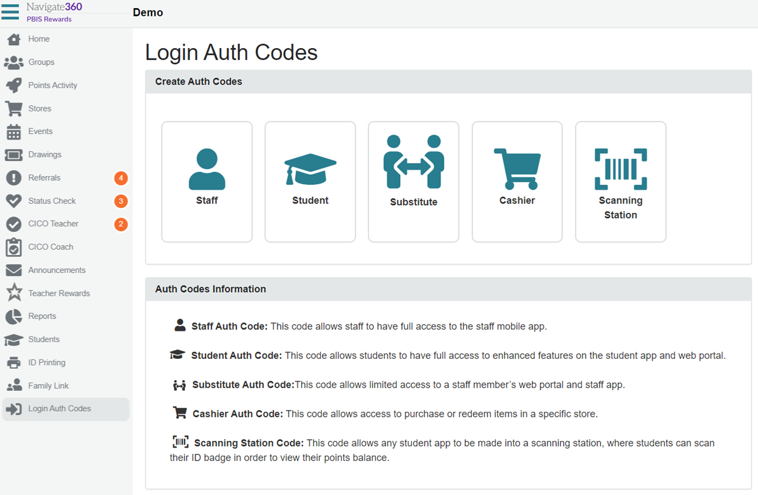
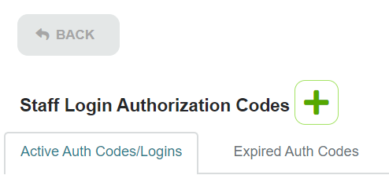
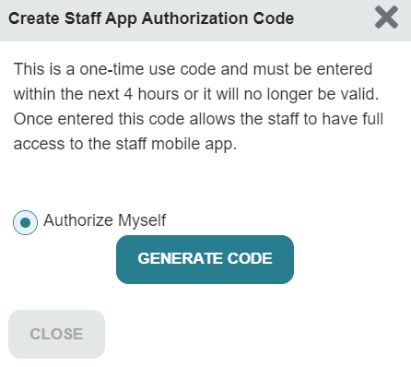
Step 2: Authorize Yourself – Staff App
Start in Web Portal
Notes:
From the PBIS Rewards Web Portal, staff members can authorize themselves to use the application. This serves as a multifactor authentication to help protect the security of your system and staff/student information. It is also nice for teachers who may not remember their passwords and rely heavily on Clever, Classlink, or other password manager.
On the left side, staff members will select the Login Auth Codes tab. {CLICK}
Since you are staff members, we will be selecting staff.
Please note, there are other options available here for you to authorize students, substitutes, volunteer cashiers for your school store (parents, community members, etc.), or even set up a scanning station for students to check the number of points they currently have in their points backpack. {CLICK}
Now that we have selected STAFF, we will see this screen. Here we will be clicking on the green plus sign! Remember, anytime we see the color green within PBIS Rewards, we are adding something to the system or getting something from the system. {CLICK}
Now, the system will ask who we are authorizing. If you are an admin, you will have the option to authorize other users, staff members without admin permissions will only be able to select “Authorize Myself.” Take note: this one-time code will only be valid for a limited amount of time (4-hours).
Next, we are going to select Generate Code. {CLICK}
This will provide us a code of numbers and letters. Everyone will have a different code. This is how the system recognizes who is logging in. We can either write this down a piece of paper or leave this up on our screen while we get the app ready on our device.
Resources:
https://support.pbisrewards.com/article/app-login/

Slide 16
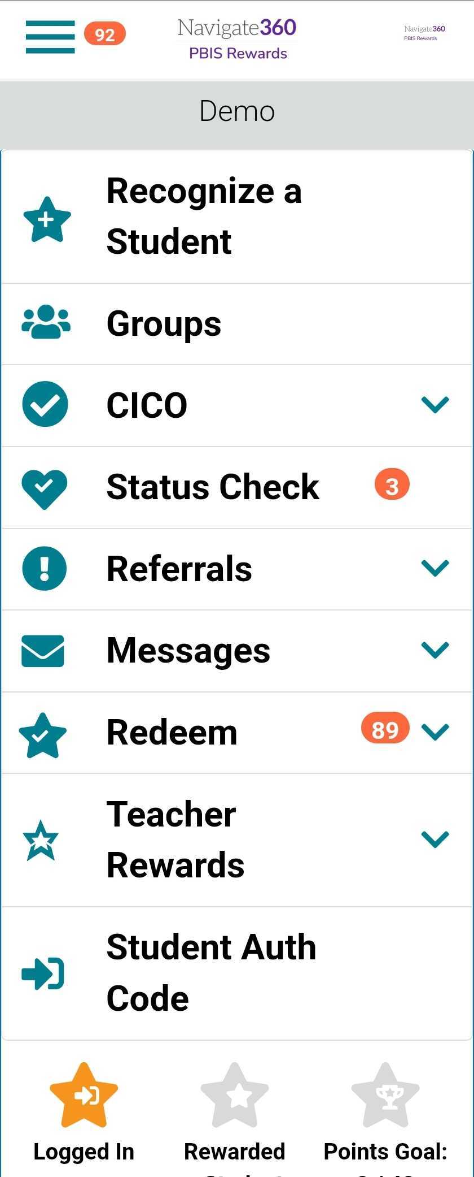
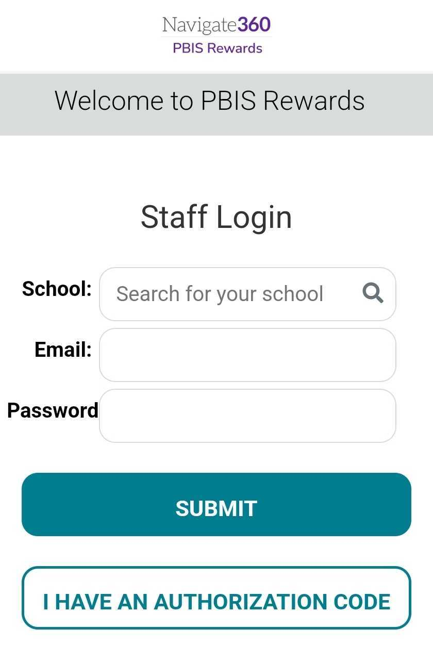
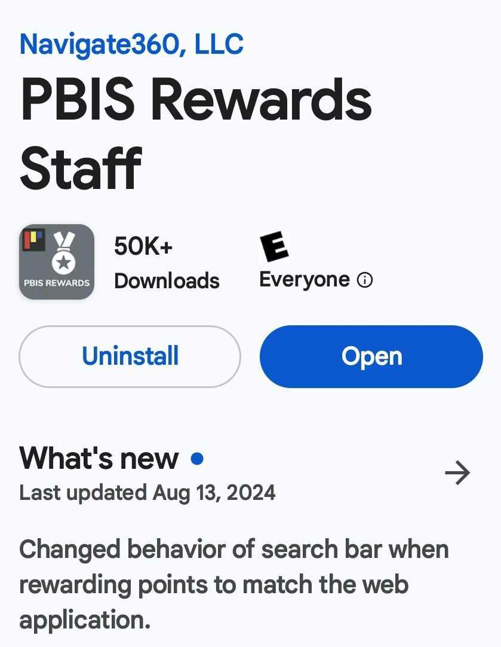
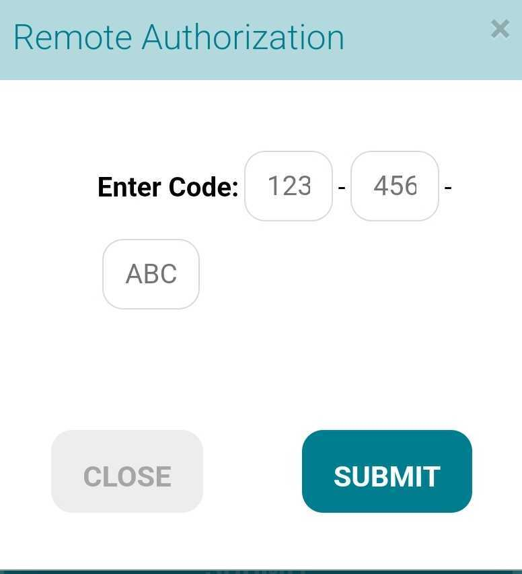
Step 3: Staff App Log In
Notes:
Here, we can see what the app will look like on your phone.
As a reminder, we do have a suite of apps for our users (one for staff, students, and families). Be sure to download the PBIS Rewards Staff App. {CLICK}
Instead of entering all of this information to log in, the staff members can select “I HAVE AN AUTHORIZATION CODE” {CLICK}
Enter the code you just generated and select SUBMIT. {CLICK}
This will take you to our staff app. This process will only need to happen once on a device unless you change devices or undergo a software upgrade.

Slide 17
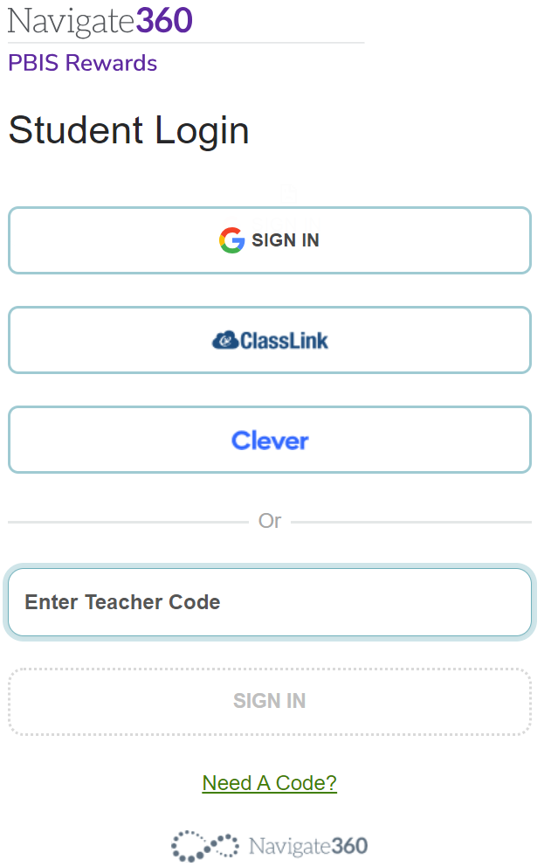
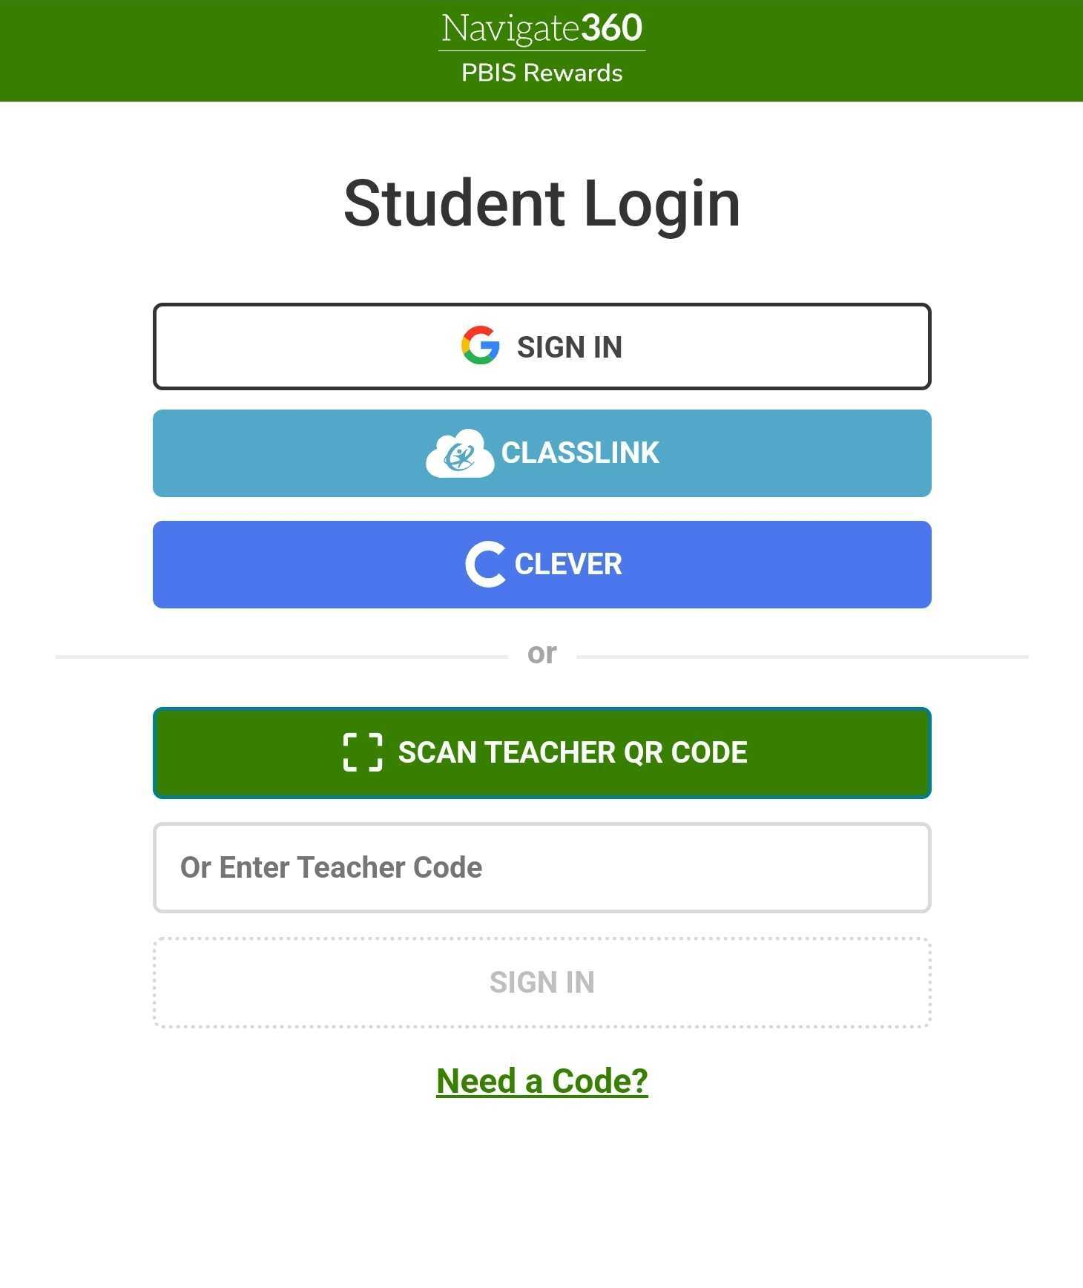
Student Login Page
Web Portal
Student App
Notes:
Students can log in several different ways, Through Google, Clever, Classlink, or through a teacher Authorization Code in both the web portal and the student app. Students can also use a QR code to login to the student app. Schools with Clever and Classlink may also have this added to the students Clever/Classlink portal as well.
Let’s review how to create this authorization code for students.

Slide 18
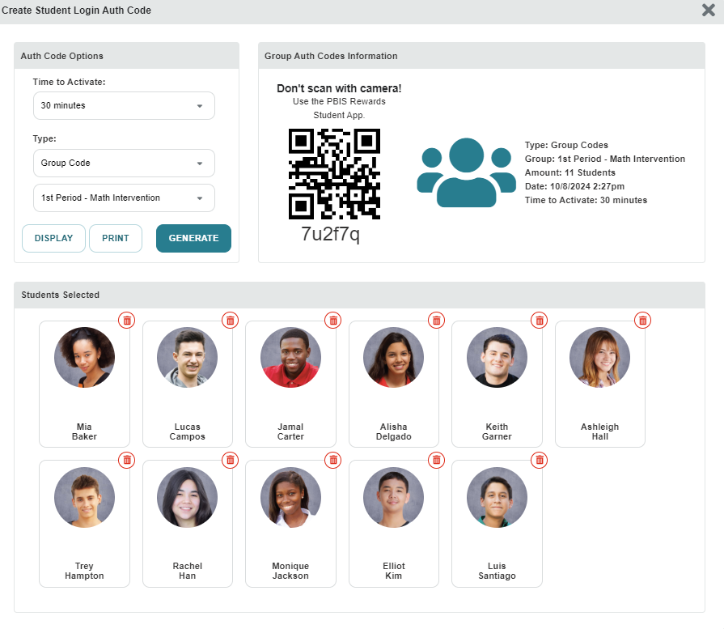
Student Login Page
Notes:
Just as we created authorization codes for ourselves, we can create those for our students, if needed. To create an authorization code for students, navigate to the Login Auth Codes tab. (CLICK)
This time, we will select Student. (Click)
This will open a new screen. Just like we did as a staff member, we will select the green plus sign. (CLICK)
Here we will be given some options. The amount of time these will be active and the option for the type of code. These can be group codes or individual student codes. (CLICK)
Students can scan the code for the app or use the alphanumeric code provided in both the web portal and the student app. If you have a group code, students will identify themselves by using their first/last name, email address, or student ID.

Slide 19
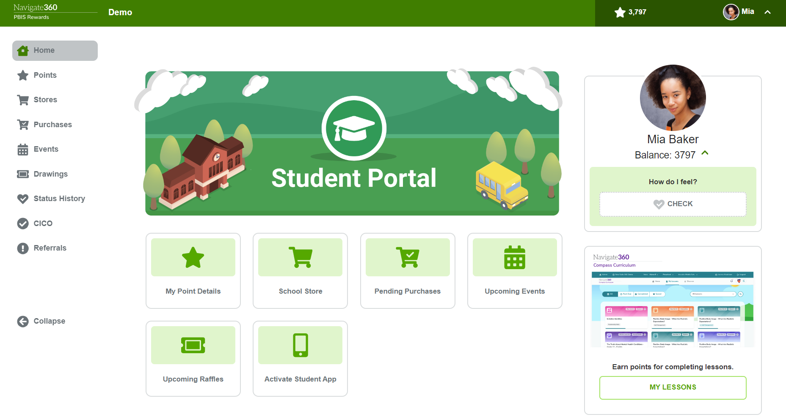
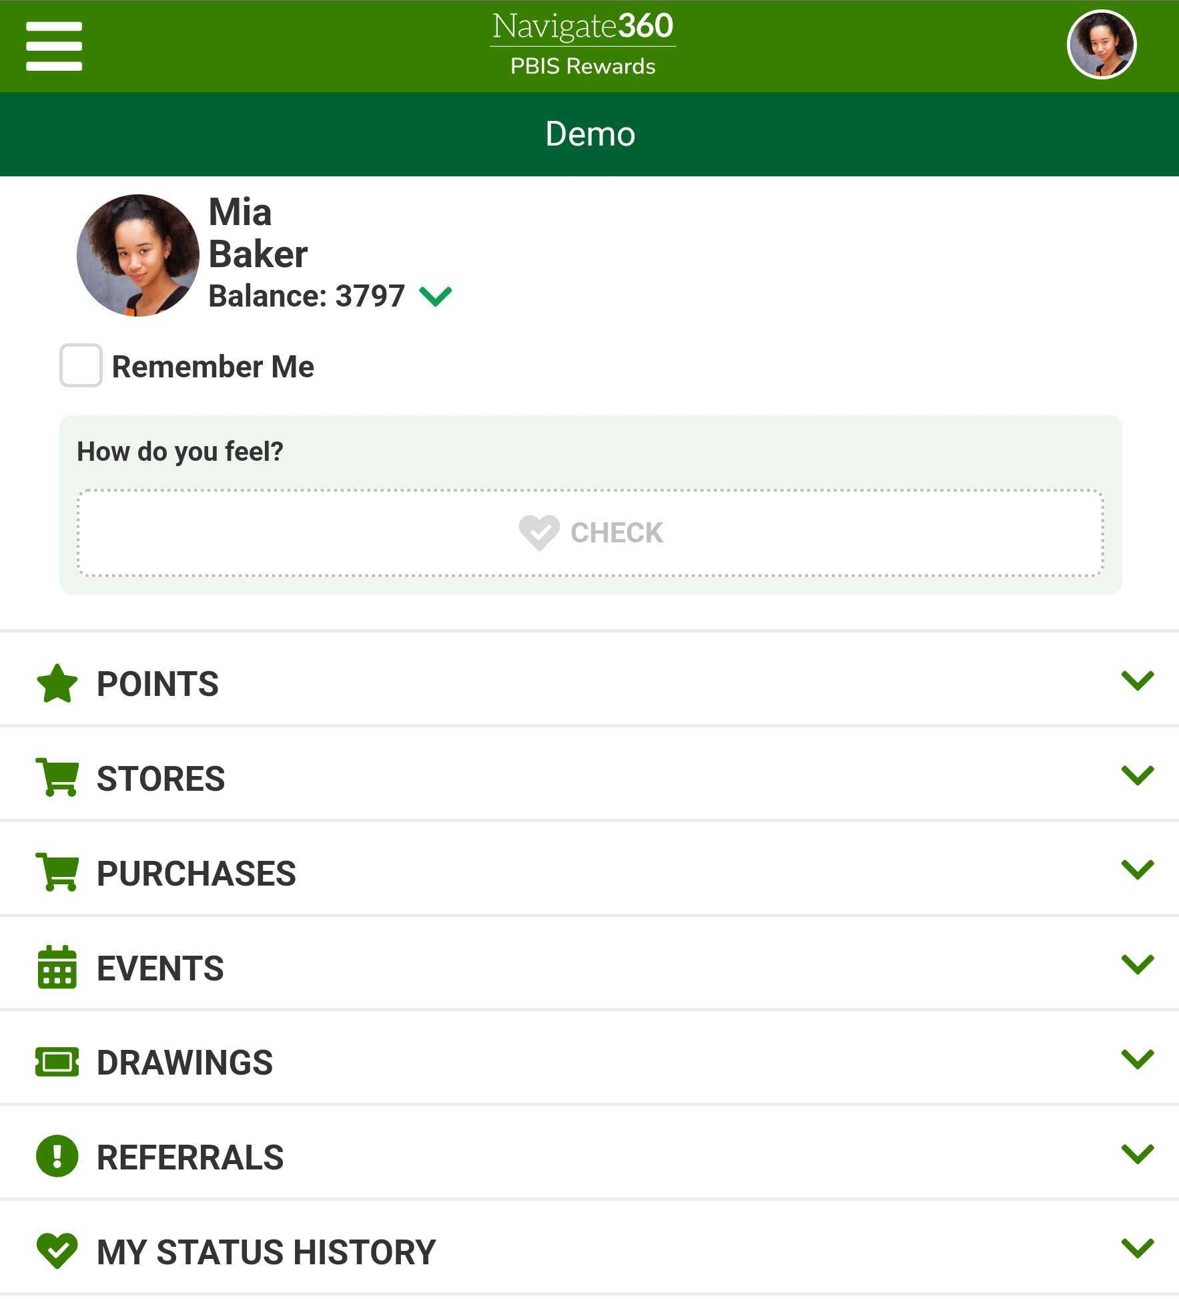
Student Web Portal and Student App
Notes:
Students can use their web portal and app to see their point balance, point details, comments teachers have made, upcoming events and raffles, Check-In/Check-Out info, stores items, and purchases. They can also purchase items from stores and register for events and raffles from their accounts when admin turns on Student Purchases from the admin settings tab. Students can also see their basic referral info and do SEL/Status Self Checks if Admin turns these features on. Students have access to SEL/Status check history but only the information they have personally entered into the system. Students will not see what staff members may have notated in the system for their SEL/Status Check.

Slide 20
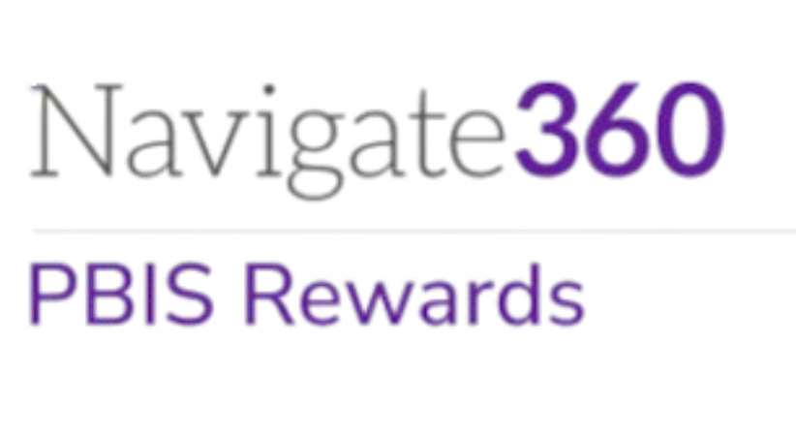
Let’s Go LIVE in PBIS Rewards
Notes:
This is a good time to make sure your staff is able to login to PBIS Rewards. You may want to have a few people with admin permissions ready to add staff members, if necessary or even troubleshoot login issues.

