Slide 1

Getting Started with
PBIS Rewards
Part 1
Notes:
In this presentation, we will cover the basics of PBIS and how to utilize the PBIS Rewards system. This will be the beginning slide of the decks we share with you in the session quick links in the follow-up email. As a reminder, there are 4 parts to these PPTs. You can customize these as you see fit or combine them, if necessary.

Slide 2
Introduction Slide
Your title
Years at current school/district
Why is PBIS Rewards important for you
and your school?
Contact information or social media details
Add a Picture or
Bit Moji
A fun fact about me is…
[Add your fun fact here.]
Notes:
Start off the session by introducing yourself to your audience and connecting with them. You might say, “I started using PBIS Rewards in _____” or “I first learned about PBIS Rewards from _____.” You might want to tell a quick story about a way you used PBIS Rewards with students or how you think this can make a difference in your classroom or school.
Get an idea about your audience by taking a quick survey – participants can raise their hand if they have used PBIS Rewards before.
On this slide you can add a picture of yourself, a Bit Moji, and your contact information in case they need assistance in the future. Use the prompts above to help you craft this page, and if you don’t use social media or have a blog, feel free to remove those bullets or get creative and add some of your own!

Slide 3
Expectations for Training
EXPECTATION | BEHAVIOR
Be Respectful | Mute your microphone when not sharing. Attend live webinars on time. Be open to new ideas.
Be Responsible | Have only PBIS Rewards content up on your screen. Silence all other devices. Gather materials (paper, writing utensil). Share the air.
Be Safe | Share relevant information and ideas in the chat. Stay engaged—use nonverbal feedback icons. Don’t be afraid to ask questions.
Notes:
Set the tone by establishing expectations for the training.
If you are training virtually, you may need to adjust the expectations. You will also need to adjust expectations to align with those on your school matrix.
Just as we set expectations with our students, we want to do the same for adults.
Here is a comical video you can play for your staff before going into your expectations.
"Cheers" Norms Matter Video Link:
https://www.youtube.com/watch?v=Pdyf9ZRjda8&feature=youtu.be

Slide 4
Today’s Agenda
Navigate360 PBIS Rewards: 2-Hour Train the Trainer
5 minutes | Welcome and Introductions
10 minutes | Training Tips - What to Expect -Foundations Review
5 minutes | Login Processes (Web Portal & App) -Teacher Login Process -Student Login Process
5 minutes | Demo School Login
10 minutes | PBIS Rewards Home Screen
20 minutes | PBIS Rewards Groups Page -Acknowledge Students -Point Balances -SEL/Status Check (View and Submit) - Random Button - Groups Settings Options (Point Sound & Group Print) - Changing Groups
5 minutes | Staff App Preview
10 minutes | Break
20 minutes | Redeeming in PBIS Rewards
10 minutes | Behavior Referral System for Staff
10 minutes | Advanced Features (Hall Pass & Teacher Rewards Overview)
5 minutes | Family Link – Connecting Families
5 minutes | Wrap-up and Questions
Notes:
Review the agenda for training. They are separated into a few basic categories, and you can add additional information that is needed for your school, if necessary.
Feel free to adjust the times for these activities as well.
Remember not to overwhelm a staff with too much information.
Try to do this in chunks. Throughout the presentation we have stop signs in helpful places to stop and allow your staff time to practice the skills they learned using test students in your school.

Slide 5
PBIS Foundations
Notes:
RESOURCE TO SHARE: https://support.pbisrewards.com/article/pbis-fundamentals/

Slide 6
What Is PBIS?
Positive Behavioral Interventions and Supports
Encouragement of positive behaviors
Teaching and promoting positive behaviors
Positive school climate
Notes:
PBIS stands for Positive Behavior Interventions and Supports. While we aim to encourage positive behaviors with the implantation of school-wide expectations and a reward system, PBIS also offers interventions and supports for students who may be struggling with behavior.
PBIS focuses on an understanding that behavior is learned and must therefore, be taught. Not only should we teach these expectations and ensure students understand what we are looking for, we must acknowledge students when they meet these expectations. You may want to begin rewarding frequently to establish a pattern of behavior and then intermittently thereafter. Be sure to provide behavior specific praise informing the student why they are getting rewarded. This can be done verbally or even written in the comment section of PBIS Rewards for students and families to see.

Slide 7
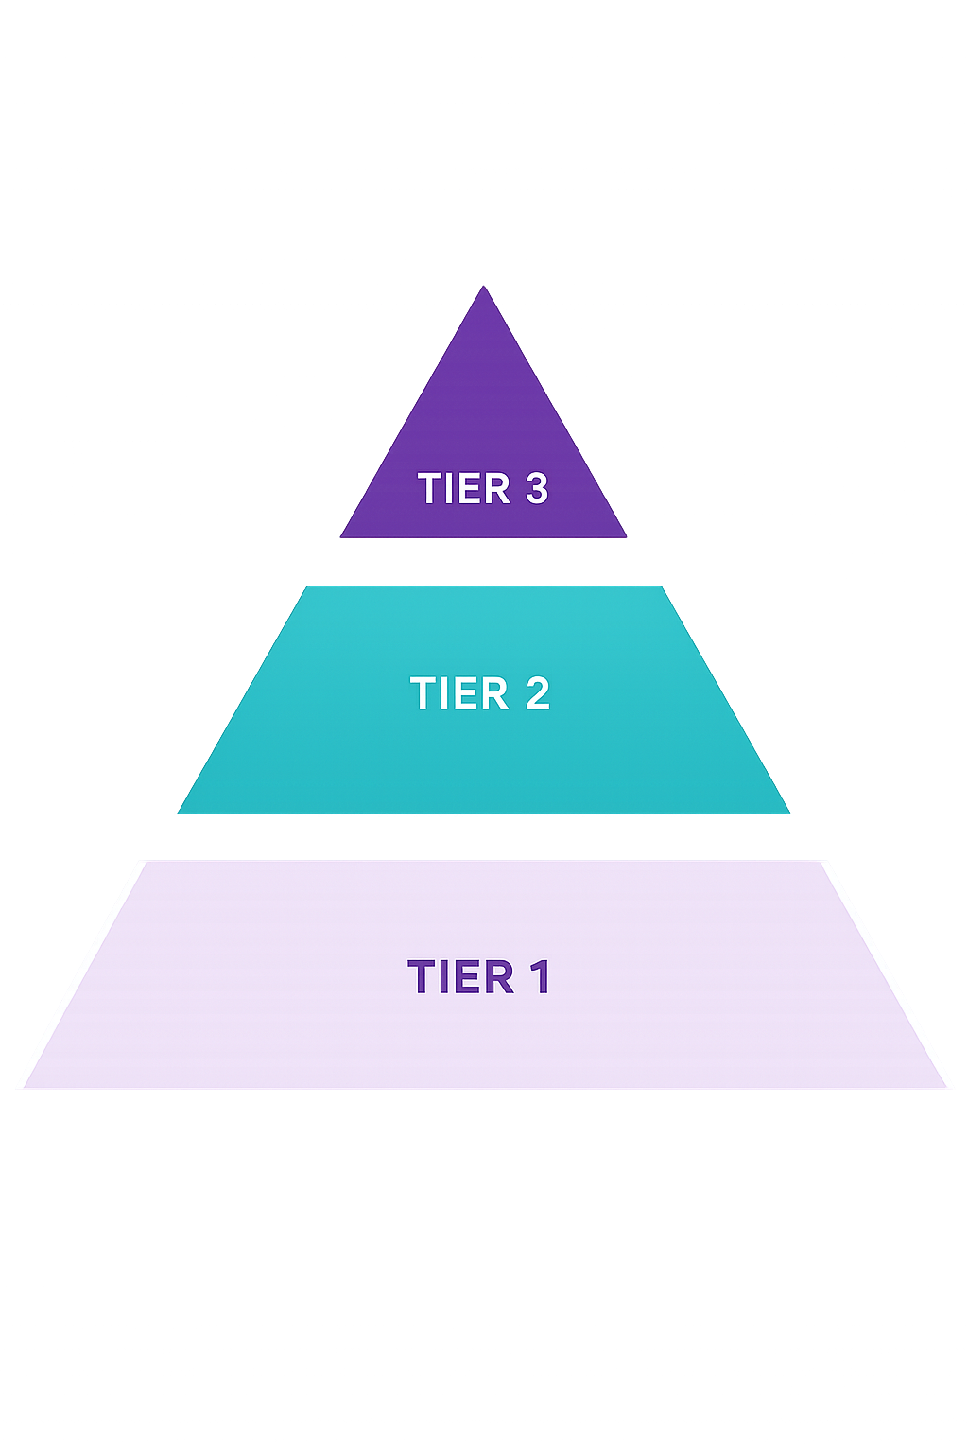
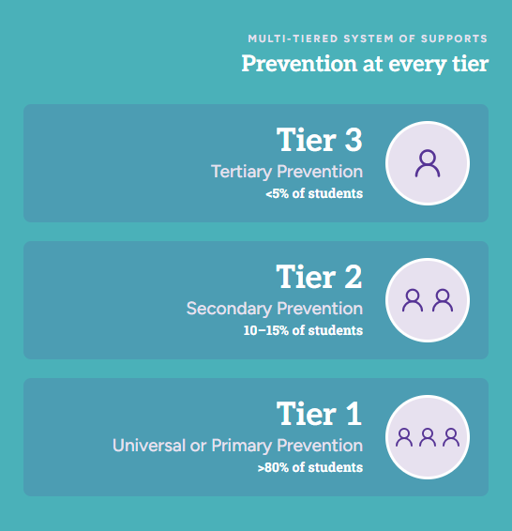
Understanding the Tiered Structure
Notes:
All students receive CORE/UNIVERSAL Tier 1 – only effective on 80%. This is where this training will focus today, on Tier 1 (The primary level of prevention). In this tier we provide school-wide expectations and promote the teaching of these expectations in our school. We acknowledge students who meet this expectations using points and behavior specific praise. It is also essential to create redeeming options for the points students earn. Lastly, we provide students with an opportunity to acknowledge their feelings and get assistance when needed with SEL Checks or Status Checks.
10-15% will need TARGETED Tier 2 interventions and supports – small group counseling, behavior charts in classroom, etc. In PBIS Reward this can be done using CICO, SEL/Status Check History, or custom interventions
5% will need INDIVIDUAL/INTENSIVE Tier 3 interventions and supports – CICO, customized individual plan (BIP)
PBIS Rewards offers Tier 2/3 interventions through Check-In/Check-Out, SEL Checks, Student Dashboards, Custom Interventions Reporting
Spicy Food Example (mouthwash cup of water, bottle water, something completely different)
PERCEPTION
Let’s all start with understanding what the letters stand for.
Read aloud.
Resource: Blog – What is PBIS?

Slide 8
If a child doesn’t know how to read, we teach.
If a child doesn’t know how to swim, we teach.
If a child doesn’t know how to multiply, we teach.
If a child doesn’t know how to drive, we teach.
If a child doesn’t know how to behave, we…teach?…punish?
Why can’t we finish that last sentence as automatically as the others?
Tom Herner
NSDE President, 1998
Notes:
If you asked most American these questions, most of them would get this response…WE TEACH!
If you would ask most Americans, if a child doesn’t know how to behave, they would say we punish instead of teach students how to behave.
Behavior is learned and should therefore be taught to students, so they understand our expectations.

Slide 9
Teaching Expectation Cycle
DEFINE simply
MODEL
with clear examples and nonexamples
PRACTICE
Multiple examples in natural settings
Supervise, ACKNOWLEDGE,
and reteach
ADJUST
Instruction based on progress
Research indicates that you can improve behavior by 80% just by pointing out what someone is doing correctly.
Notes:
For a child to learn something new, it needs to be repeated on average 8 times
For a child to unlearn an old behavior and replace it with a new behavior, the new behavior must be repeated on average 28 times (Harry Wong)
Teaching follows this flow chart:
Define – define school-wide expectations simply (just as you would present new content – starting with definitions) Simplify per grade level. Front-loading with behavior instruction will gain back academic instructional time
Model - Examples and Non-Examples (teachers acting foolish or student leadership groups)- lead with the non-examples vs. examples. Remind them, students will always watch you and they tend to do what you do rather than what you say so let’s be sure we are showing the behaviors we expect to see!
Activity: Follow my finger example
Practice – Just like any skill, behavior makes perfect. It is best to teach this in the location/setting for that expectation to make connections between the action and expectation and/or procedure to follow. (examples include: walking in the hallway, changing classes, dismissal, etc.)
Acknowledge – This is where PBIS Rewards helps! As you supervise and acknowledge students with points. Re-teaching can happen with an entire class or with individuals, reviewing those expectations and getting students back on track.
80% Research bubble: Research shows us that people improve their behavior by 80% when someone acknowledges them for performing correctly. This is where we get the most bang for our buck!
Supervise – Just like within our curriculums, we consistently supervise our students and provide them with interventions, when needed.
Reteach – As Coachs, we often must reteach skills and/or review concepts with our students even after they have mastered it. This is true with behavior as well. Can you think of some time you may need to reteach student expectations (after a long weekend, after a long break from school, holidays, or during a full moon).
Adjust – As teachers, many of us have created a lesson plan that may not have worked out as well as we planned. Does this mean we don’t teach that concept or objective? Of course not, we adjust the delivery of that lesson, and we try again. The same is true with behavior, we will need to adjust how we teach these expectations and find ways to connect those expectations with the students in our class/school.

Slide 10
Addressing Negative Behaviors
Pre-Corrections
Rewarding Others
Re-Teaching Expectations
Consequences
Notes:
Along with teaching behavior comes addressing inappropriate behaviors – read the 4 ways to address it
Discussion about addressing negative behaviors
Pre-correct Example: Before entering the hallway, say to your students: “Boys and Girls, as we enter the hallway, lets remember we will be on a voice level of zero with our hands in our pockets. We will travel in the second block and will face forwards
Rewarding Others – look for students following expectations and reward them, motivating others around them to follow expectations, especially when using the PBISR App – it makes a sound
Re-Teaching Expectations – If more than half of your class is not following expectations, stop, re-teach expectations and return to content. Allows more focused time on content and less on behavior distractions.
Consequences – There are natural consequences for your actions. Some states may require specific consequences that tie in with problem behaviors. It is okay to make sure students aware of these consequences. For example, if little Johnny writes on his desk, it is okay to have little Johnny erase those marks he created. I would not ask little Johnny to clean all the desks in the classroom, that may be taking things too far.

Slide 11
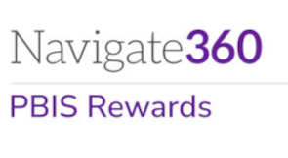
Why Use PBIS Rewards?
Saves Time
Reduces Office Referrals
Increases Instructional Time
All Grade Levels
Increases Positive Relationships
Schoolwide
Builds Positive School Culture
Notes:
Schoolwide – Any staff member can reward any student at any time.
All Grade Levels – PBIS Rewards can be used for early childhood through adults! Everyone wants to be recognized for their hard work and PBIS Rewards is here to help make it easier!
Saves Time – Stop wasting time cutting out tickets and paper money! PBIS Rewards saves so much time by collecting all that information and increasing the fidelity of your PBIS implementation.
Reduces Office Referrals – Schools that use PBIS Rewards have seen at least a 30% decrease in their ODRs, allowing students to stay in the instructional setting.
Increases Instructional Time – Utilizing PBIS Rewards increases instructional time, allowing students to increase their academic and social emotional achievements.
Increases Positive Relationships – By rewarding points and increasing positive interactions between staff and students, positive relationships are fostered across your school.
Builds Positive School Culture – The increase in positive interactions, relationship building and increased instructional time will all equate to building a positive school culture and climate.
Resources
What is PBIS Rewards Student Video (K-6): https://youtu.be/ByemrmJyQ9s
What is PBIS Rewards Student Video (7-12): https://youtu.be/zcG9uJ2FS2U
Student Access: https://support.pbisrewards.com/article/student-access/
What is PBIS Rewards Parent Video: https://www.youtube.com/watch?v=wZLyt6uPVy8

Slide 12
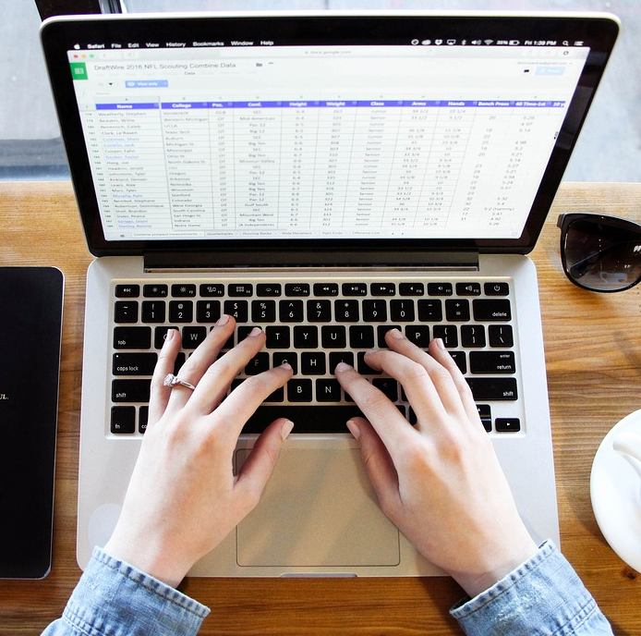
Logging into PBIS Rewards
Notes:
In this section, we will discuss how to log into the PBIS Rewards system for staff and students
Have staff go through this process with you and be sure they can log in to PBIS Rewards
RESOURCE TO SHARE:
Login Page: https://pbisr.navigate360.com/login.php
Log in to the Web Portal Resource: https://support.pbisrewards.com/article/web-portal/
Log in to the Staff App Resource: https://support.pbisrewards.com/article/app-login/

Slide 13
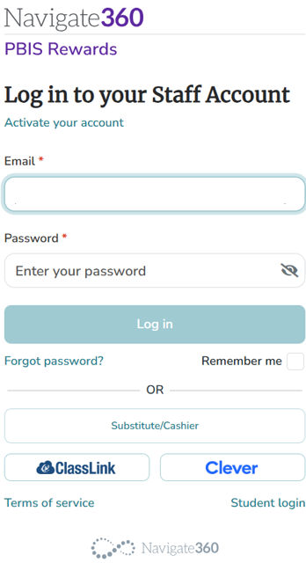
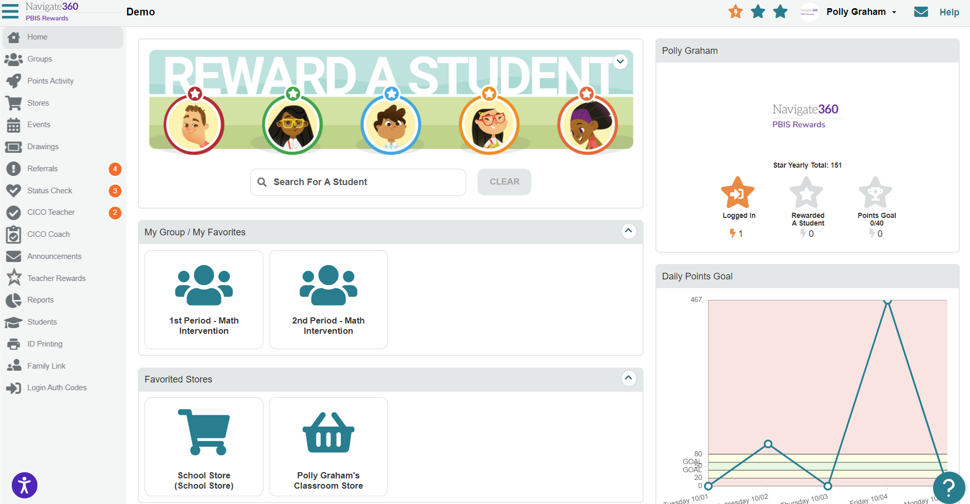
Step 1: Accessing the Web Portal
Access PBIS Rewards through your district Clever/ClassLink Portal
Access through our website:
https://pbisr.navigate360.com/login.php
Single Sign-On Option
Email Address and Password
Substitute/Cashier Login
https://pbisr.navigate360.com/login.php
Notes:
USE THIS SLIDE FOR CLEVER OF CLASSLINK
When you are logging in, go to our home page (https://pbisr.navigate360.com/login.php). (CLICK)
Since your school is a Clever or ClassLink school, staff members will easily be able to use the single sign-on options for Clever or ClassLink. (CLICK)
You can also login with your email address and password (CLICK)
You can create access for substitutes and cashiers who may be running your school store (parent volunteers) (CLICK)
Once you are logged into PBIS Rewards, you will see the landing page!
Resources: Login into PBIS Rewards: https://support.pbisrewards.com/article/web-portal/

Slide 14
Step 1: Accessing the Web Portal
Access through our website:
https://pbisr.navigate360.com/login.php
Single Sign-On Option
Email Address and Password
Substitute/Cashier Login
https://pbisr.navigate360.com/login.php
Notes:
USE THIS SLIDE FOR NON-CLEVER OR CLASSLINK SCHOOLS
When you are logging in, go to our home page (https://pbisr.navigate360.com/login.php). (CLICK)
Since your school is a Clever or ClassLink school, staff members will easily be able to use the single sign-on options for Clever or ClassLink. (CLICK)
You can also login with your email address and password (CLICK)
You can create access for substitutes and cashiers who may be running your school store (parent volunteers) (CLICK)
Once you are logged into PBIS Rewards, you will see the landing page!
Resources: Login into PBIS Rewards: https://support.pbisrewards.com/article/web-portal/

Slide 15
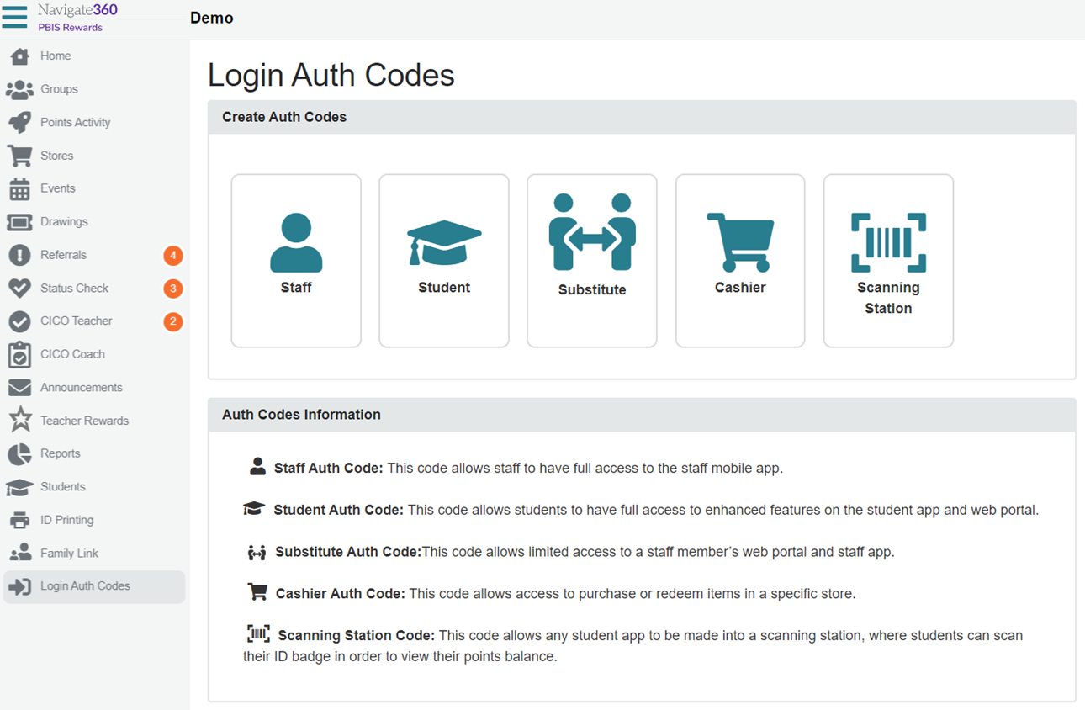
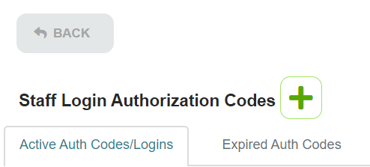
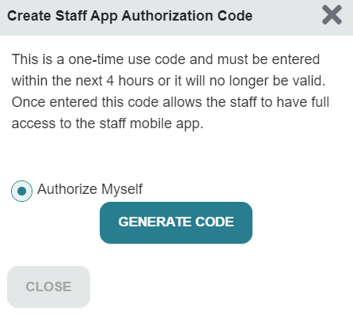
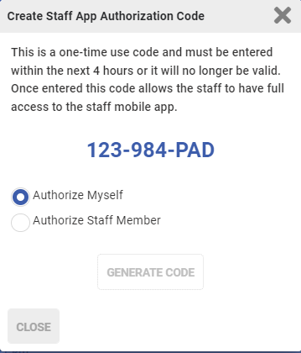
Step 2: Authorize Yourself – Staff App
Start in Web Portal
Notes:
From the PBIS Rewards Web Portal, staff members can authorize themselves to use the application. This serves as a multifactor authentication to help protect the security of your system and staff/student information. It is also nice for teachers who may not remember their passwords and rely heavily on Clever, Classlink, or other password manager.
On the left side, staff members will select the Login Auth Codes tab. {CLICK}
Since you are staff members, we will be selecting staff.
Please note, there are other options available here for you to authorize students, substitutes, volunteer cashiers for your school store (parents, community members, etc.), or even set up a scanning station for students to check the number of points they currently have in their points backpack. {CLICK}
Now that we have selected STAFF, we will see this screen. Here we will be clicking on the green plus sign! Remember, anytime we see the color green within PBIS Rewards, we are adding something to the system or getting something from the system. {CLICK}
Now, the system will ask who we are authorizing. If you are an admin, you will have the option to authorize other users, staff members without admin permissions will only be able to select “Authorize Myself.” Take note: this one-time code will only be valid for a limited amount of time (4-hours).
Next, we are going to select Generate Code. {CLICK}
This will provide us a code of numbers and letters. Everyone will have a different code. This is how the system recognizes who is logging in. We can either write this down a piece of paper or leave this up on our screen while we get the app ready on our device.
Resources:
https://support.pbisrewards.com/article/app-login/

Slide 16
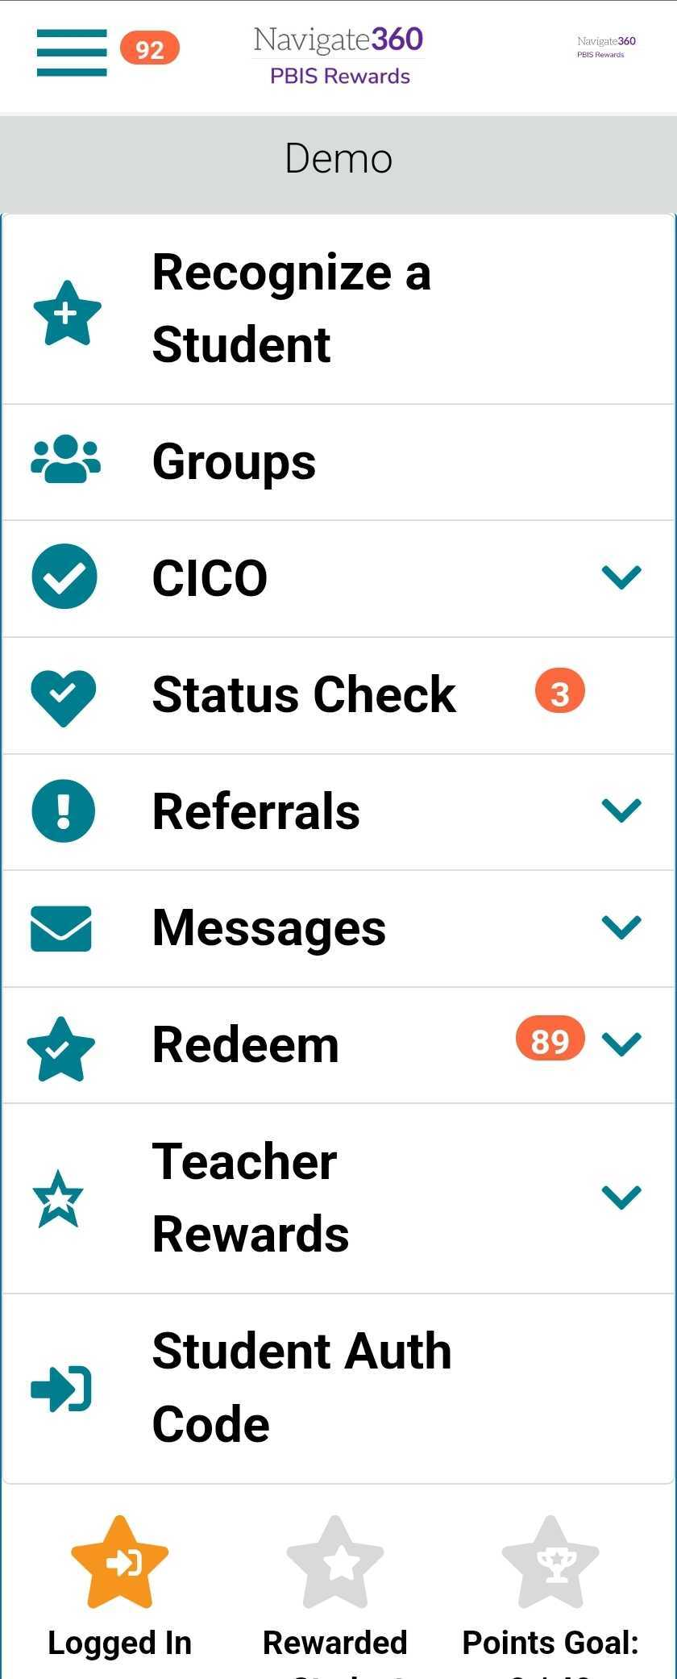
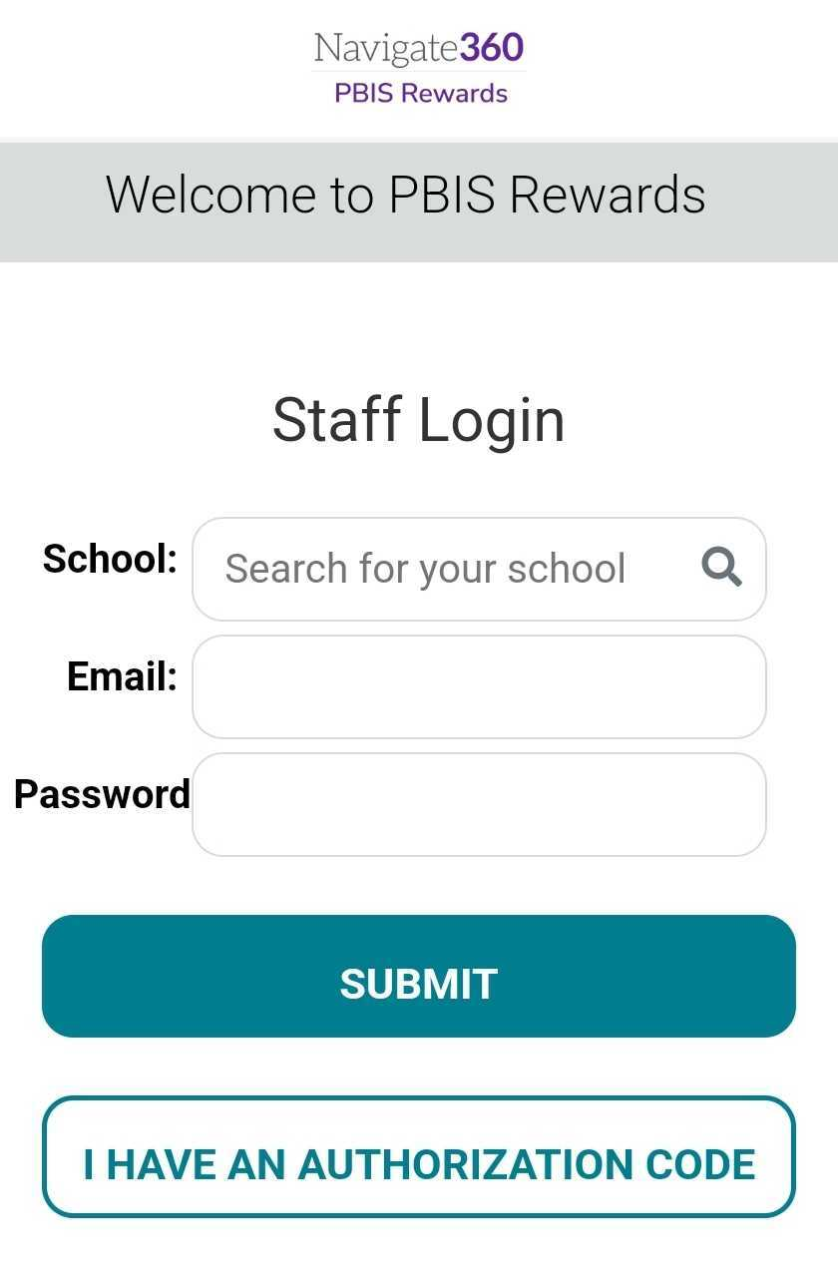
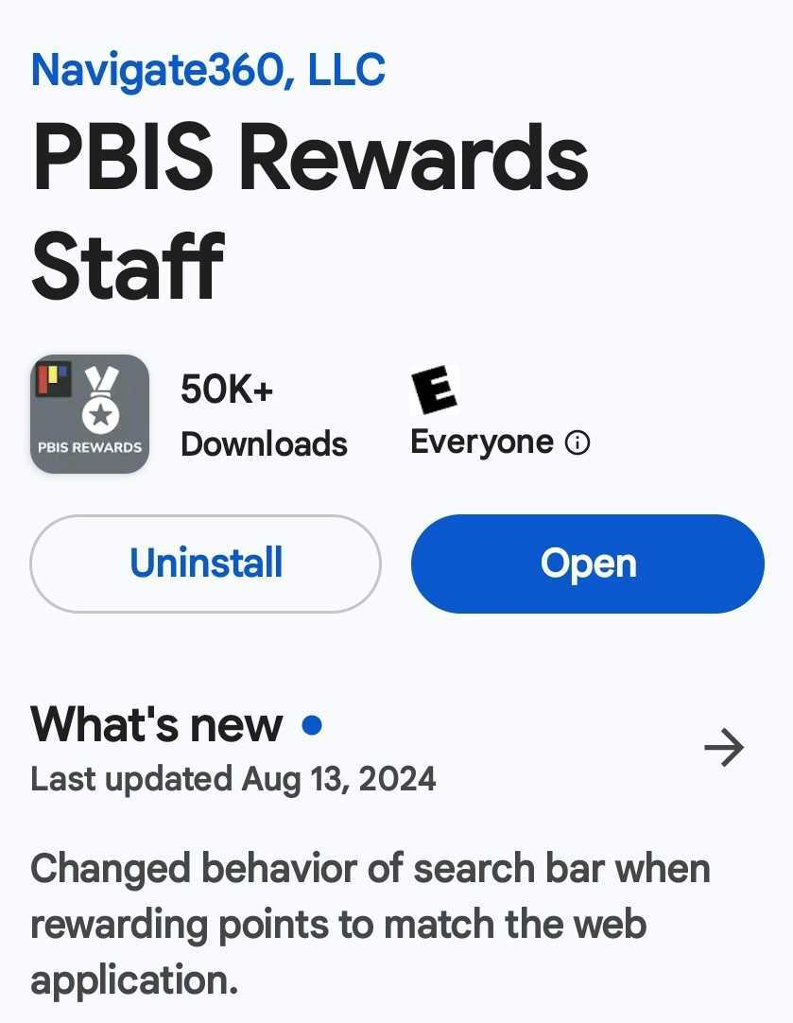
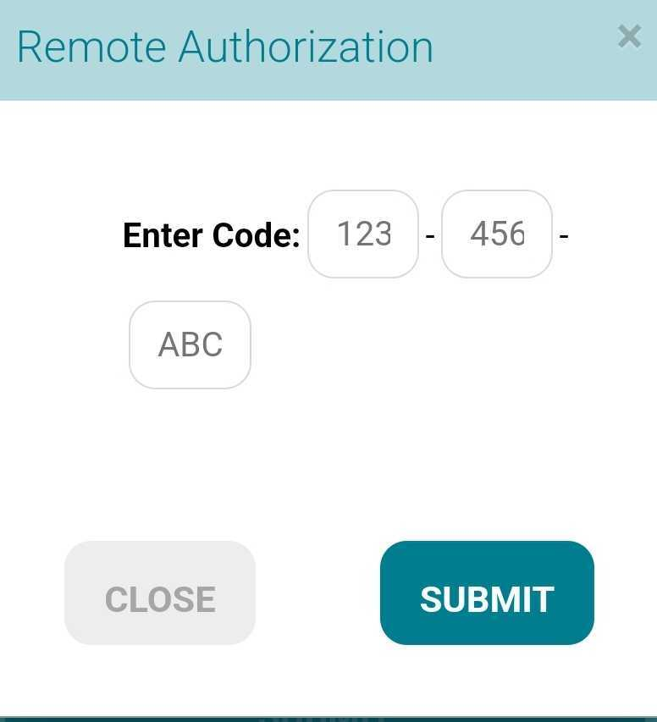
Step 3: Staff App Log In
Notes:
Here, we can see what the app will look like on your phone.
As a reminder, we do have a suite of apps for our users (one for staff, students, and families). Be sure to download the PBIS Rewards Staff App. {CLICK}
Instead of entering all of this information to log in, the staff members can select “I HAVE AN AUTHORIZATION CODE” {CLICK}
Enter the code you just generated and select SUBMIT. {CLICK}
This will take you to our staff app. This process will only need to happen once on a device unless you change devices or undergo a software upgrade.

Slide 17
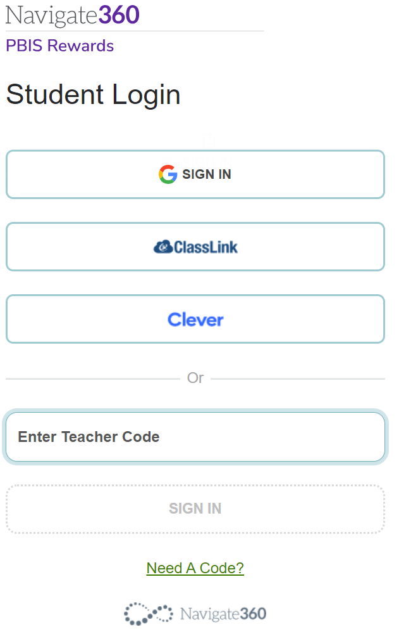
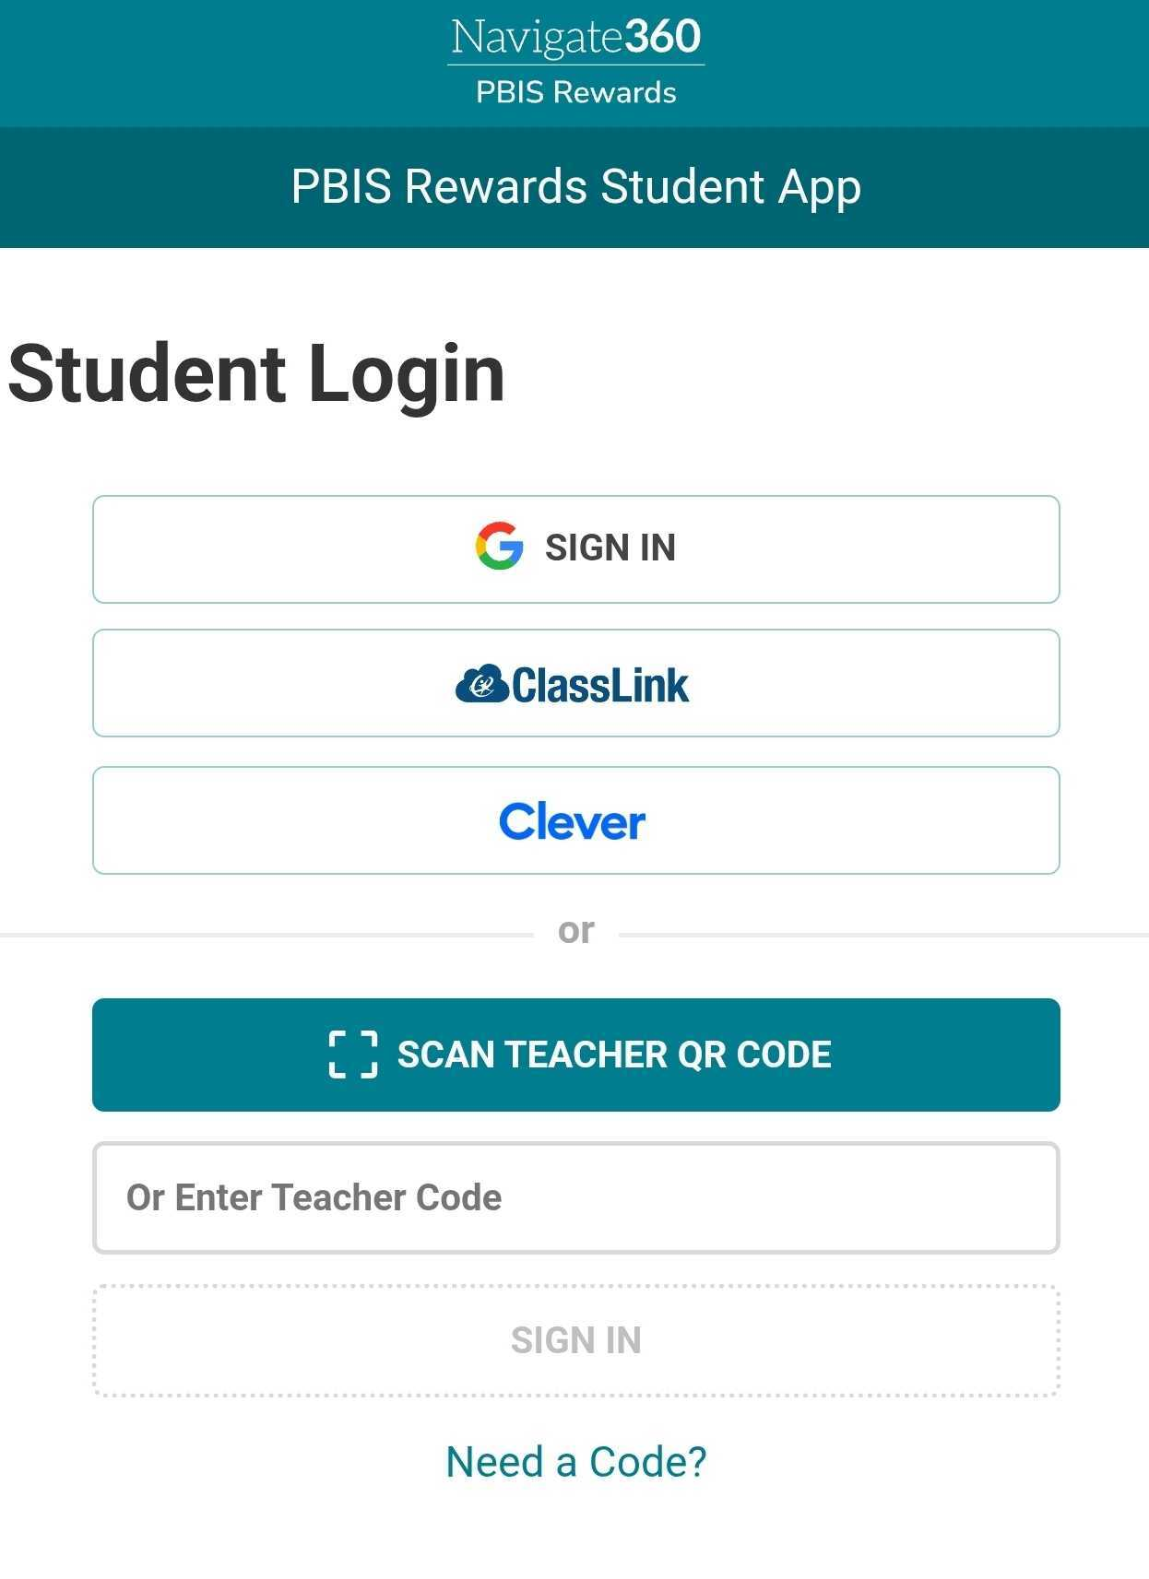
Student Login Page
Web Portal
Student App
Notes:
Students can log in several different ways, Through Google, Clever, Classlink, or through a teacher Authorization Code in both the web portal and the student app. Students can also use a QR code to login to the student app. Let’s review how to create this authorization code for students. Student Web Portal: https://pbisrstudent.navigate360.com/login.php

Slide 18
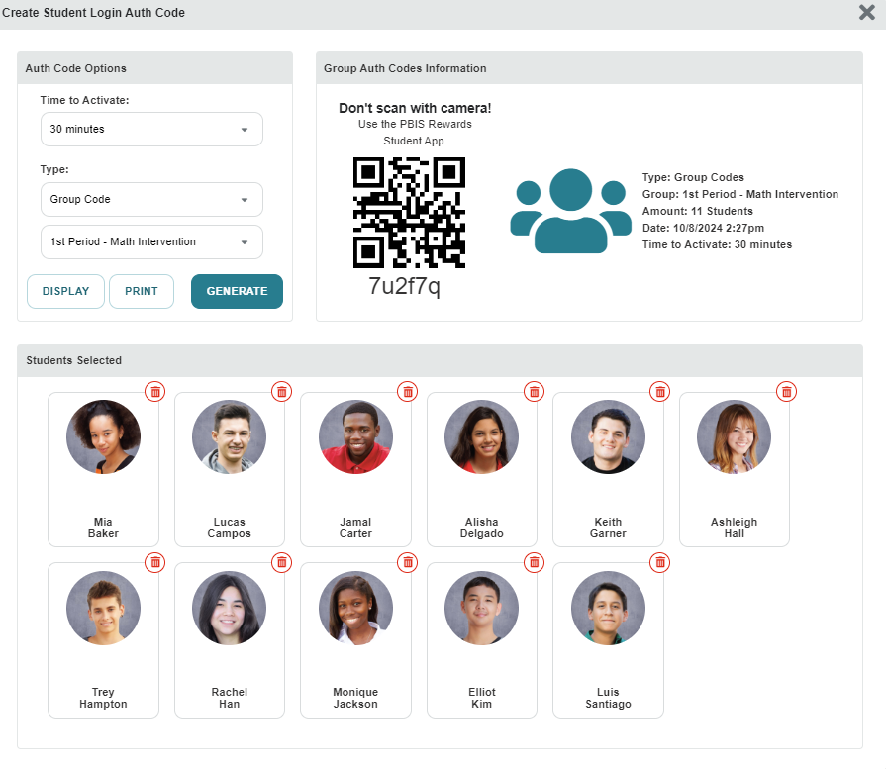
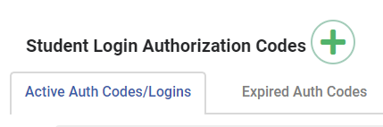
Student Login Page
Notes:
Just as we created authorization codes for ourselves, we can create those for our students, if needed. To create an authorization code for students, navigate to the Login Auth Codes tab. (CLICK)
This time, we will select Student. (Click)
This will open a new screen. Just like we did as a staff member, we will select the green plus sign. (CLICK)
Here we will be given some options. The amount of time these will be active and the option for the type of code. These can be group codes or individual student codes. (CLICK)
Students can scan the code for the app or use the alphanumeric code provided in both the web portal and the student app. If you have a group code, students will identify themselves by using their first/last name, email address, or student ID.

Slide 19
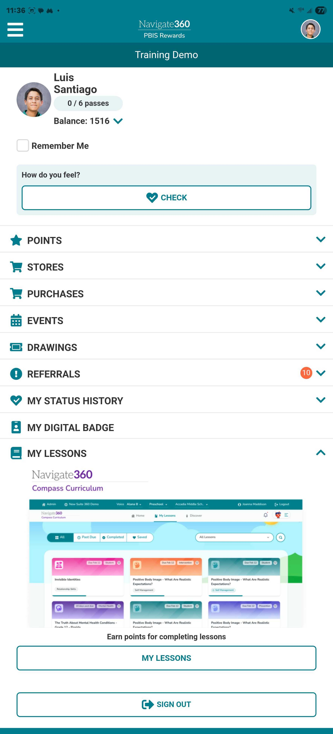
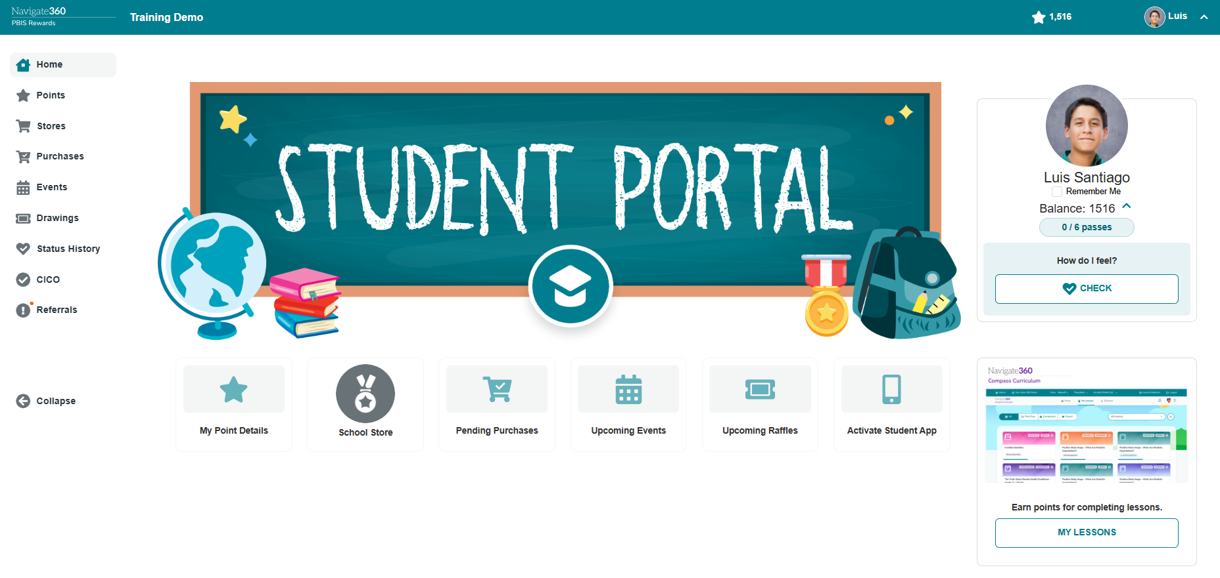
Student Web Portal and Student App
Notes:
Students can use their web portal and app to see their point balance, point details, comments teachers have made, upcoming events and raffles, Check-In/Check-Out info, stores items, and purchases. They can also purchase items from stores and register for events and raffles from their accounts when admin turns on Student Purchases from the admin settings tab. Students can also see their basic referral info and do SEL/Status Self Checks if Admin turns these features on. Students have access to SEL/Status check history but only the information they have personally entered into the system. Students will not see what staff members may have notated in the system for their SEL/Status Check.

Slide 20
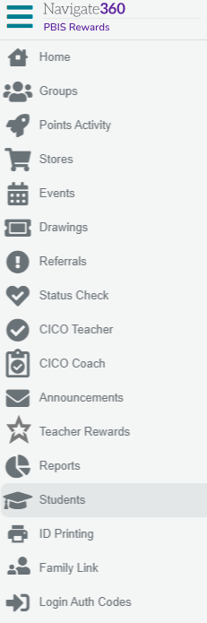
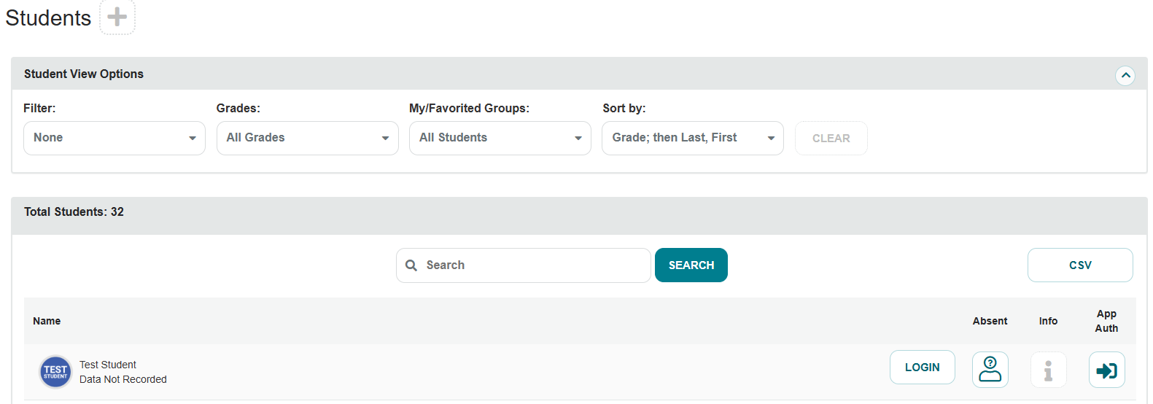
Viewing the Student Portal for Staff

Slide 21
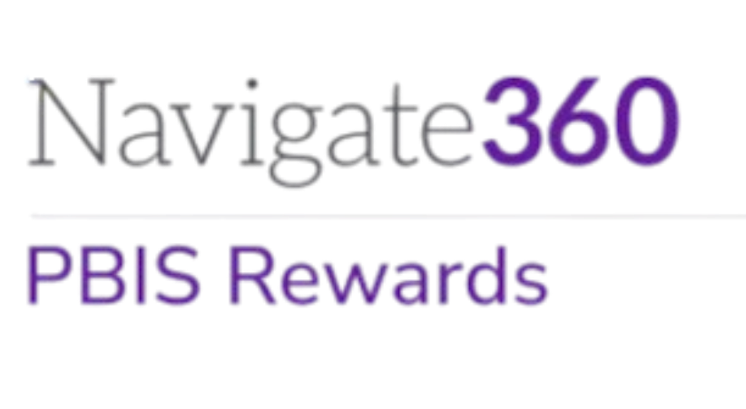
Let’s Go LIVE in
PBIS Rewards
Notes:
This is a good time to make sure your staff is able to login to PBIS Rewards. You may want to have a few people with admin permissions ready to add staff members, if necessary or even troubleshoot login issues.

