Slide 1

Getting Started with
PBIS Rewards
Part 2

Slide 2
Rewarding Students
Home Page and Group Features
Notes:
Now that we can all login to PBIS Rewards, let’s take a moment and learn how to use the Home Page and Group Page.

Slide 3
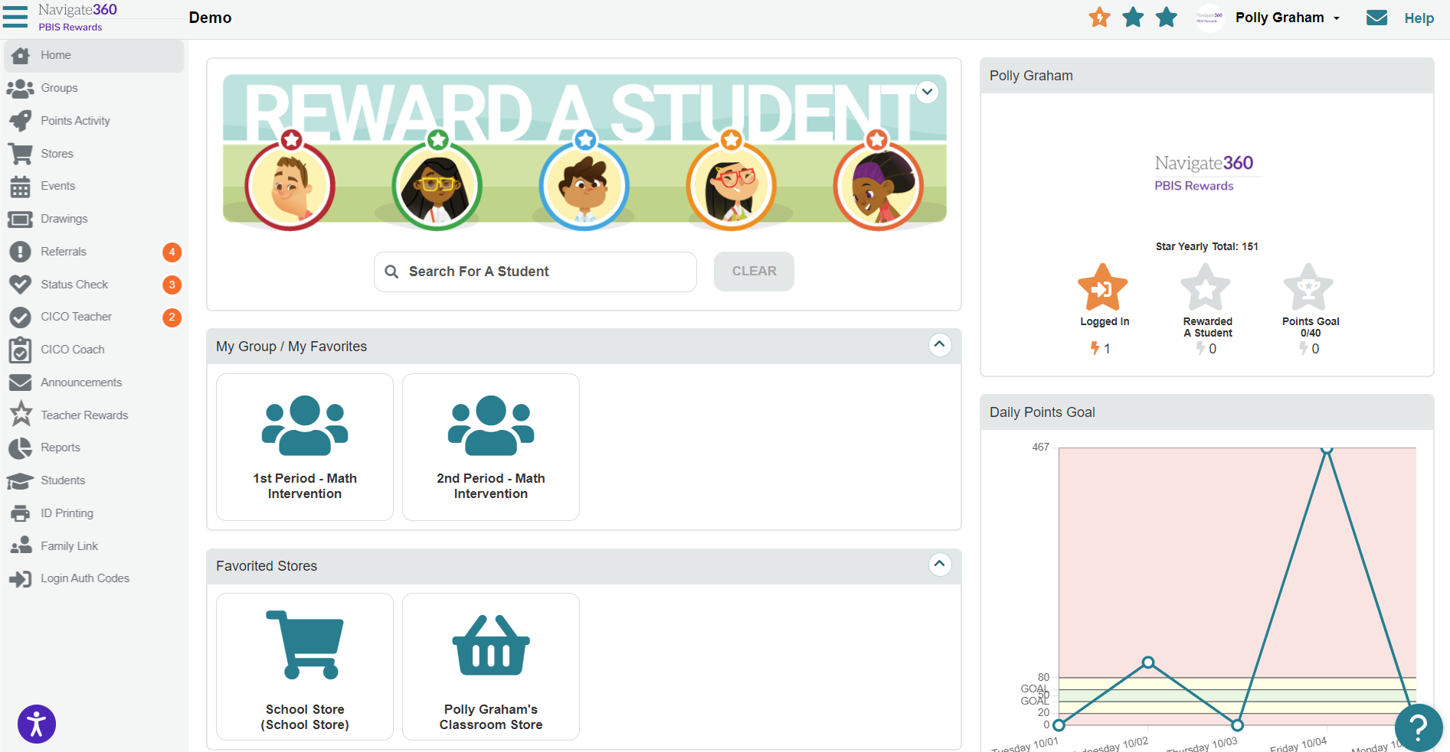
Understanding the Homepage – Identification
Notes:
This is the landing page for PBIS Rewards and serves as the home page. Let’s discuss what we can see on this page! Take note, we can see the staff members name in the upper right-hand corner and the school's name in the upper left-hand corner.

Slide 4
Understanding the Homepage – Star Rewards
Notes:
Beside the staff members name, we will see 3 stars. You can hover over these stars to see how you can earn them or look just below your image in the system.
You can also see that we track streaks as well.
These are provided for doing this each day. If you miss a day, the streak will reset unless this is notated as a non-school day in your in-session calendar through PBIS Rewards.

Slide 5
Understanding the Homepage – DPG Graph
Notes:
Below those stars, we can see a graph showing the last 5 days of points we have provided to students.
We want to try to stay in the green zone or go above that.
Falling below that means you are not implementing PBIS Rewards with fidelity.

Slide 6
Understanding the Homepage – Store Options
Notes:
We can also see our store options here. For most of us, this will be a school store and an individual classroom store.

Slide 7
Understanding the Homepage – My Groups
Notes:
We can also see any groups that have been created for us. If you are syncing with Clever/Classlink, these groups will already be formed for you based on your rosters.
If your school doesn’t use Clever or Classlink, you may need to create groups.
You may also want to create a group for a team you are working with, a small group of students, extra-curricular activities, or even tutoring.
Please share the resource below with your staff to help them understand how this works.
RESOURCE:
Creating a Group: https://support.pbisrewards.com/article/set-up/#h-create-a-new-group

Slide 8
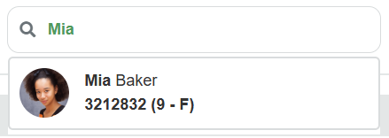
Understanding the Homepage – Rewarding
Notes:
From the home screen we can also reward students in the school.
This is the place you would acknowledge students who are not in your groups or grade level.
Simply type in the first 3 characters of the student’s name and options will appear that match that search.
Select the student’s card that you are searching.

Slide 9
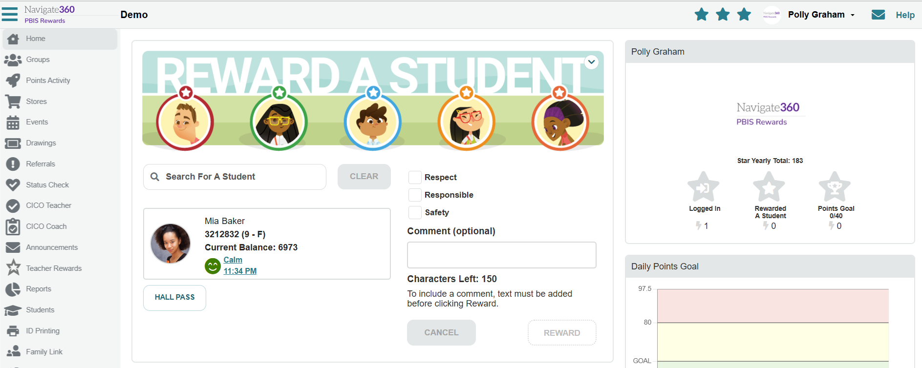
Understanding the Homepage – Rewarding
Notes:
Now that we have selected the card, we can see basic information about the student including their student ID, grade level, gender, and current balance. We can also see their last SEL/Status Check as well, if this feature is being used at your school.

Slide 10
Understanding the Homepage – Rewarding
Notes:
Either to the right or just under this, we will see our schoolwide expectations. Please note, these can be customized for your school by staff with admin permissions.
Select the expectation or expectations you would like to acknowledge by clicking the boxes beside the expectation(s).

Slide 11
Understanding the Homepage – Rewarding
Notes:
Remember, it is imperative to provide behavior specific praise, either verbally or in the system.
What is put in the system is stored there and is accessible to students and families.
I would encourage you to put these in the system occasionally even if giving verbal praise as well.
Remember to link the expectation to the behavior.

Slide 12
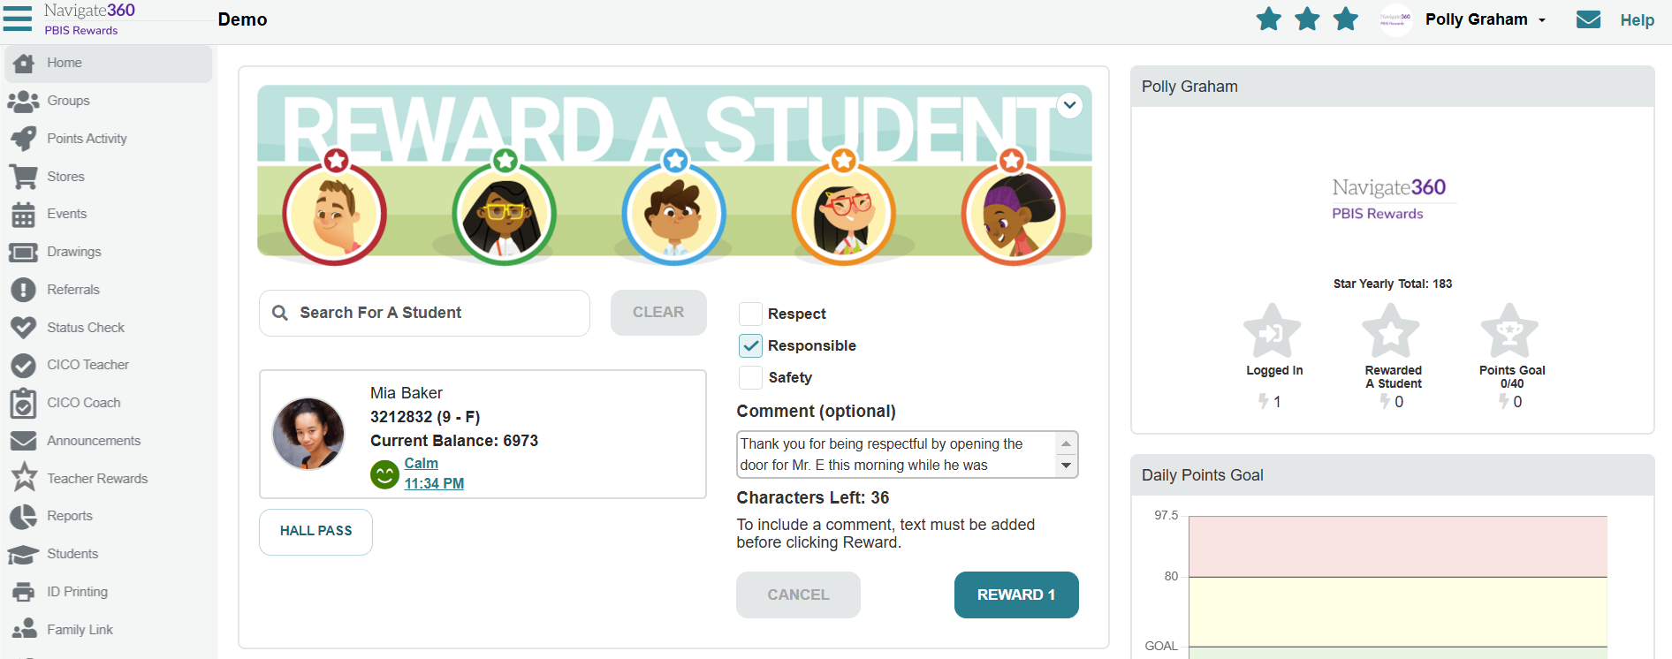
Understanding the Homepage – Rewarding
Notes:
Now that we have everything completed, we see that our Reward button is green, and we can reward the student with the point(s).

Slide 13
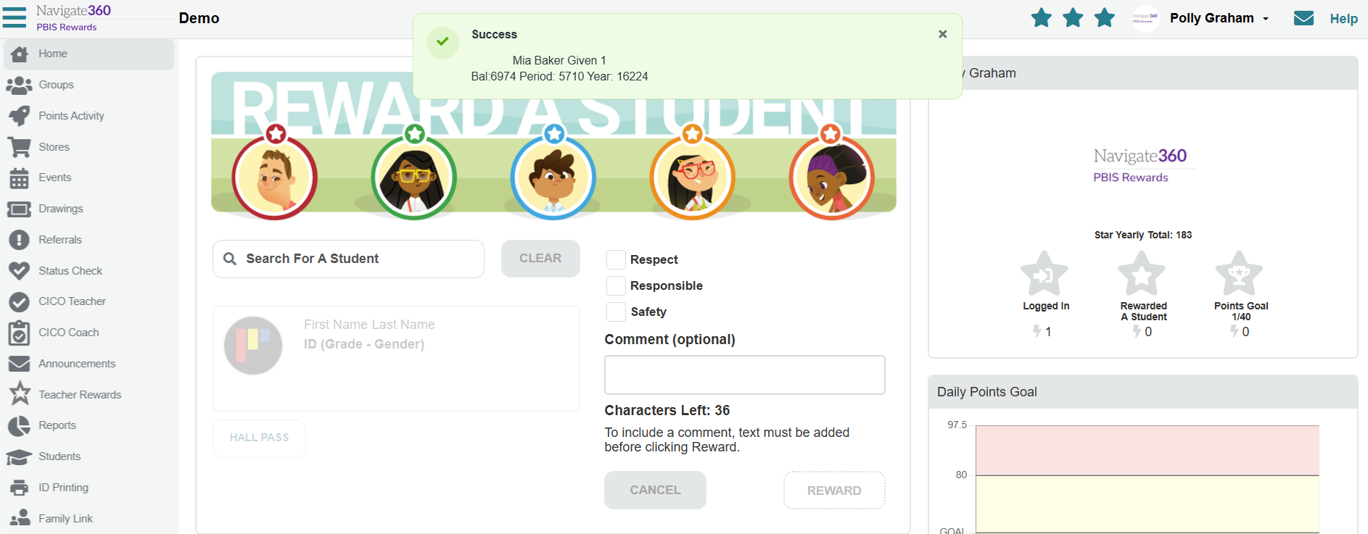
Understanding the Homepage – Rewarding
Notes:
After you provide the point from the home screen, we will see a banner pop up at the top letting us know it was successful.

Slide 14
Understanding the Homepage – Groups
Notes:
Now, we will begin working with groups. Remember, you can access groups from your home screen. You can also access group from the left side menu as well. Select your group. This will take you to the groups page, Remember, as a teacher, if you want to stay in the loop, stay in the group. Almost anything a teacher needs to do with PBIS Rewards can be done from the groups page.

Slide 15
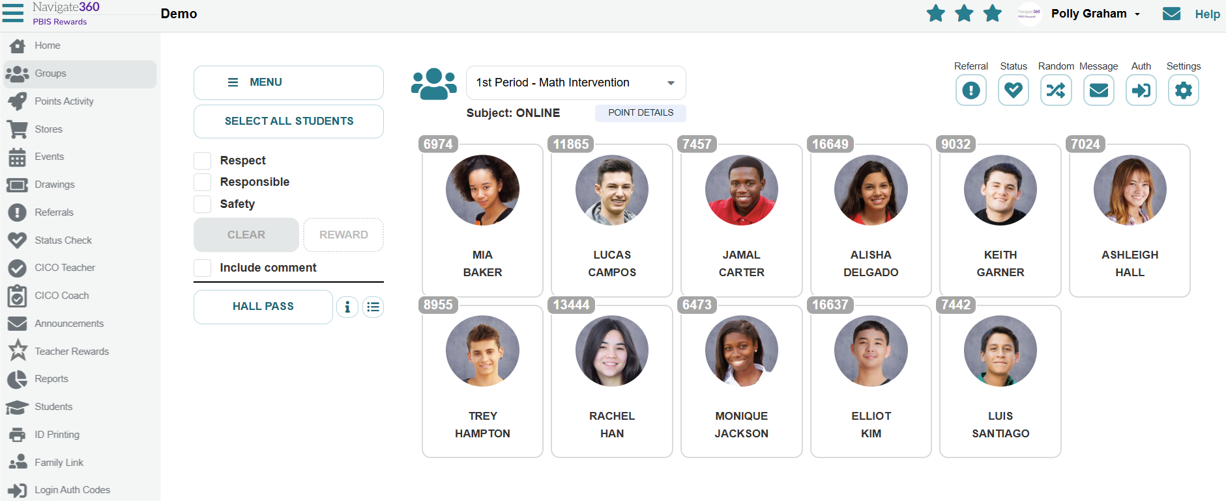
Understanding the Groups Page – Rewarding
Notes:
To reward an individual student with points simply select their card.

Slide 16
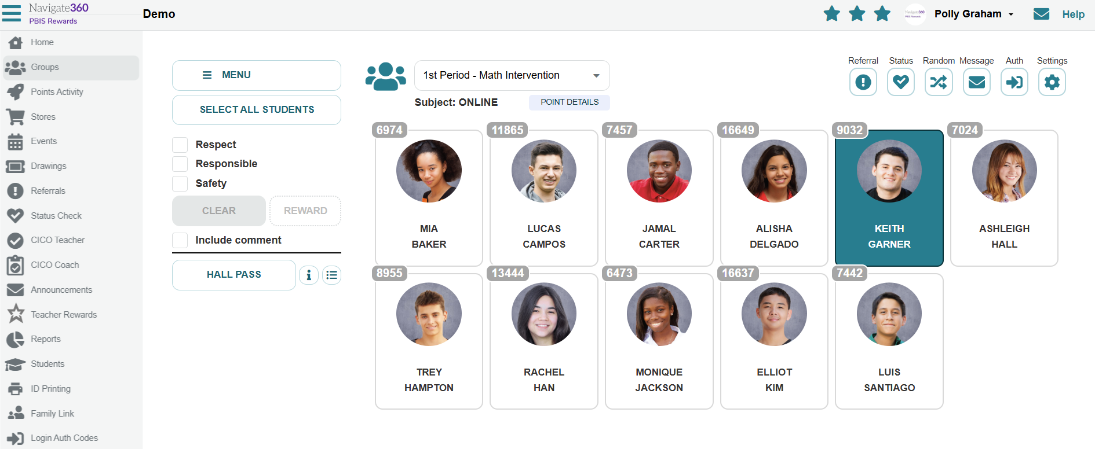
Understanding the Groups Page – Rewarding
Notes:
This will highlight their card in green.

Slide 17
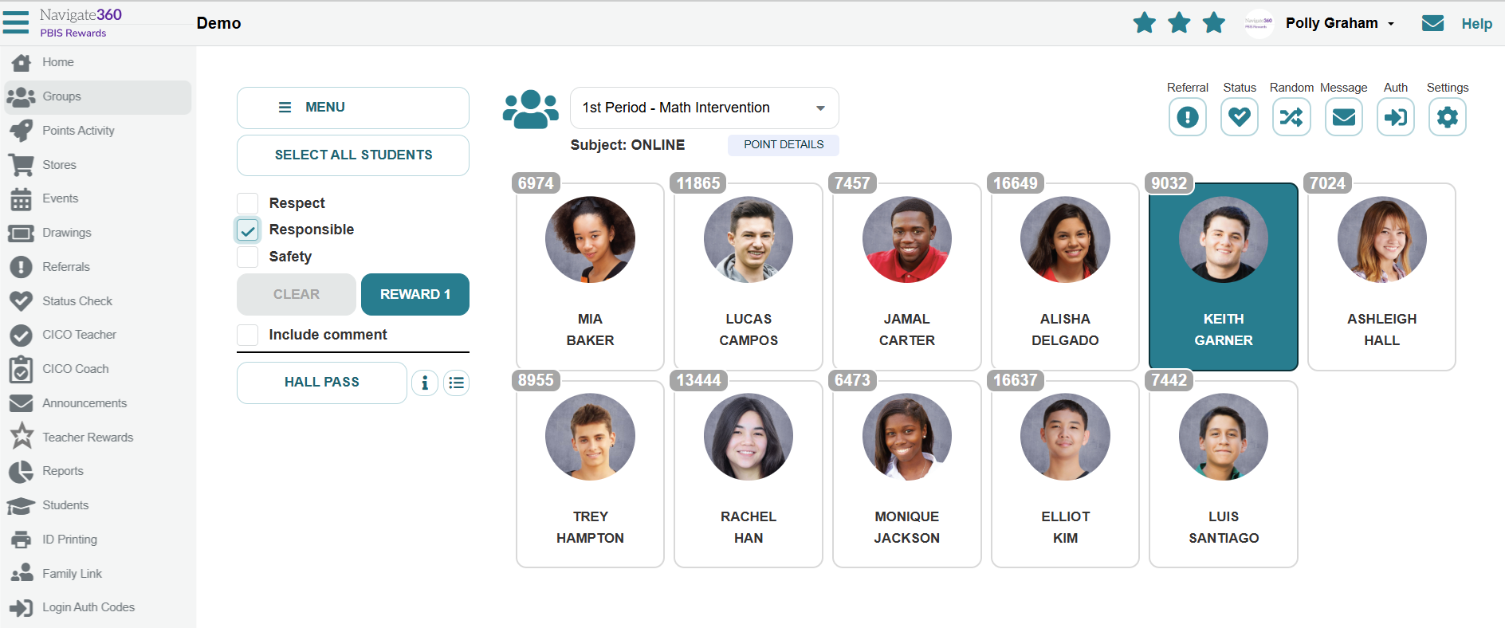
Understanding the Groups Page – Rewarding
Notes:
Now, we will select the expectation and reward the point. You can also select include comment to provide behavior specific praise a well. You will then select the button that says REWARD 1. (CLICK)
Please note, the number will increase if you select multiple expectations.

Slide 18
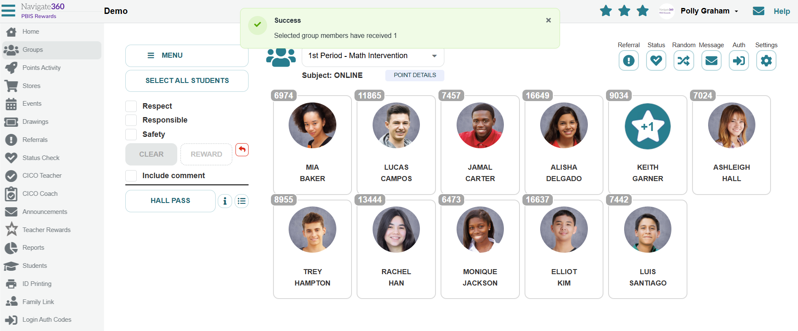
Understanding the Groups Page – Rewarding
Notes:
After you provide points in the groups page, three things will always happen. A star with the number of points provided will show up over the student's card, a banner will appear at the top of the screen, and a sound will be heard.

Slide 19
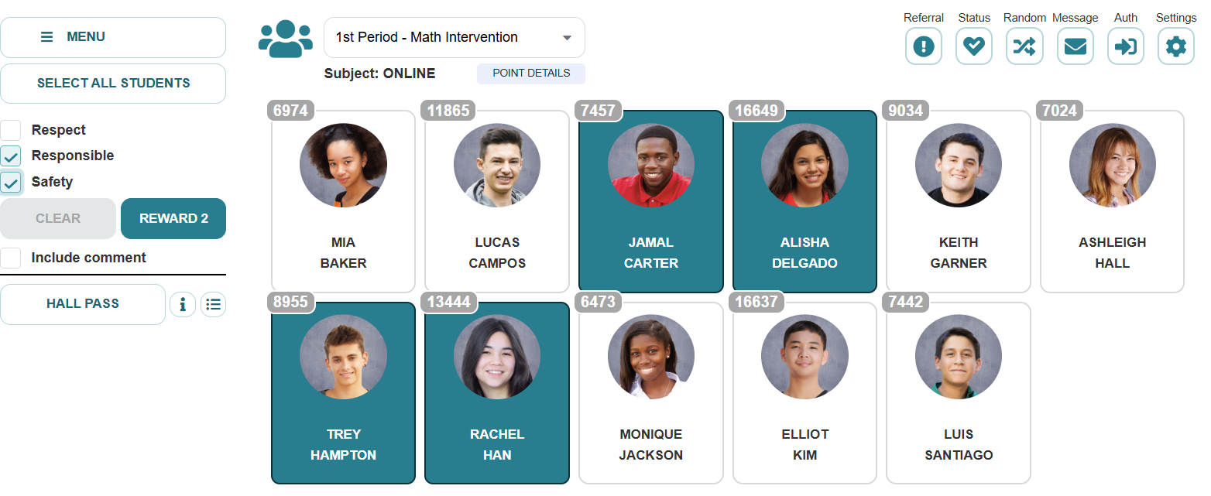
Understanding the Groups Page – Rewarding
Notes:
You can also do this with multiple students. Simply select the students’ cards, then select the expectation(s), and select the REWARD button to provide those students with points.

Slide 20
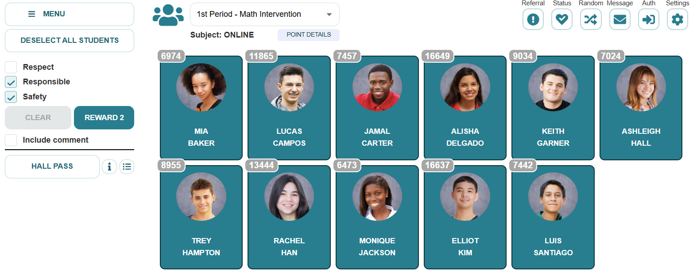

Understanding the Groups Page – Rewarding
Notes:
This can also be done for your whole class with a few clicks. First SELECT ALL STUDENTS in the upper left-hand corner. (CLICK)
Next, select the expectation(s) you would like to acknowledge. (CLICK)
Finally, select the REWARD button to provide your whole class with these points.

Slide 21
Understanding the Groups Page –
Changing Groups
Notes:
If you need to move between your groups, you can always use the drop-down here which lists all the teacher’s groups or any group that has been favorited in the system.

Slide 22
Understanding the Groups Page –
Point Details
Notes:
Clicking here, you can see point details for your group. These are broken down into daily points, grading period, YTD, and students’ current balance for each student. Let’s take a look.

Slide 23
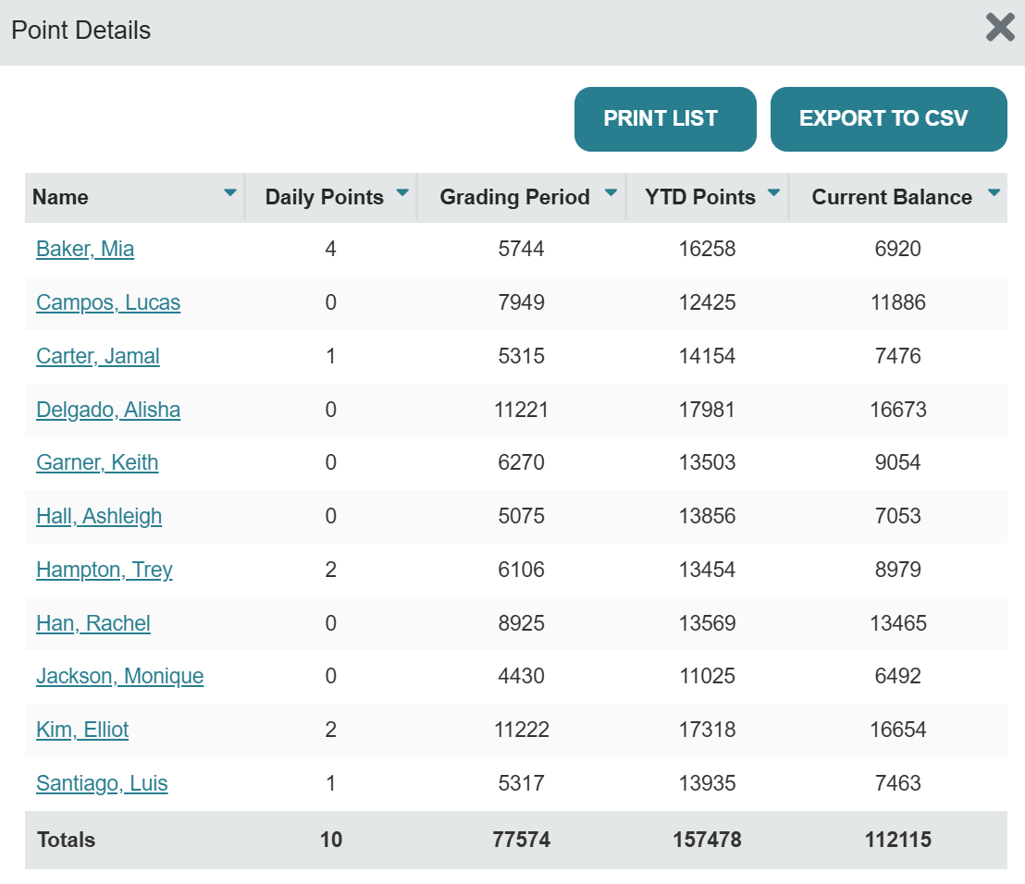
Understanding the Groups Page –
Point Details
Notes:
From here, you can easily click on student names to view their student dashboard. This is also an easy way to navigate to the student dashboard to add custom interventions as well, if needed.

Slide 24
Understanding the Groups Page –
SEL/Status Checks
Notes:
From the groups page you can also view the statuses of students in your group or complete a SEL/Status Check for a student or a group of students.

Slide 25
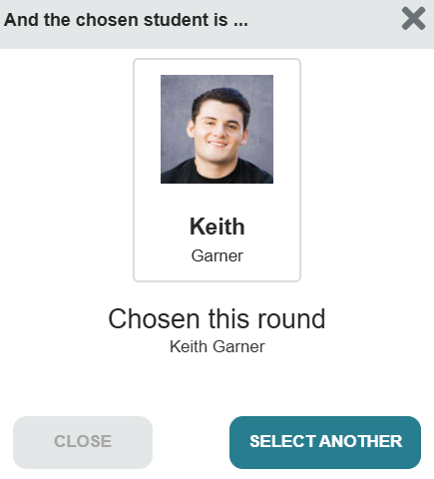
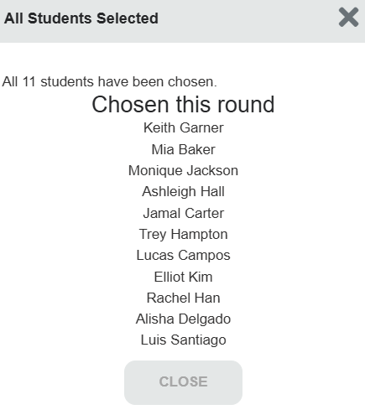
Understanding the Groups Page –
Random Button
Notes:
Another great feature offered in PBIS Rewards is the RANDOM Button. This can be used with a few students in the group or the whole group. This will allow you choose a child for a classroom job, to answer a question, or assist you with a task. (CLICK)
To use the random button for your whole group, first select all of your students and select the RANDOM button. (CLICK)
As you can see, it will choose a student for you. You can continue to select another student until you go through your whole group if you want to use this to assign partners or groups as well. (CLICK)
Here you can see all of your students randomly sorted. You can then assign them to partners or groups using this. For example, if I were creating partners (Keith & Mia, Monique & Ashleigh, Jamal & Trey, etc.).

Slide 26
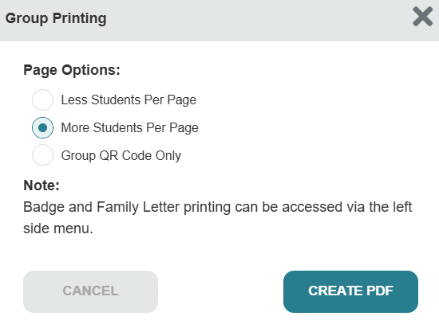
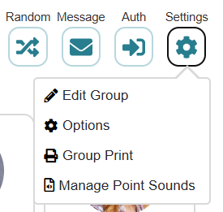
Understanding the Groups Page –
Settings – Group Print
Notes:
You also have setting available for your groups. You can see the options available by clicking on the setting cogwheel in the upper right-hand corner. (CLICK)
Let’s dive into how to do a group print page. (CLICK)
Select the option you would like from the options provided. You can even print the group QR code and hang this on your door or put it on the back of your staff ID so other staff members can easily reward your class when they see them demonstrating expectations. (CLICK)
Now, select CREATE PDF to download this PDF to your computer. This will open a file for you to print.

Slide 27
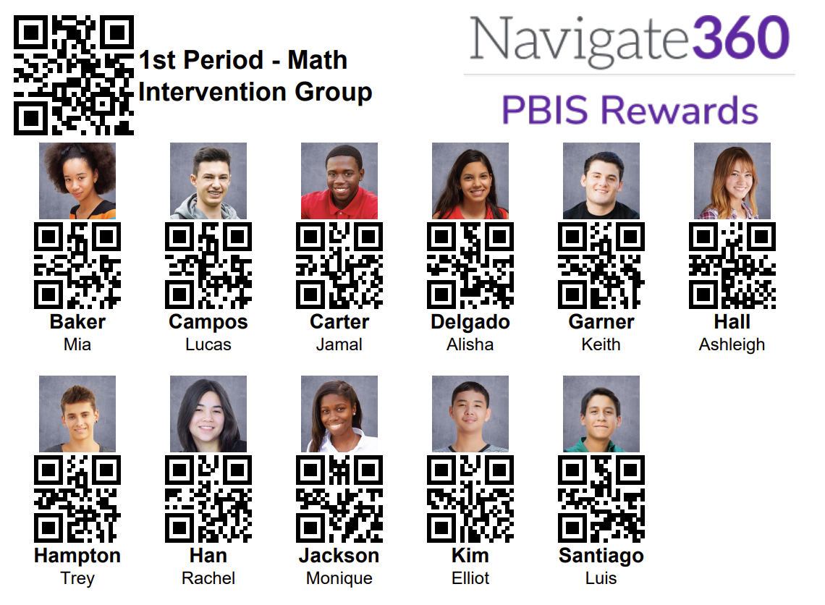
Understanding the Groups Page –
Settings – Group Print
Notes:
This is what the group print will look like. (CLICK)
You can use your staff app and scan any of the individual students QR codes to assign points to that student. (CLICK)
You can also scan the group code from your staff app and it will select all students in your class. You can certainly deselect students from this if necessary.

Slide 28
Let’s Go LIVE in
PBIS Rewards
Using Test Students
Notes:
This is a good time to make sure your staff practice using the system using a test student. They can even add the test student to their groups page as well.

