Slide 1

Getting Started with
PBIS Rewards
Part 3

Slide 2
Redeeming in PBIS Rewards
Stores, Events, & Raffles/Drawings
Notes:
In this section, we will discuss how to redeem points in various ways – the store, events and raffles.
RESOURCES TO SHARE:
Redeeming in PBIS Rewards: https://support.pbisrewards.com/article/redeem/

Slide 3
Stores
Notes:
Using Stores is the most popular redeeming option in schools today. Let's examine how these are setup in PBIS Rewards.
RESOURCES TO SHARE:
Set-Up Store Article: https://support.pbisrewards.com/article/store/#Set-up-the-school-store
Store Article (How it Works): https://support.pbisrewards.com/article/store/

Slide 4
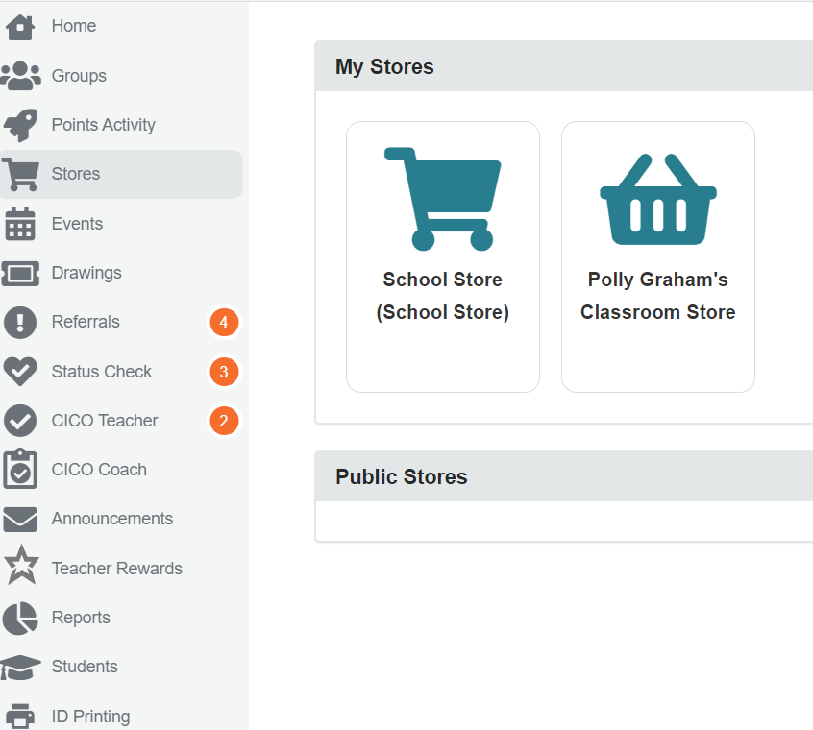
School Store Versus My Store
-Visible to ALL staff members
-ALL staff members can sell items from School Store
-Students can purchase from School Store (if that feature is turned on)
-Visible to TEACHER ONLY
-TEACHER ONLY can sell items from My Store
-Students can purchase from My Store (if that feature is turned on)
Notes:
There are 2 types of stores in PBIS Rewards. The School Store and the My Store (the teachers’ individual stores). (CLICK)
The School Store is visible to all staff and all staff can sell items from the School Store (CLICK)
The My Store, on the other hand, is only visible to the teacher in charge of the group.
Please note, if student purchasing is turned on in your school, students can purchase from the school store and any teachers store if they are a part of one of the teacher’s groups.

Slide 5
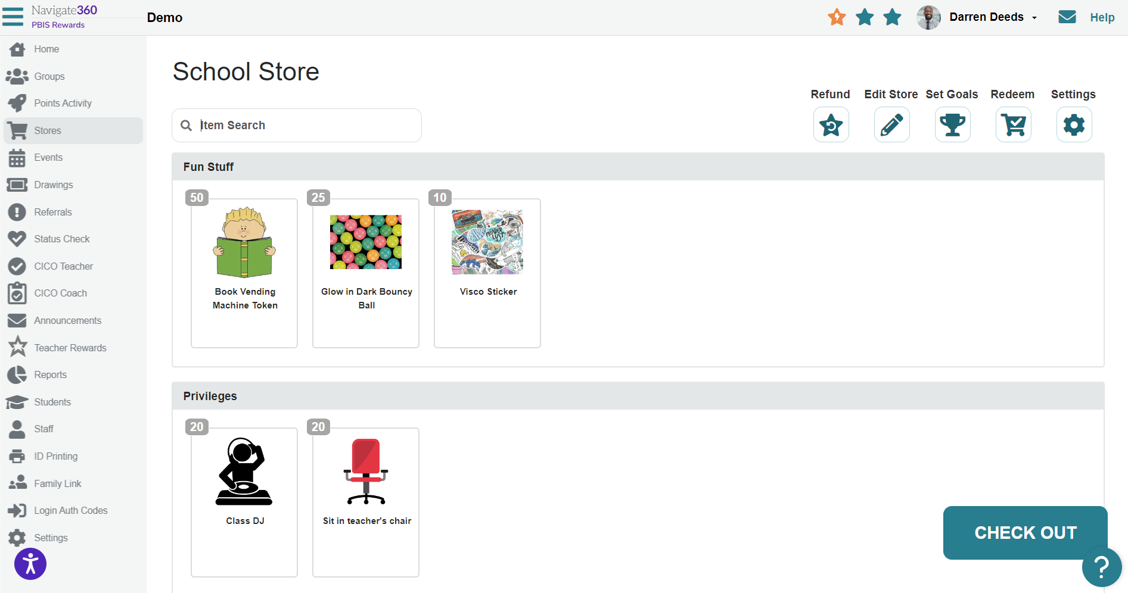
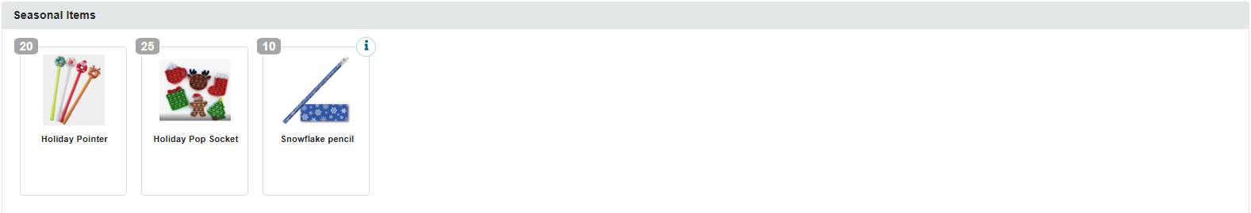

Store Setup Overview
Notes:
From the store tab, you can edit your school store and teacher store. These work the same way. Only admin and redeem admin can edit the school store. To edit, click the pencil. (CLICK)
This will allow you to add items, set a sale, or even create categories to organize the store. (CLICK)
Here is an example of a category you can create. We have a seasonal store here. Other categories may include Privileges, School Spirit, Snacks, school Supplies etc. You may also use a Chuck-E-Cheese method, where categories are point values (everything in this category is 10 points, everything in this category is 20 points, etc.). This is particularly useful for early elementary students. (Click)
Pictures can be added to each item (great for pre-reading students to shop)
In the upper left hand corner, you see a gray bubble and a number. Any guesses as to what that number stands for? (this is the cost of this item) (CLICK)
You may also check out from this page in addition to redeeming in the groups page (redeem menu) (CLICK)
You can check your redeem and approval queues here. Let’s take a look at how this works.

Slide 6
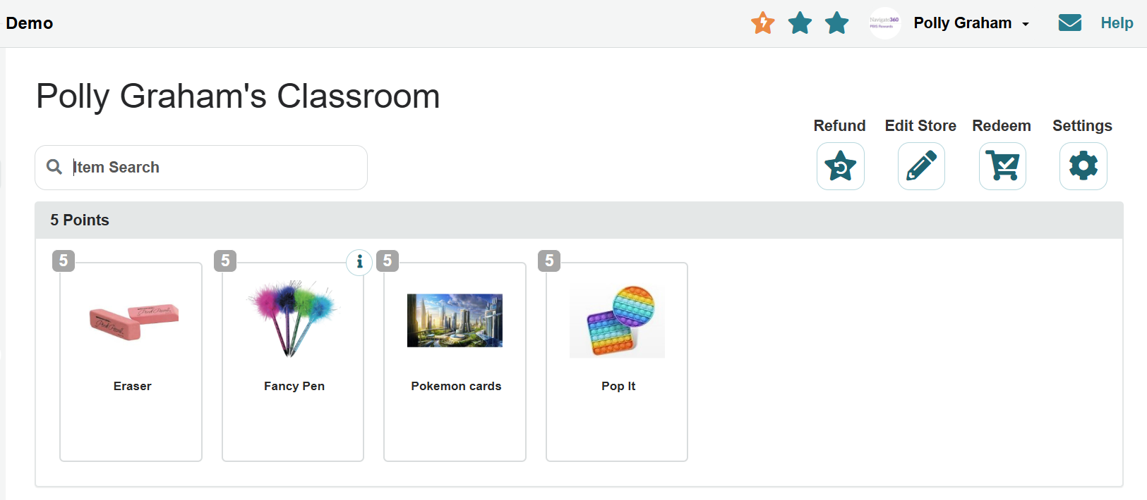

Understanding the Approval Queue
Notes:
When we click the shopping cart, we can navigate to the redeem purchases or approve purchases queue. (CLICK)
Lets first check our approved purchases. These are purchases students make if student purchasing is turned on in your stores.

Slide 7
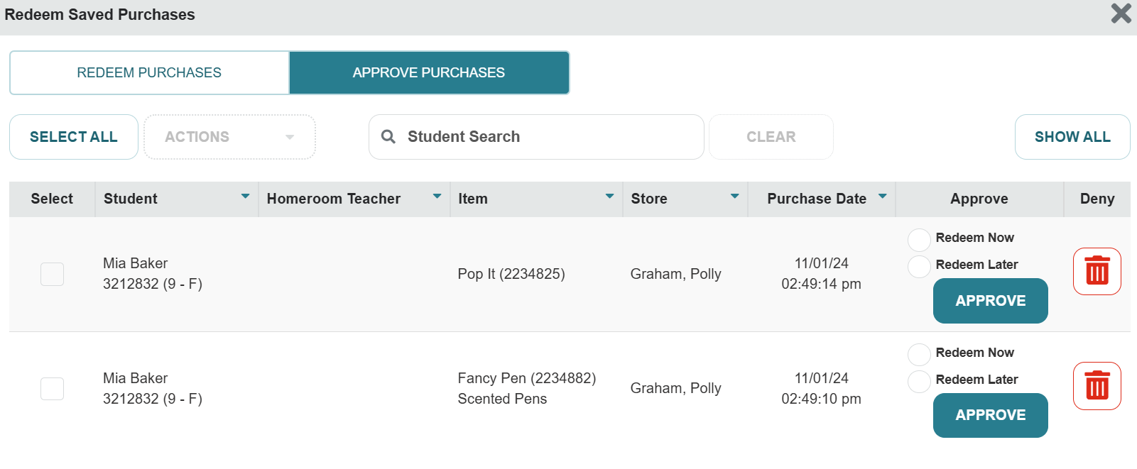
Understanding the Approval Queue
Notes:
This is the approval queue. (CLICK)
In this column, we can approve the purchase. Remember, if you are not handing the student their item immediately, select redeem later. This will move the item to the redeem queue until you are ready to deliver the item(s) to the student.

Slide 8
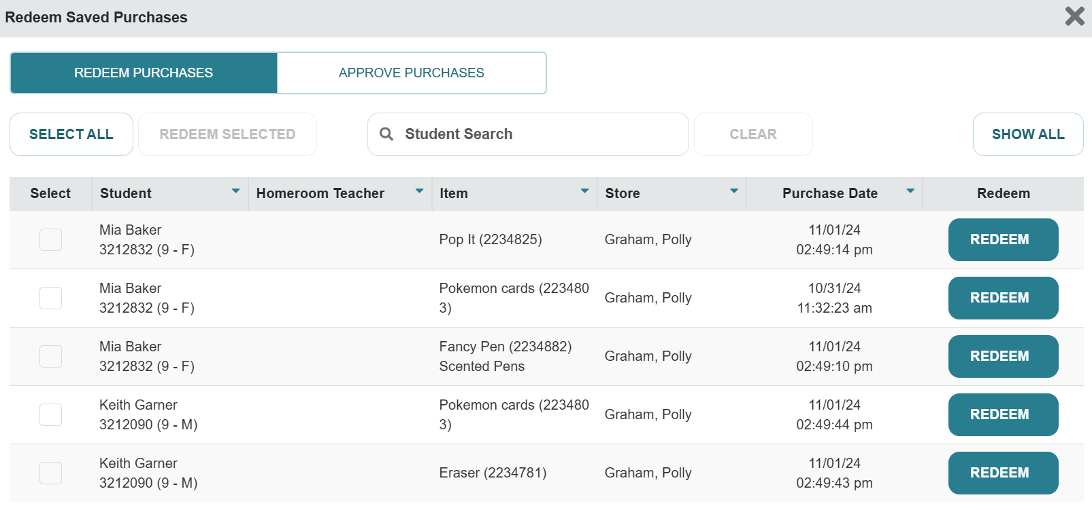
Understanding the Redeeming Queue
Notes:
From the redeem queue, you will select show all (CLICK)
This will show all items that need to be redeemed and delivered to the student. (CLICK)
When you have the item delivered or ready for delivery, you can select redeem. This will remove the item from your queue.

Slide 9
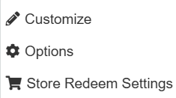
Classroom Store Settings
Notes:
You also have setting you can manage in your store. (CLICK)
When we click on the setting cogwheel, we will see our options available (CLICK)
Lets take a look at each of these options.

Slide 10
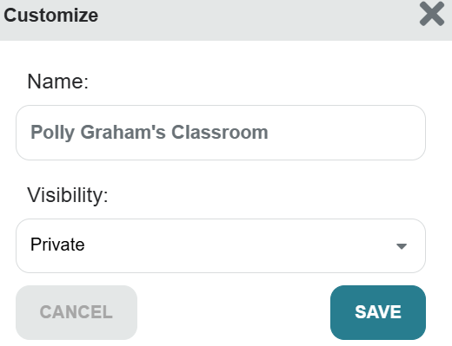
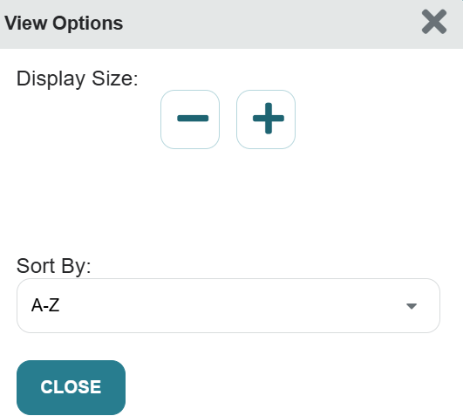
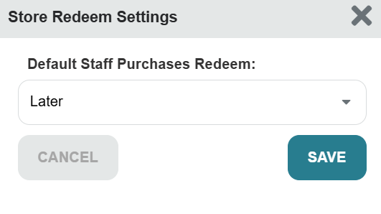
Classroom Store Settings
Be sure to use the customizations available to ensure your store is ready
You can customize the audience (Private is recommended)
You can also determine your viewing options
Set your default options for purchasing (Later is recommended)
Notes:
Be sure to use the customizations available to ensure your store is ready
You can customize the audience (Private is recommended)
You can also determine your viewing options
Set your default options for purchasing (Later is recommended)

Slide 11
Events
Notes:
We will now look into ways we can incorporate events into our redeeming options
RESOURCE TO SHARE:
Create an Event Guide: Creathttps://support.pbisrewards.com/guides/create-an-event/

Slide 12
3 Types of Events
Redeem = Cost Points
Qualify = Point Goal
Reward = Earn Points
Notes:
Create an Event Guide: https://support.pbisrewards.com/guides/create-an-event/
Redeem – same as redeem raffle (cost)
Qualify – No Cost- students must reach a point goal
Award – if they attend event, they can earn points from year to year. EX: Open House, Honor Roll, turning in paperwork at the beginning of the year, PTO, Afterschool Tutoring, etc.
Events will not roll from year to year

Slide 13
Elementary Event Ideas…
Popcorn Party
School Dance
Student vs Teacher Game
(volleyball, kickball, dodgeball, etc.)
Holiday Party
Family Night
Field Day
Movie
Painting Party
Dress up Day
(Superhero, PJ's, Princess, Book Character)
Hat Day
Crazy Sock Day
Carnival
Snow cone day
Talent Show
Special Lunch
(Chick fil A, McDonalds etc.)
Stuffed Animal Day
PBIS Olympic Games
Reward Events:
Parent Meeting
School Sporting Event
Turning in Paperwork
Afterschool Tutoring

Slide 14
Secondary Event Ideas
Admission to school events
                (school dance or sporting event)
                Dodge ball tournament
                Teacher vs. student basketball game
                Afternoon movie
                Bingo game for prizes
                Cell phone charging time
                Lunch with teacher or coach
Decorate a ceiling tile or Happy Corner
                Class dance party
Use headphones or technology in class
Duct tape teacher/admin. to wall
Class recess
Reward Events
Parent meeting
School sporting event
Turning in paperwork
After-school tutoring
Extracurricular activities
Coming to school on a Friday

Slide 15
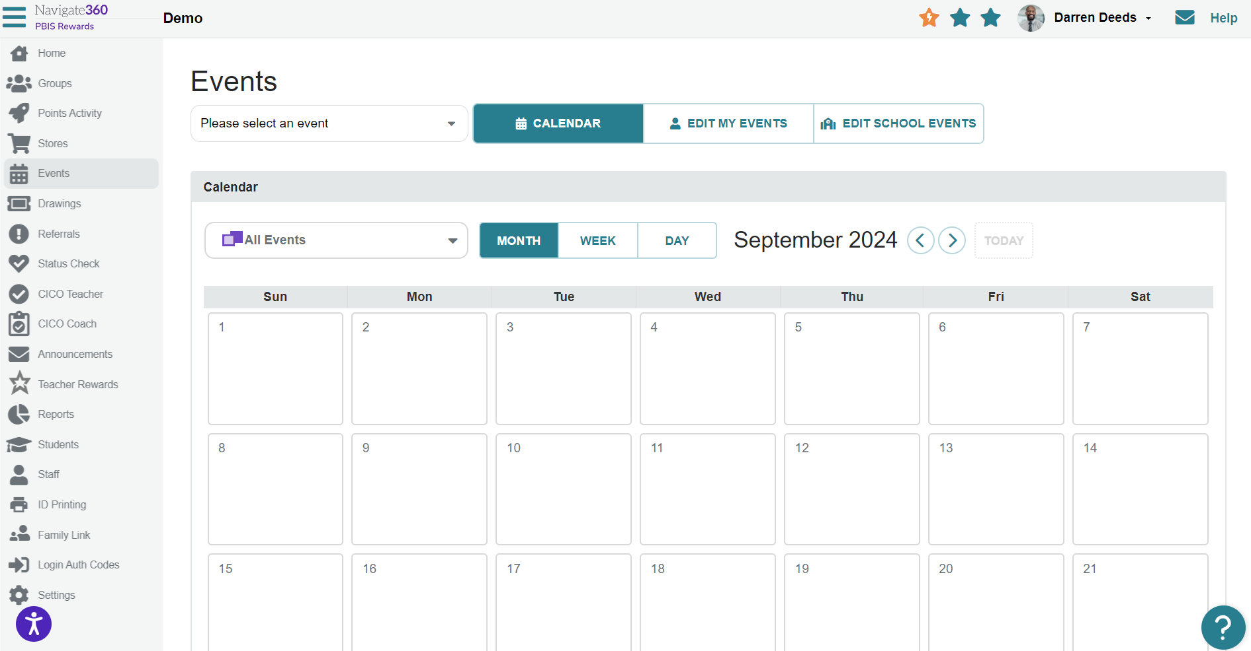
Event Setup
Notes:
From the events tab, you can select any events that you have created for your class or the school by selecting this drop-down. (CLICK)
You can also edit the events. Remember, only admin and redeem admin will be able to edit school events. (CLICK)
This information will show in your calendar. This will only show school events and the events you created. Admin can see these events in the reports section under redeem reports.

Slide 16
Raffles/Drawings
Notes:
RESOURCE TO SHARE:
Create Raffles Guide: https://support.pbisrewards.com/guides/raffles/

Slide 17
Redeem = Points to Enter
Qualify = Points Earned
2 Types of Raffles/ Drawings
Notes:
Create Raffles Guide: https://support.pbisrewards.com/guides/raffles/
Two Types of Raffles:
Redeem – Use Points from backpack to enter. 1 point per entry. EX: Amazon Gift Card.
Qualify – Enter raffle based on points they have earned in their backpack of points. EX: If they have earned 100 respect points this school year, they are entered in a raffle for movie tickets provided by the local cinema.
Ask students what items should be raffled off, they are full of ideas we never think about!!
EOY Redeem Raffle – use 100% of points (clears out all points) – Use of points that are meaningful and start new year over fresh

Slide 18
Raffles/Drawing Ideas
Admission to school events
(school dance or sporting event)
                Gift cards
                Store memberships
                Subscriptions
                Family movie pass
                Tablet
                Mystery Bags
                Cell phone chargers
                Gaming system
                Video games
Principal for the day
Lego sets
Gift baskets

Slide 19
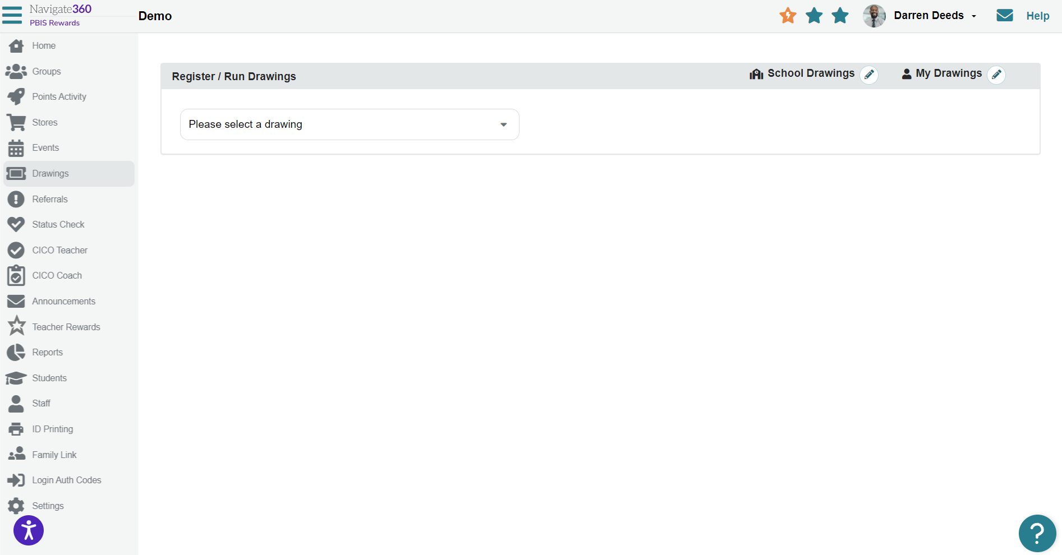
Raffles/Drawings Setup
Notes:
From the raffle/drawing tab, we can add new drawings or edit what we have created. (CLICK)
Only admin and redeem admin can edit school raffles/drawings. (CLICK)
In this drop-down, we can select the raffle/drawing.

Slide 20
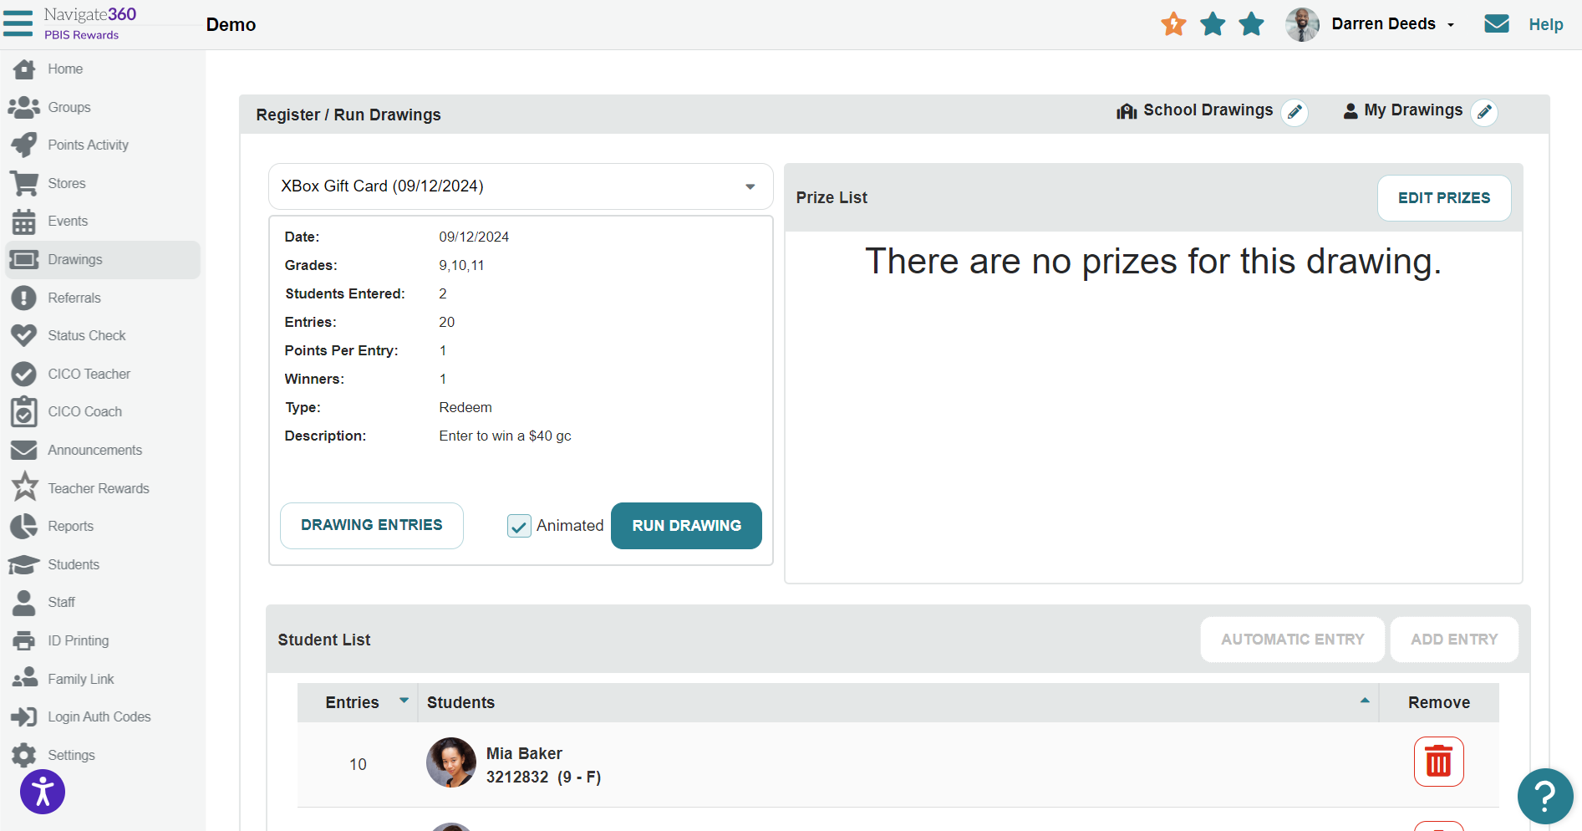
Running a Raffle/Drawing
Notes:
When we select a raffle or drawing, we can see the registered students at the bottom. (CLICK)
You can also remove students or add students here, if needed (CLICK)
When we are ready to run the raffle, we can select run raffle/drawing (CLICK)
Be sure the animated option is selected to hear the drum roll and see the confetti. This can only be done on the day of the raffle/drawing.

Slide 21
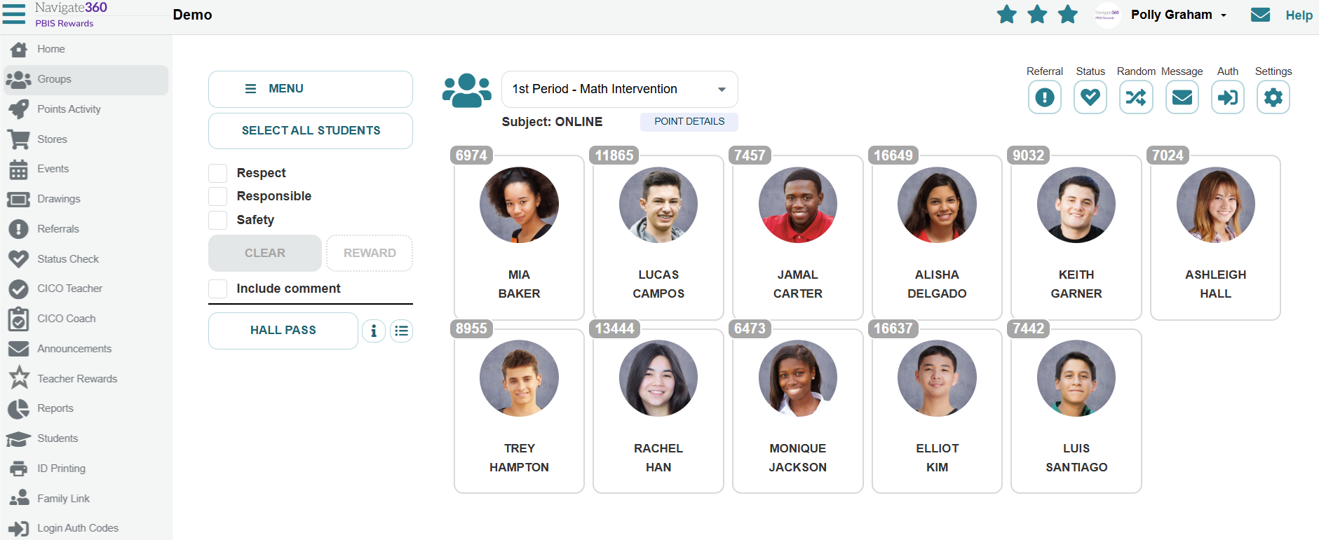
Understanding the Groups Page –
Redeem Menu
Notes:
As I mentioned before, you can also checkout from the groups page. This can easily be done by selecting the Redeem MENU.

Slide 22
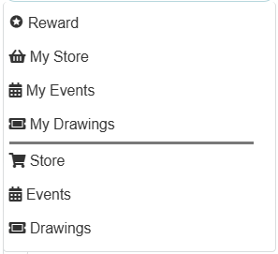
Understanding the Groups Page –
Redeem Menu
Notes:
At the top you will see all of the teacher’s individual redeeming options and at the bottom we can see our school-wide redeeming options.

Slide 23
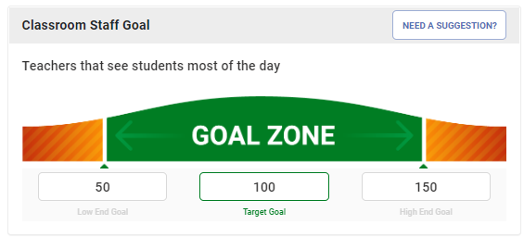
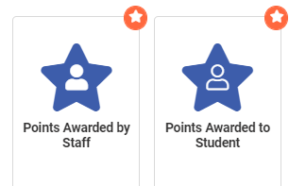
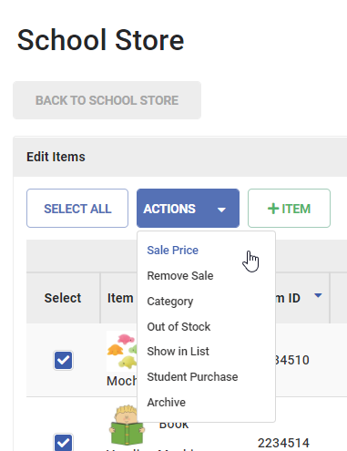
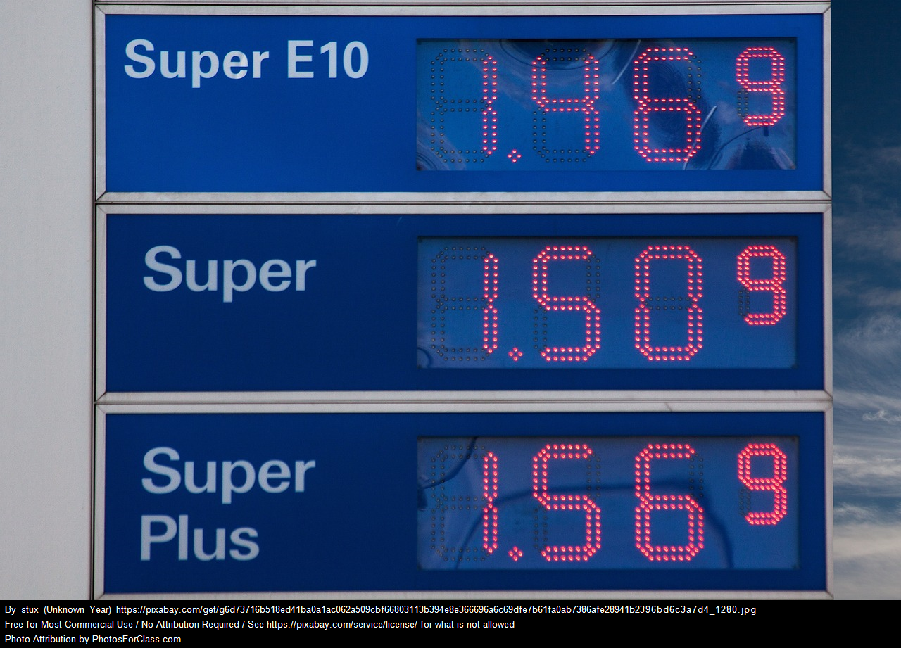
Setting Prices
Use POINT REPORTS to determine the number of points earned.
DAILY POINT GOALS – time to earn points
Price items on HIGH side.
Students like when prices come DOWN.
Put items on SALE in the School Store.
QUANTITY of items –
  Lots of items, lower prices
  Fewer items, higher prices
Notes:
Here are some ways we can set up prices in our redeeming options.

Slide 24

Incentives Jackpot
Notes:
Ultimate Incentives List: https://www.pbisrewards.com/pbis-incentives/

Slide 25
Let’s Go LIVE in
PBIS Rewards
Using Test Students
Notes:
This is a good time to allow your staff to test their ability to redeem points for students in PBIS Rewards using a test student.

