Slide 1

Getting Started with
PBIS Rewards
Part 4

Slide 2
Behavior Referral System

Slide 3
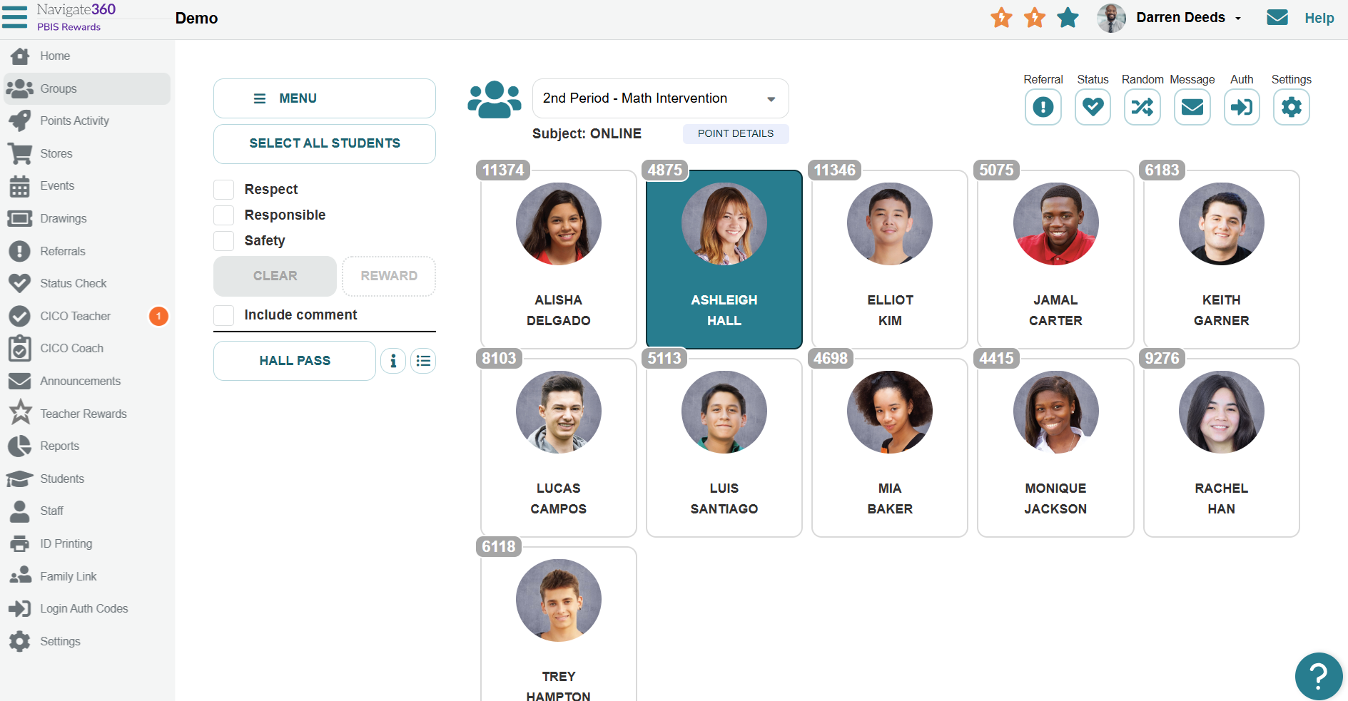
Writing a Minor Referral
Notes:
Select the groups tab and open your group (CLICK)
Next -Choose a student (CLICK)
Now, we will select referral.

Slide 4

Writing a Minor Referral
Notes:
This will open our referral options. Let's begin by exploring the minor referrals.

Slide 5
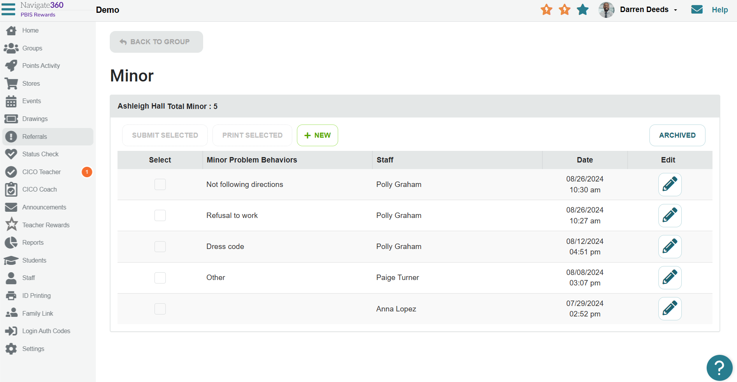
Writing a Minor Referral
Notes:
Here we can see all minor referral for this student. Depending on admin settings, we may see all minors for the students or minors that were written by you for the student. (CLICK)
We can select these minors to combine them and submit them as a major referral.

Slide 6
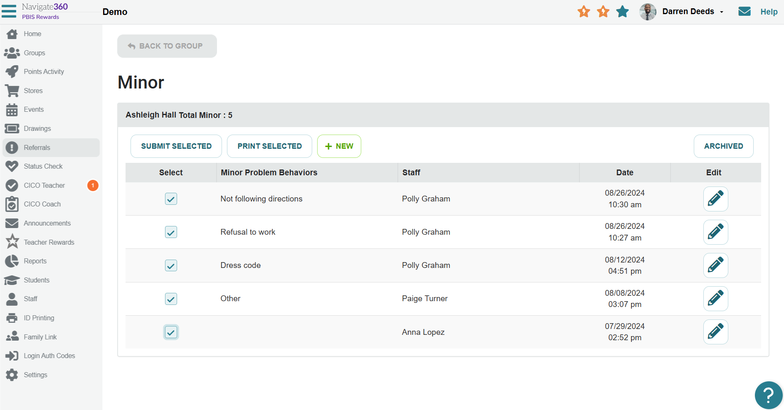
Writing a Minor Referral
Notes:
Repeated minors are selected here. We will then select submit selected if we are combining these and turning them into a major referral. This is done when we see a pattern of behavior (CLICK)
If we are writing a new minor referral, we select new here (CLICK)
This will open the minor referral form.

Slide 7
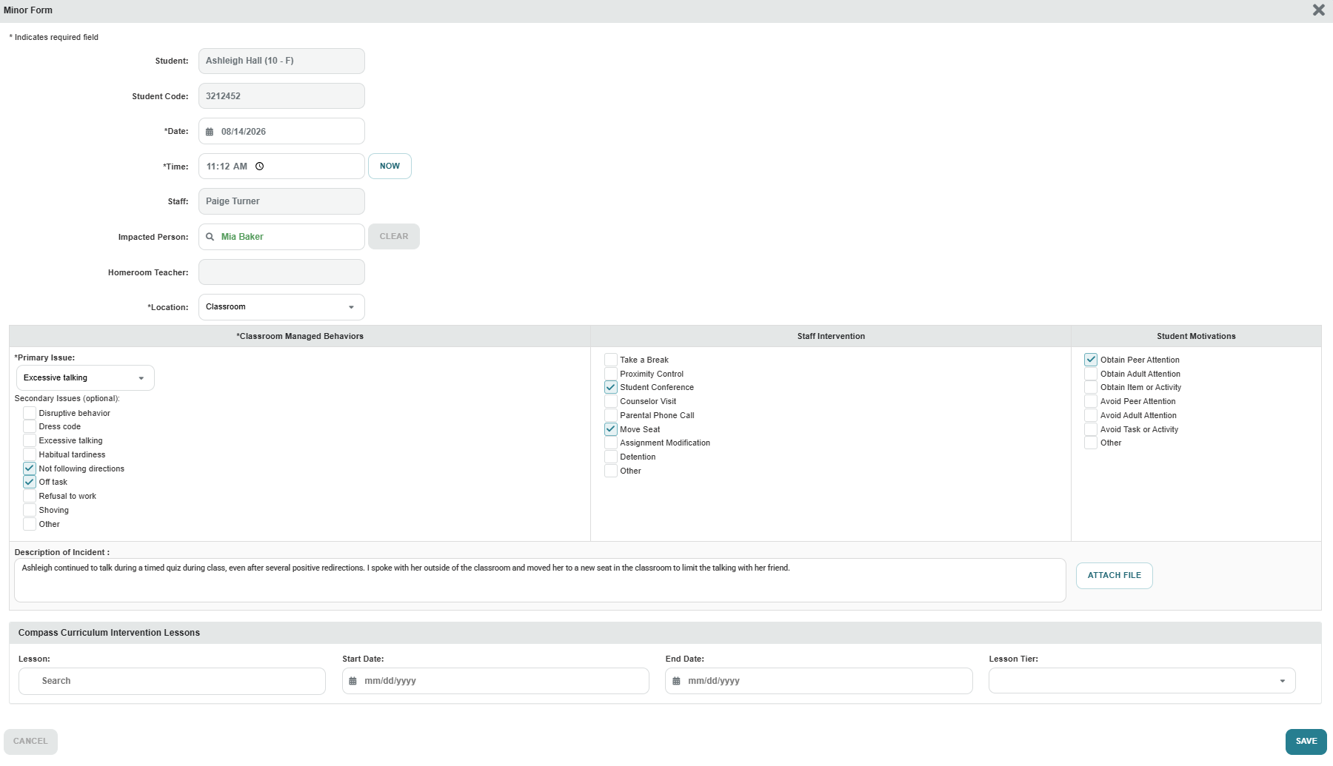
Some fields automatically filled. Be sure to input the time of the incident
Who was impacted?
Location of incident
Primary MINOR Issue
Secondary MINOR Issue(s)
A Compass Curriculum lesson may be assigned
Notes:
Entering details of minor (classroom managed)
Admin. will only be notified if minor form if that setting is turned on. (they will receive an email and message in system when students have a specific number of minor forms)
After you have completed all details, you will simply save. This will store this referral and make it visible for families. It may also be shown on the student portal, if that option is turned on in the admin settings.

Slide 8
Writing a Major Referral
Notes:
Select the groups tab and open your group (CLICK)
Next -Choose a student (CLICK)
Now, we will select referral.

Slide 9
Writing a Major Referral
Notes:
Let’s explore the major referral

Slide 10
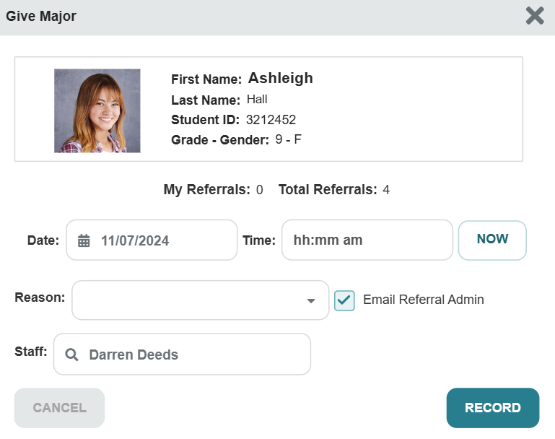
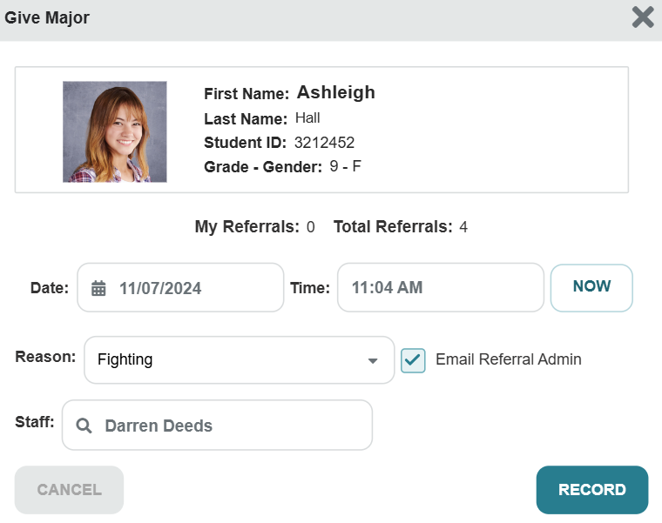
Writing a Major Referral
Notes:
Different from the minor form, with a major form, we will get a pop up to complete first. Fill out this information. (CLICK)
You can even select to email this to the referral admin immediately by clicking here (CLICK)
Once all information has been inputted, we then select record (CLICK)
This will open the major referral form.

Slide 11
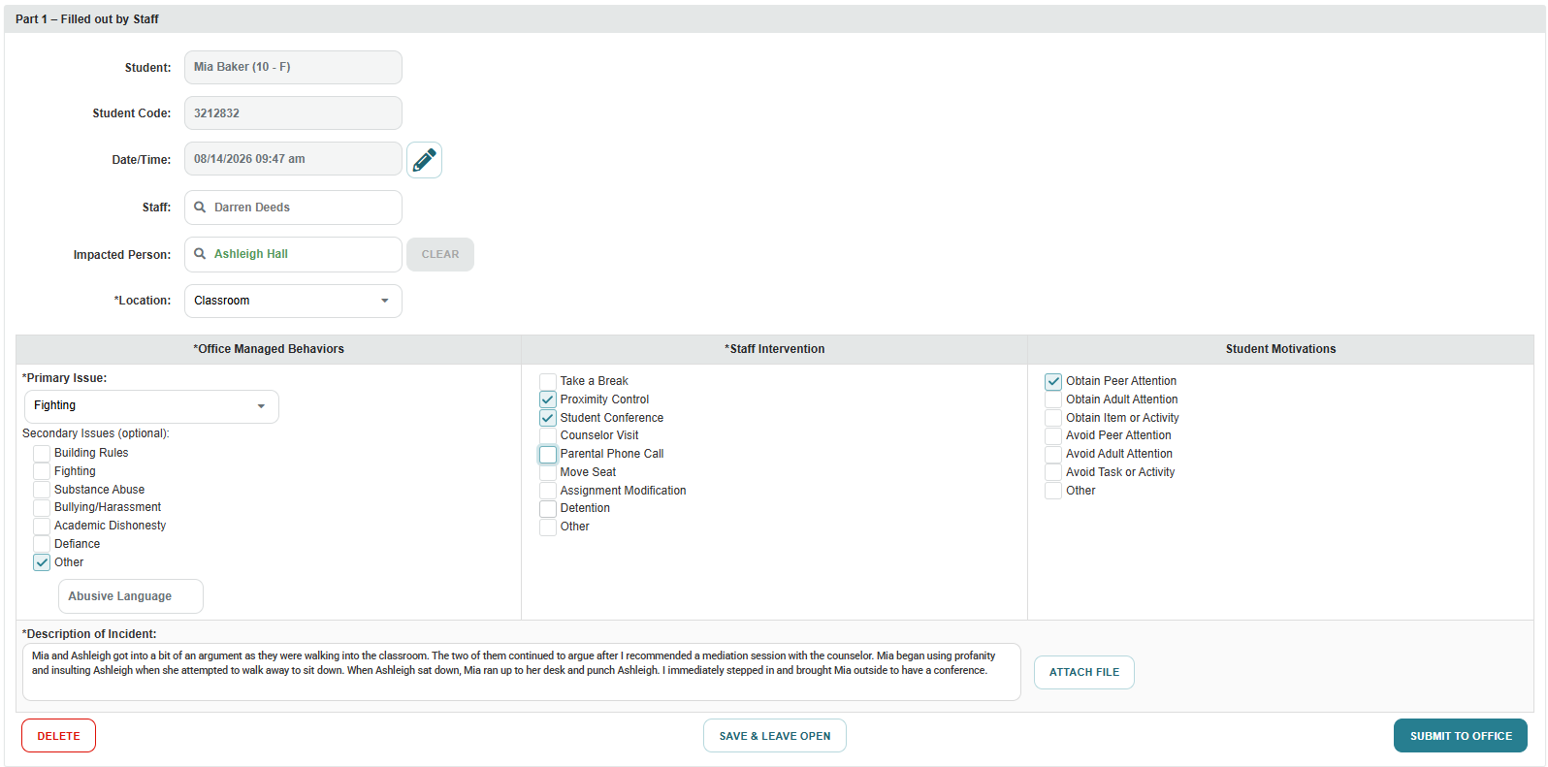
Some fields automatically filled
Who was impacted?
Location of incident
Primary MAJOR Issue
Secondary MAJOR
Issue(s)
Notes:
Similar form appearance to minor but fields contain different behaviors/issues. Be sure all sections with a star have been completed or the submit option will not turn green and allow you to submit this to the office. Give as much information as possible for your administrators.

Slide 12
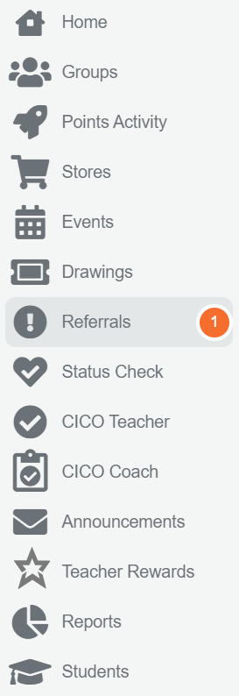
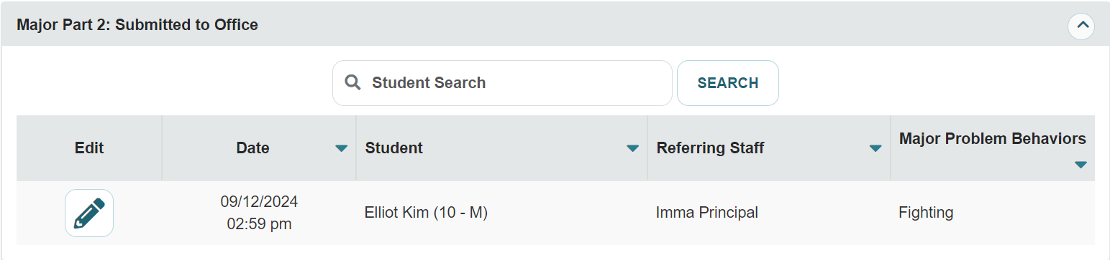
Processing Major Referrals
Notes:
After these are submitted to the office, administrators will receive an alert.
You will then open that tab and click on the pencil to finish processing the referral. We can see some basic information here and the pencil will allow us to see the full referral. Admin will process these referral by selecting the pencil in the Major Part 2 which are referrals that have been submitted to the office. (CLICK)
To finalize and process the referral, select the pencil..

Slide 13
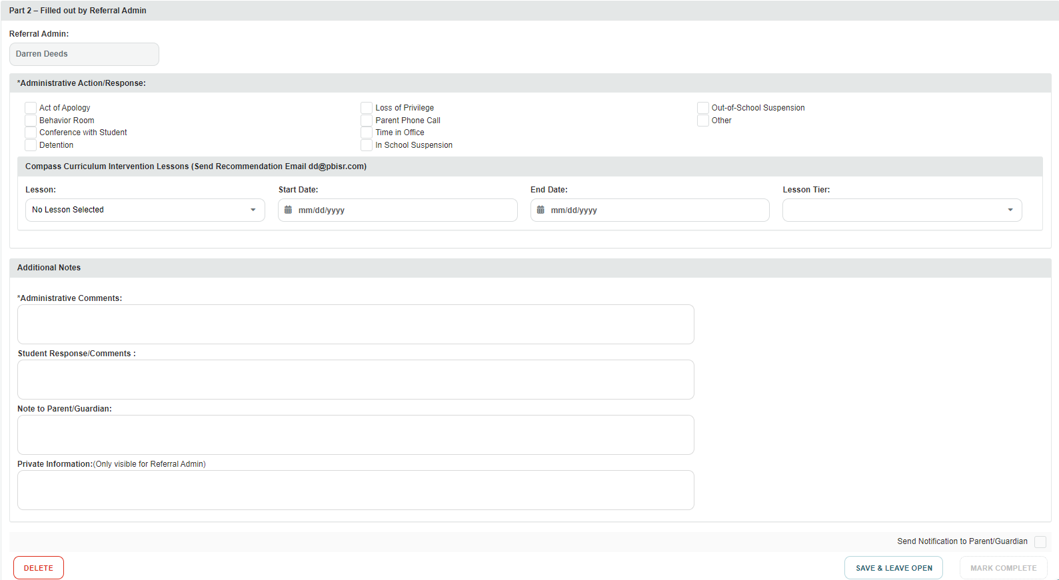
Processing Major Referrals
Notes:
The referral form will be located at the top of the page, at the bottom we will see options to provide administrative action and responses. {CLICK}
These options were created in your BRS settings. You can even assign Compass Curriculum lessons as a part of the corrective action for the student. Lesson options will populate for you based on the problem behavior. You will then assign the start and end date, as well as the tier. {CLICK}
At the bottom you will have a space for additional notes. Administrative comments are required. Much like the major referral form, the MARK COMPLETE button will not become available until all fields are completed. These are indicated by the star on these forms. {CLICK}
You may also want to send a notification home to families. To be clear, families will see these referrals, even if you don’t send a notification home. {CLICK}
Once you have completed the referral, you will click MARK COMPLETE to finalize the referral. This is when the notification is sent to the family. If you opt not to send the notification, it will still be available to view for the family, but an alert will not be sent.

Slide 14
Family Notifications with BRS
Major
Point Details
Minor
Major
Date | Staff | Problem Behavior
11/15/2026 10:28 am | Demo Explorer | Disruptive behavior
10/27/2026 02:29 pm | Hoffman Boston | Not following directions
10/27/2026 12:31 pm | Hoffman Boston | Shoving
10/25/2026 05:04 pm | Andrew Weber | Disruptive behavior
10/25/2026 02:06 pm | Andrew Weber | Disruptive behavior
10/25/2026 01:04 pm | Eva Rodriguez | Shoving
09/28/2026 06:45 am | Andrew Weber | Disruptive behavior
07/29/2026 01:22 pm | Andrew Weber | Disruptive behavior
07/29/2026 11:50 am | Eva Rodriguez | Refusal to work
07/22/2026 10:49 am | Andrew Weber | Dress code
Also in Spanish, Arabic, French, German, & many other languages
Date | Staff | Problem Behavior
10/27/2026 02:30 pm | Hoffman Boston | Defiance/Disrespect
10/25/2026 07:06 pm | Andrew Weber | Defiance/Disrespect
10/24/2026 01:45 pm | Andrew Weber | Defiance/Disrespect
10/22/2026 02:47 pm | Eva Rodriguez | Defiance/Disrespect
10/11/2026 03:33 pm | Andrew Weber | Defiance/Disrespect
10/08/2026 09:34 pm | Andrew Weber | Defiance/Disrespect
10/06/2026 04:28 pm | Demo Explorer | Repeated Minor Referrals
10/01/2026 09:01 am | Staci Adler | Defiance/Disrespect
08/26/2026 12:24 pm | Eva Rodriguez | Academic Dishonesty
08/04/2026 08:58 pm | Andrew Weber | Repeated Minor Referrals
Notes:
Abbreviated information sent to parent app with major and minor forms. This is also visible to students on the student app if this is turned on in your school admin settings.
Minor form – sent to parent when staff member clicks Save
Major form – sent to parent when admin. completes form
Forms can be printed as PDF and sent home as paper copy or emailed home

Slide 15
Attendance & Hall Passes in PBIS Rewards
Notes:
In this section, we will discuss how to log into the PBIS Rewards system
Take note of the laptop on our screen. We are first going to discuss ways for you to log in to your school’s PBIS Rewards platform. While we show you this information, we will not need to
New Account Password Set-up, Staff App Download and Auth Code Sign-in Video Link: https://support.pbisrewards.com/guides/new-account-set-up-video/

Slide 16
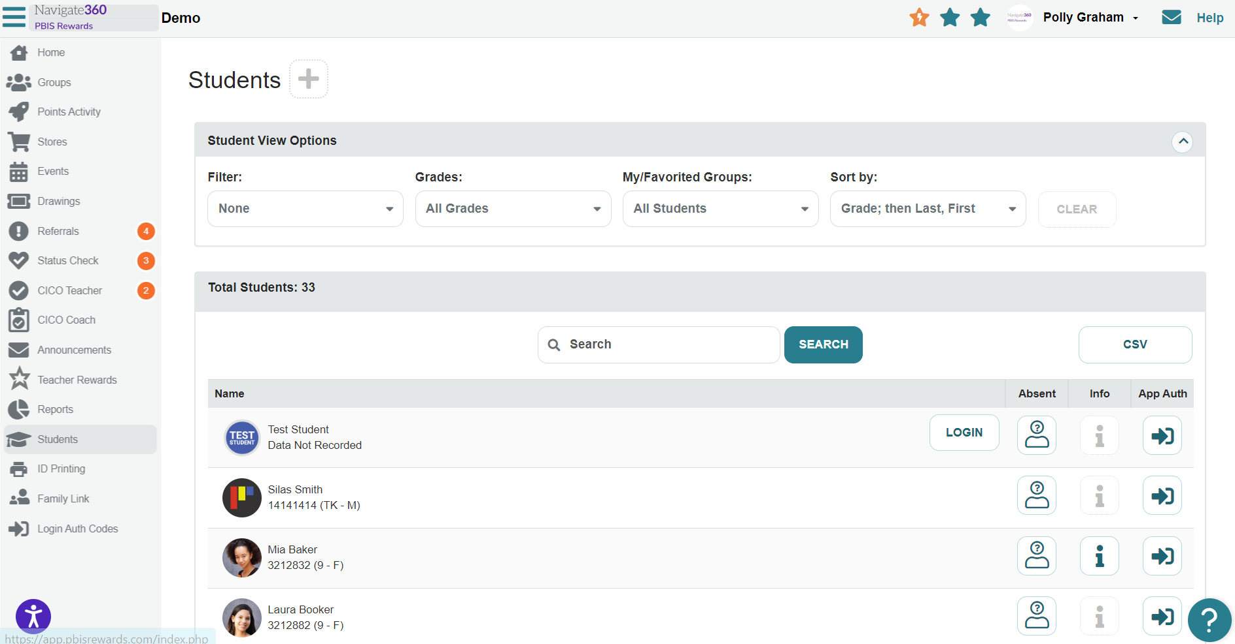
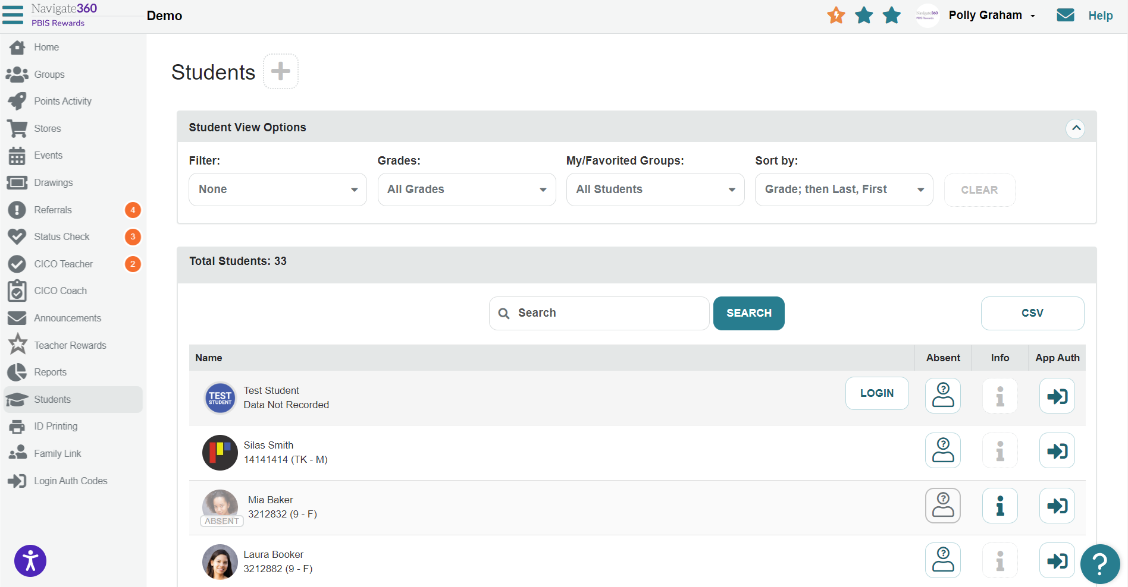
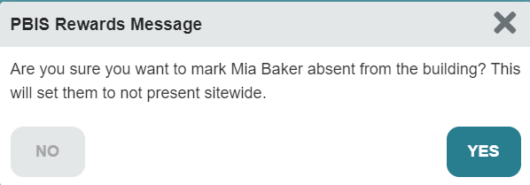
Attendance in PBIS Rewards (Student Page)
Notes:
From the home screen click on Students. This will bring you to the student page. From here, you see an absent column. (CLICK)
Find the student you are marking absent and select that attendance icon. (CLICK)
This dialog box will appear to inform you that you are marking this child absent from the school, not just a class, and you will confirm by choosing yes, to mark the student absent. {CLICK}
Here you can see the student was marked absent.
Follow the same steps to mark the student as present.
You can also mark the child present from the home page and groups page as well. I will show you this in the coming slides.

Slide 17
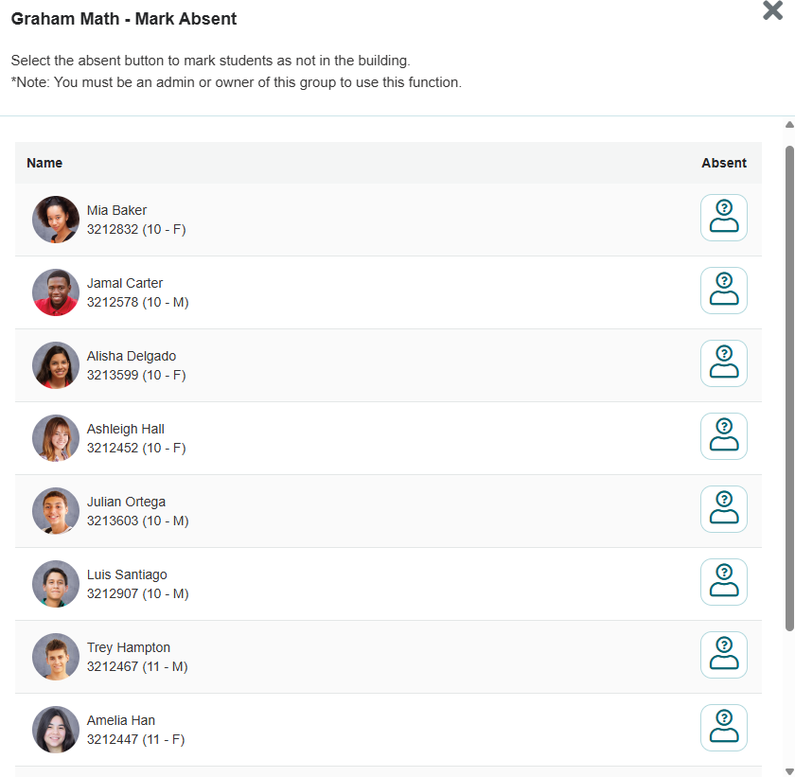
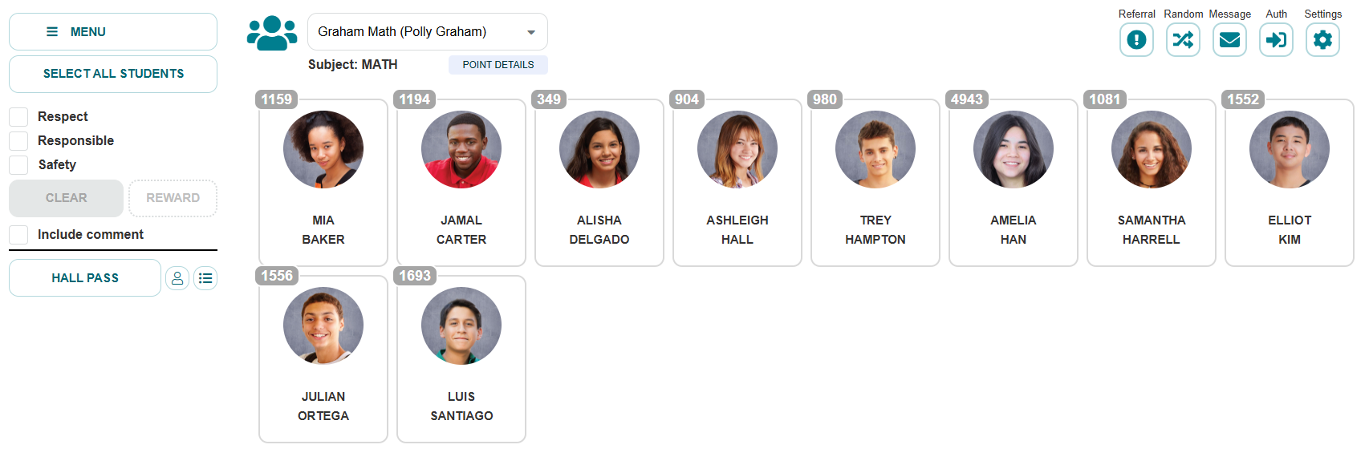
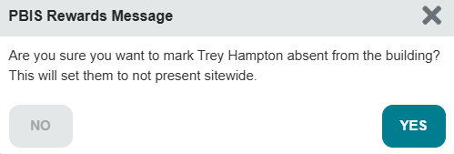
Attendance in PBIS Rewards (Group Page)
Notes:
From the home screen click on Students. This will bring you to the student page. From here, you see an absent column. (CLICK)
Find the student you are marking absent and select that attendance icon. (CLICK)
This dialog box will appear to inform you that you are marking this child absent from the school, not just a class, and you will confirm by choosing yes, to mark the student absent. {CLICK}
Here you can see the student was marked absent.
Follow the same steps to mark the student as present.
You can also mark the child present from the home page and groups page as well. I will show you this in the coming slides.

Slide 18
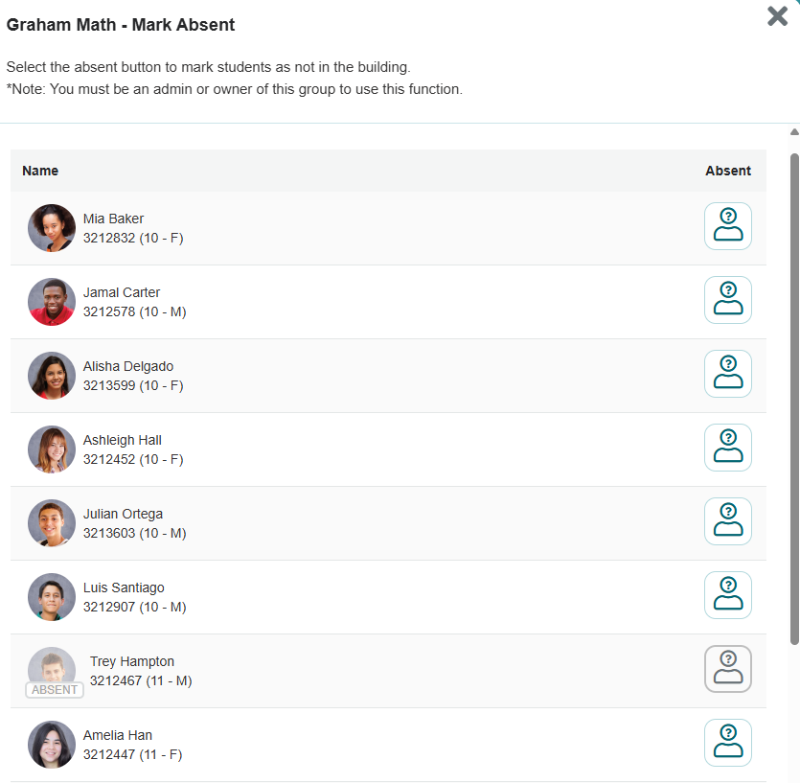
Attendance in PBIS Rewards (Group Page)
Notes:
From the home screen click on Students. This will bring you to the student page. From here, you see an absent column. (CLICK)
Find the student you are marking absent and select that attendance icon. (CLICK)
This dialog box will appear to inform you that you are marking this child absent from the school, not just a class, and you will confirm by choosing yes, to mark the student absent. {CLICK}
Here you can see the student was marked absent.
Follow the same steps to mark the student as present.
You can also mark the child present from the home page and groups page as well. I will show you this in the coming slides.

Slide 19
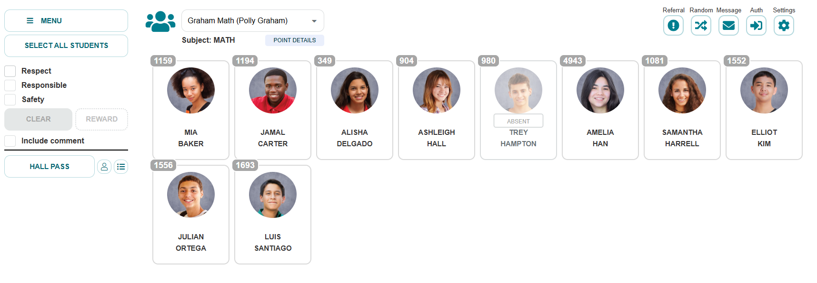
Attendance in PBIS Rewards (Group Page)
Notes:
From the home screen click on Students. This will bring you to the student page. From here, you see an absent column. (CLICK)
Find the student you are marking absent and select that attendance icon. (CLICK)
This dialog box will appear to inform you that you are marking this child absent from the school, not just a class, and you will confirm by choosing yes, to mark the student absent. {CLICK}
Here you can see the student was marked absent.
Follow the same steps to mark the student as present.
You can also mark the child present from the home page and groups page as well. I will show you this in the coming slides.

Slide 20
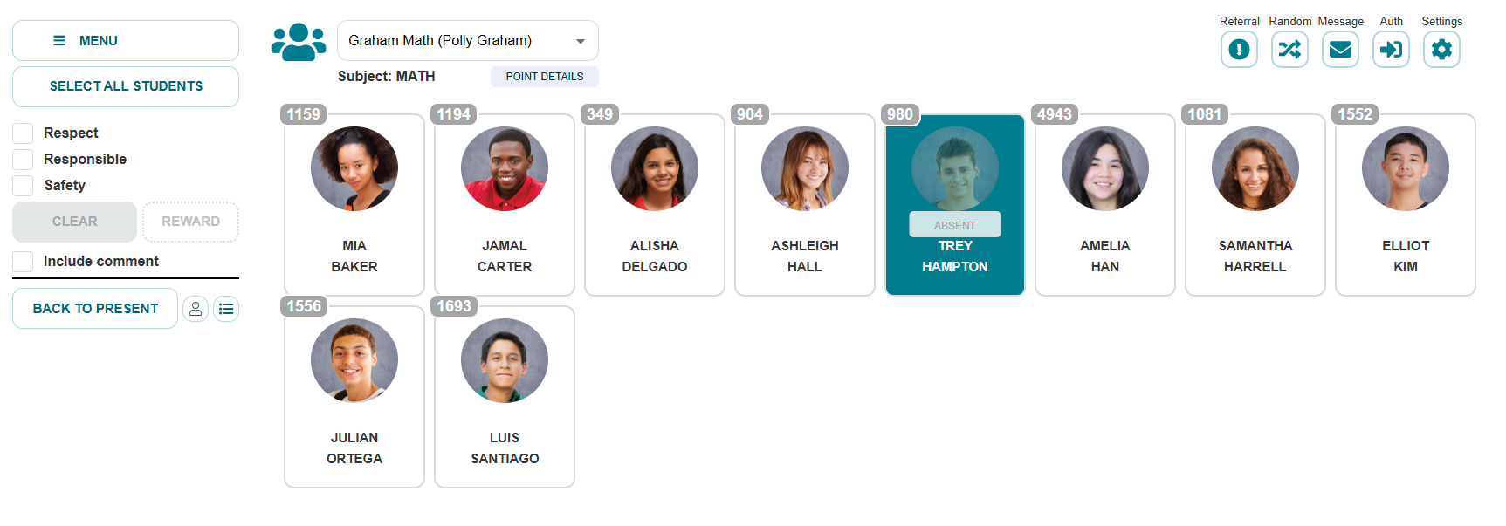
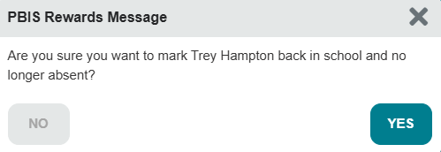
Attendance in PBIS Rewards (Group Page)
Notes:
From the home screen click on Students. This will bring you to the student page. From here, you see an absent column. (CLICK)
Find the student you are marking absent and select that attendance icon. (CLICK)
This dialog box will appear to inform you that you are marking this child absent from the school, not just a class, and you will confirm by choosing yes, to mark the student absent. {CLICK}
Here you can see the student was marked absent.
Follow the same steps to mark the student as present.
You can also mark the child present from the home page and groups page as well. I will show you this in the coming slides.

Slide 21
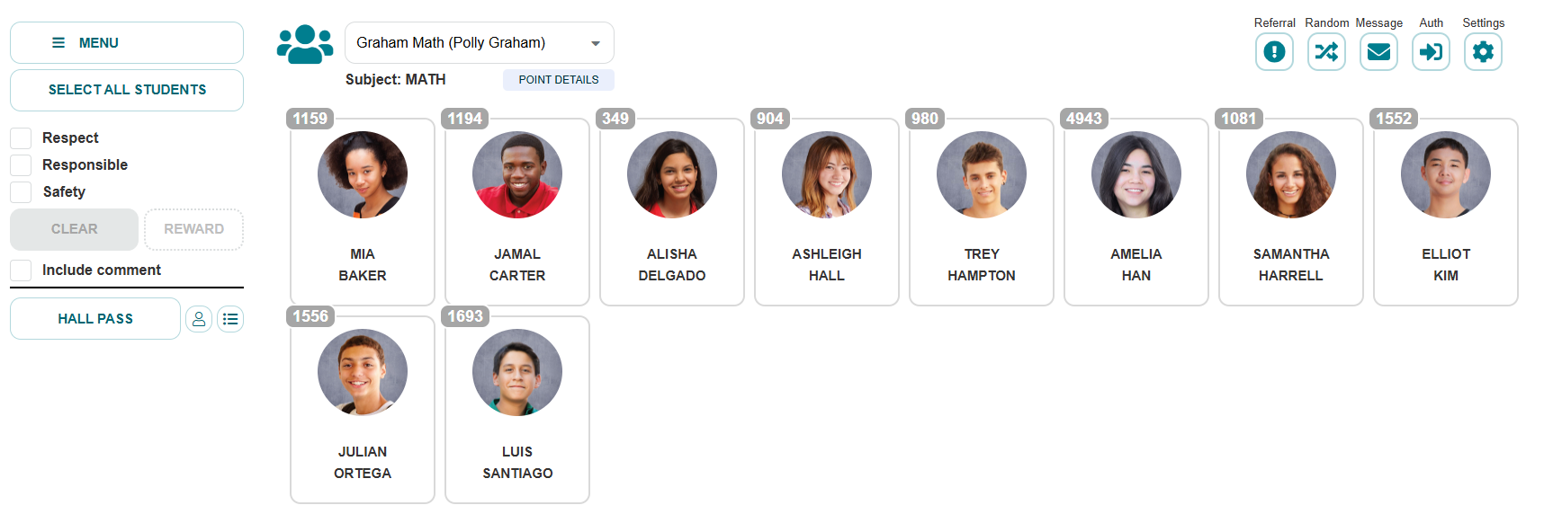
Attendance in PBIS Rewards (Group Page)
Notes:
From the home screen click on Students. This will bring you to the student page. From here, you see an absent column. (CLICK)
Find the student you are marking absent and select that attendance icon. (CLICK)
This dialog box will appear to inform you that you are marking this child absent from the school, not just a class, and you will confirm by choosing yes, to mark the student absent. {CLICK}
Here you can see the student was marked absent.
Follow the same steps to mark the student as present.
You can also mark the child present from the home page and groups page as well. I will show you this in the coming slides.

Slide 22
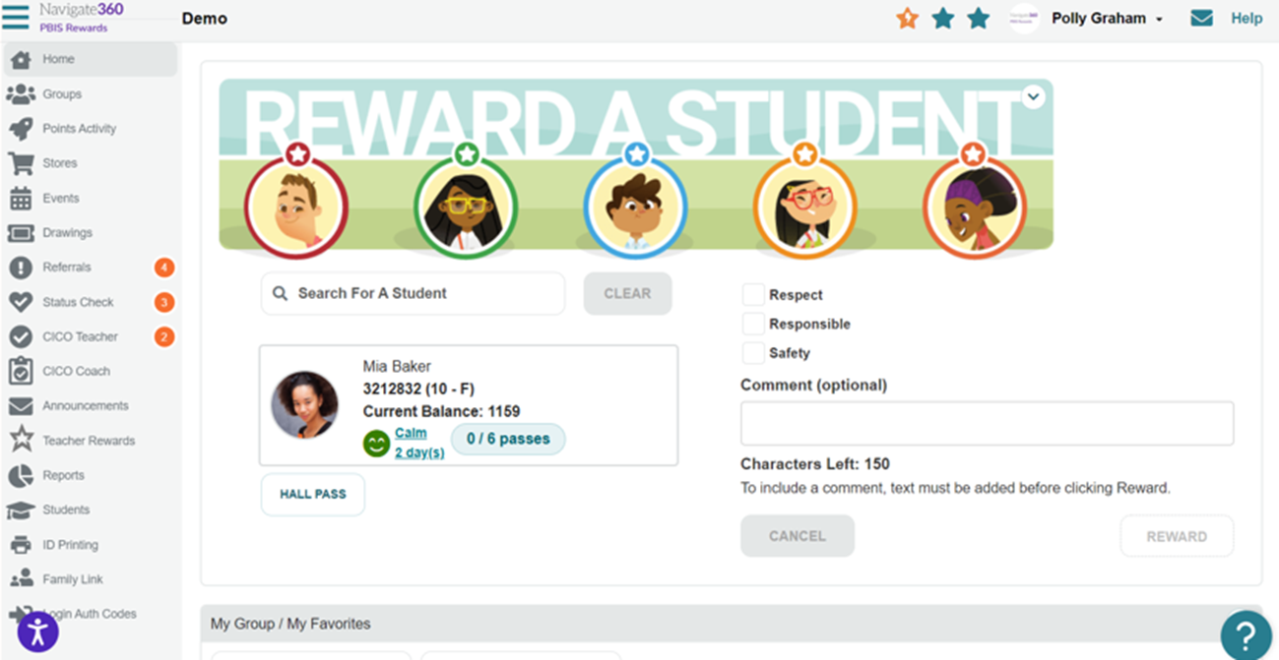
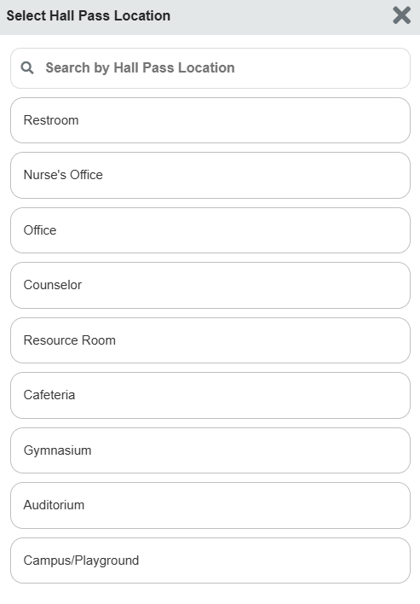
Hall Passes from the Home Screen
Notes:
Hall passes can be done from the home page and the groups page. Let’s take a look at how this is done from both places.
From the home screen, you will search for a student by clicking in this box and typing the student’s name and then, select the student’s card. (CLICK)
To issue a hall pass, click the hall pass button. {CLICK}
Next, we will need to determine where the student is heading. You can choose from the options provided. Admin can add additional Hall Pass Options in the system.

Slide 23
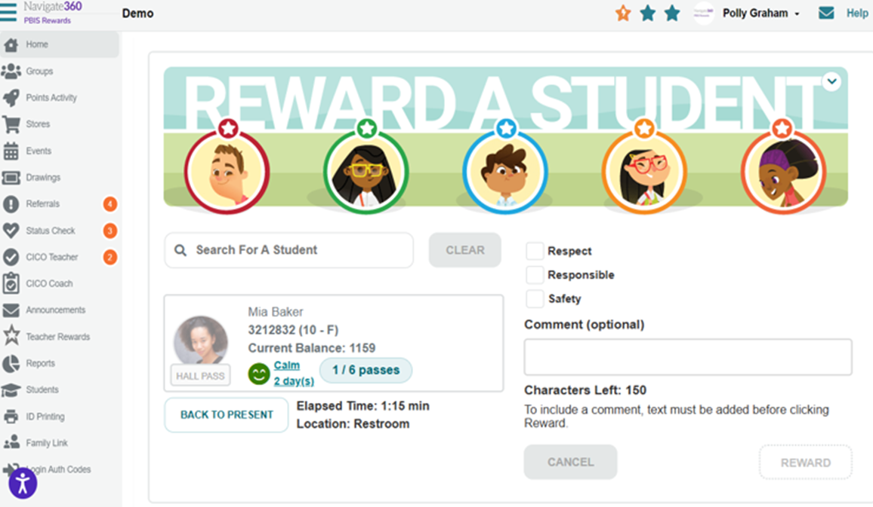
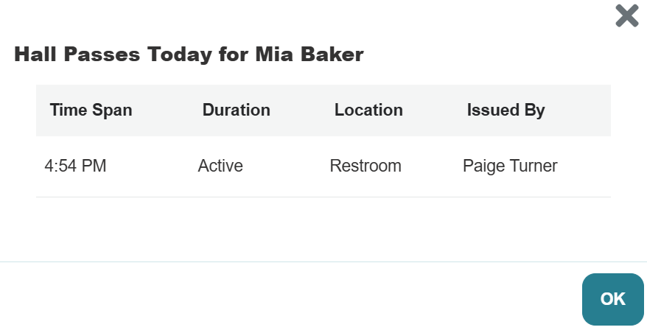
Hall Passes from the Home Screen
Notes:
This will place the student on a hall pass and begin to track the elapsed time and show the location for the student as seen here. {CLICK}
When the hall pass is no longer needed and the student has returned to class, you can select the back to present button. (CLICK)
This can be done by searching for the student again if you have left this page. We can also mark an absent student as present in this way as well.

Slide 24
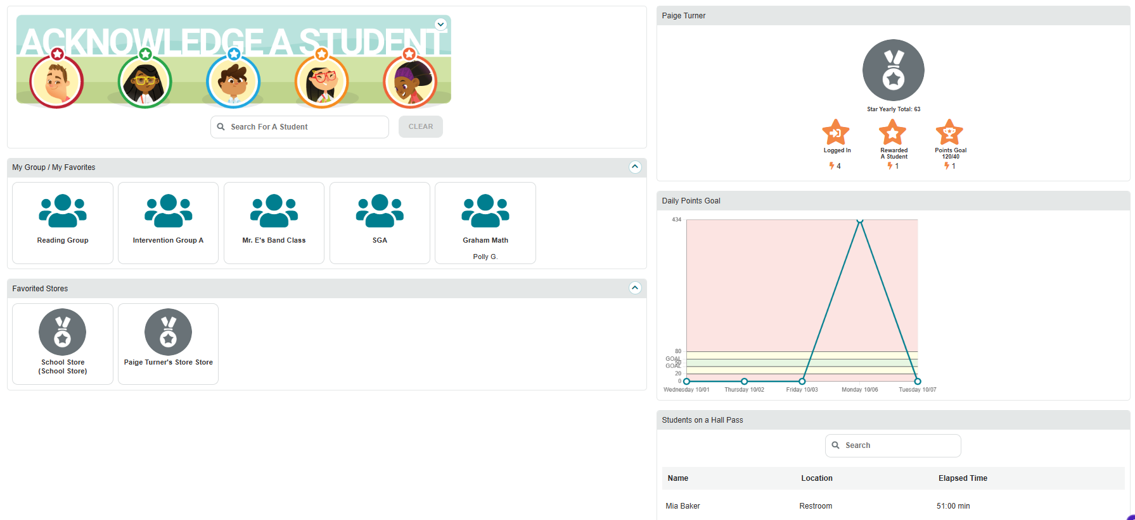
Hall Passes from the Home Screen
Notes:
This will place the student on a hall pass and begin to track the elapsed time and show the location for the student as seen here. {CLICK}
When the hall pass is no longer needed and the student has returned to class, you can select the back to present button. (CLICK)
This can be done by searching for the student again if you have left this page. We can also mark an absent student as present in this way as well.

Slide 25
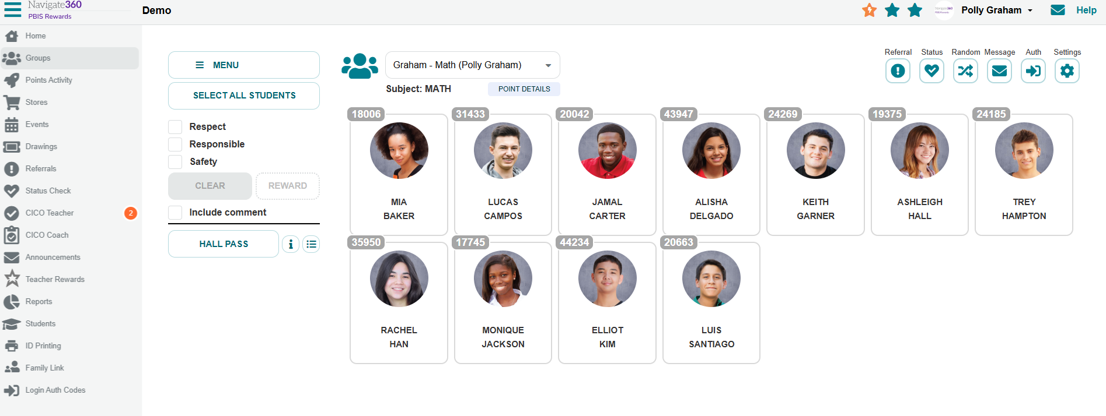
Hall Passes from the Groups Page
Notes:
From your groups page, you will easily be able to put a child on a hall pass, check to see other students on a hall pass in your building, and of course, mark the students return to the classroom. First, we will select the student who is leaving the classroom.

Slide 26
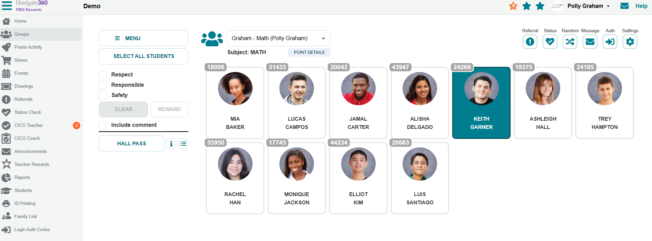
Hall Passes from the Groups Page
Notes:
The student will highlight in green. Now select Hall Pass. {CLICK}
You will then be prompted to choose where the student is going while on the hall pass. (CLICK) Now, choose the location to begin the hall pass

Slide 27
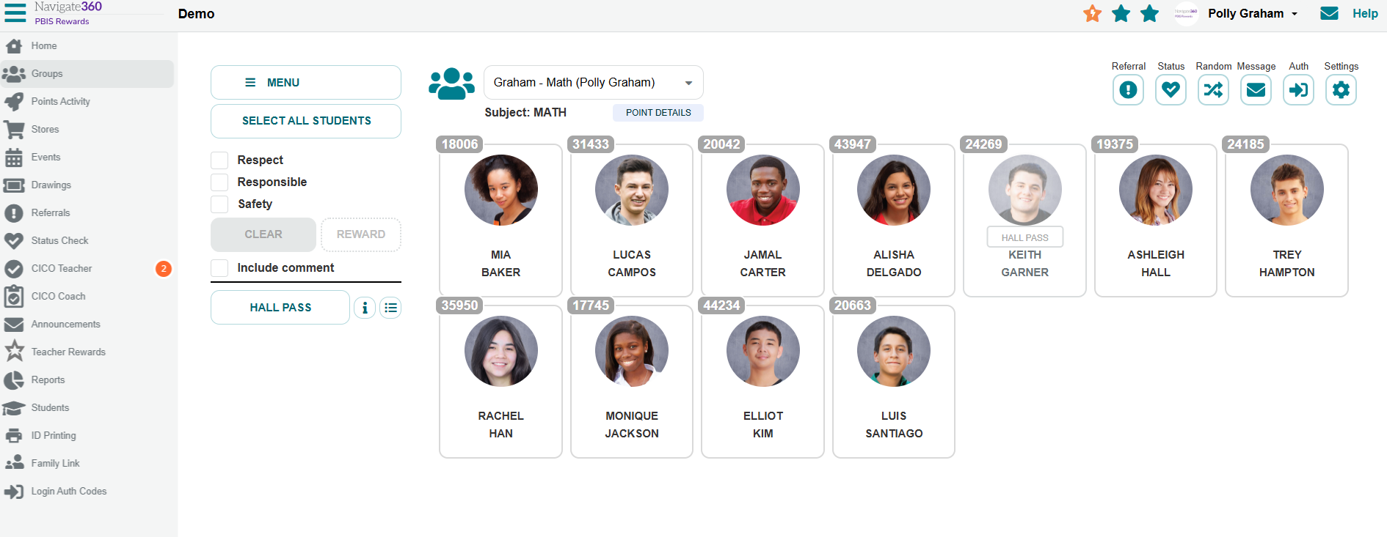
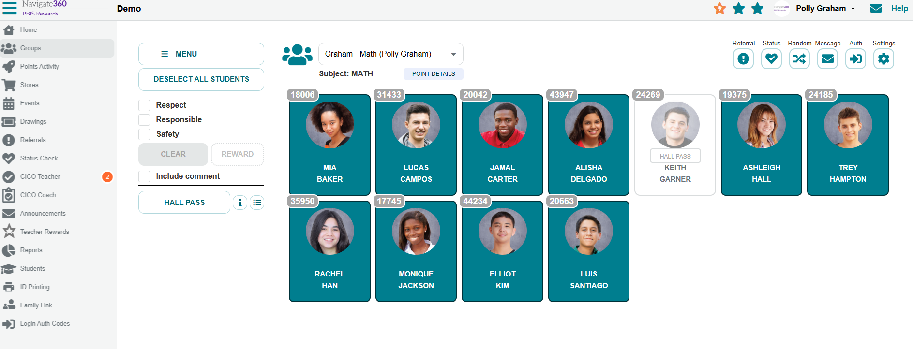
Hall Passes from the Groups Page
Notes:
Once you have put the student on the hall pass, you will see the student is grayed out and will not receive points when you select all students. {CLICK}
As you can see, all students were selected except Keith since he was on a hall pass when the points were awarded. If it is a point that he earned, you can still select him in addition to selecting all students to reward the point.

Slide 28
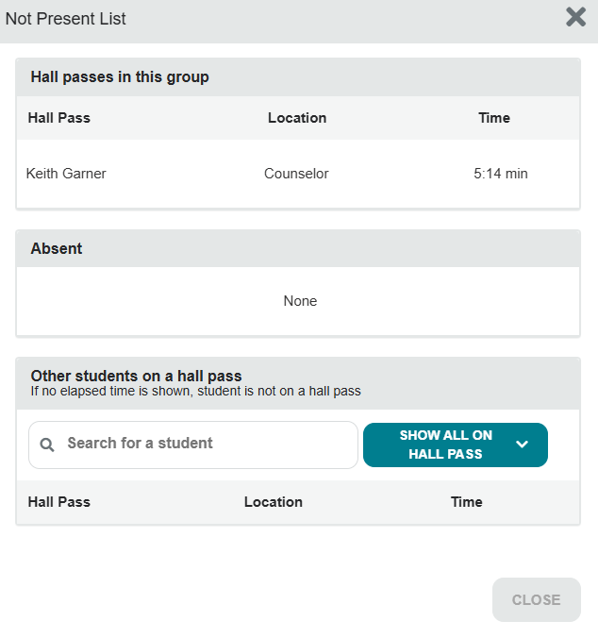
Hall Passes from the Groups Page
Notes:
You can track their elapsed time by clicking the Not Present List, located here {CLICK}
This will show you all students in your group that are absent or on a hall pass. (CLICK)
It will also show you the students elapsed time in the hallway for this hall pass. (CLICK)
You can also see other students in the hallway. It might be beneficial to check this before issuing a hall pass to a student if you are aware of issues that may involve other students as a preventative measure considering they will be in a less supervised area, like the hallway, further aiding to the supervision and safety in your school.

Slide 29
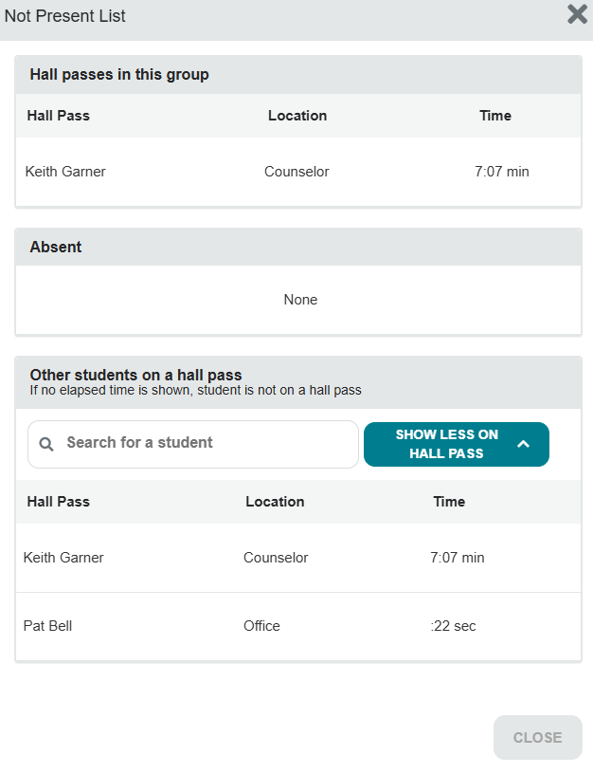
Hall Passes from the Groups Page
Notes:
Here we can see Keith and Pat are both in the hallway within the school. Remember, this does also show the elapsed time for any student in the school on an active hall pass.

Slide 30
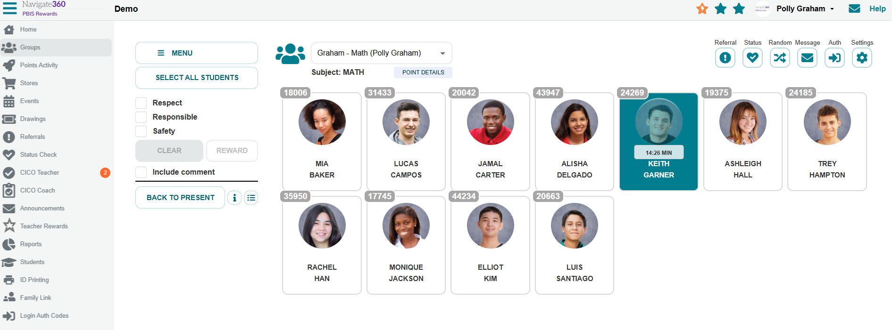
Hall Passes from the Groups Page
Notes:
You can also see a student’s elapsed time in the hallway by selecting their card (CLICK)
They will highlight in green and we will see how long he has been in the hallway. (CLICK)
When he returns to class, we will select his card and select Back to Present. You can also mark an absent student present in this way. (CLICK)

Slide 31
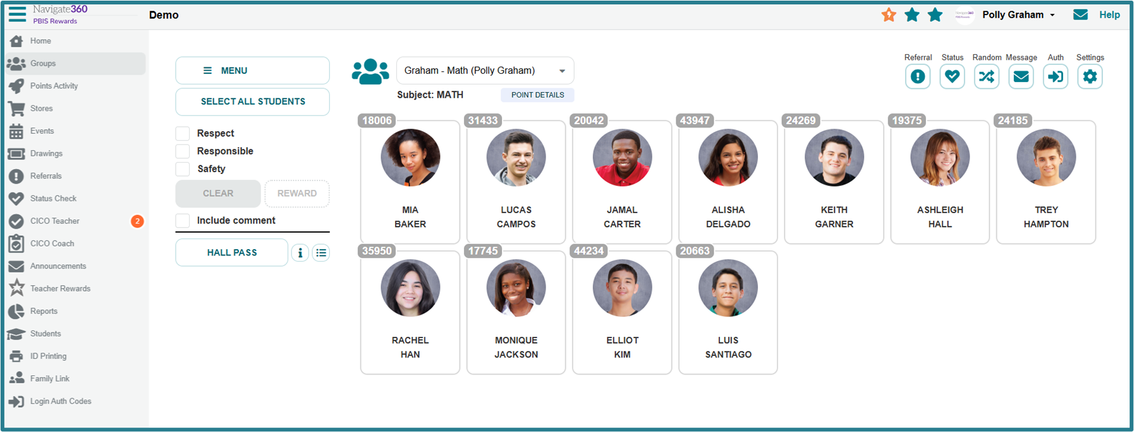
Hall Passes from the Groups Page
Notes:
Now, we can see that Keith is back in class and will earn points again when I SELECT ALL STUDENTS.
Admin can run reports for attendance and hall passes which tracks student attendance and their hall passes as well as calculating an average time out of class with a hall pass for each student.

Slide 32
Building Staff Buy-In with Teacher Rewards

Slide 33
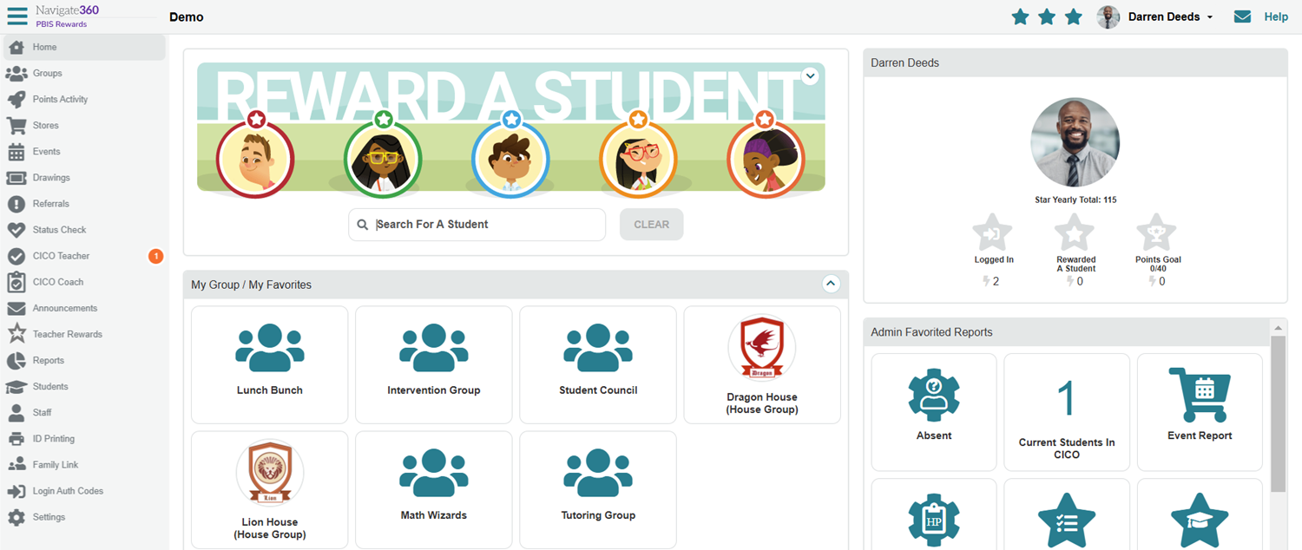
Staff Star Rewards
Notes:
Beside the staff members name, we will see 3 stars. You can hover over these stars to see how you can earn them or look just below your image in the system.
Staff members can also earn points for collecting these stars as well, if this is turned on in the admin settings.

Slide 34
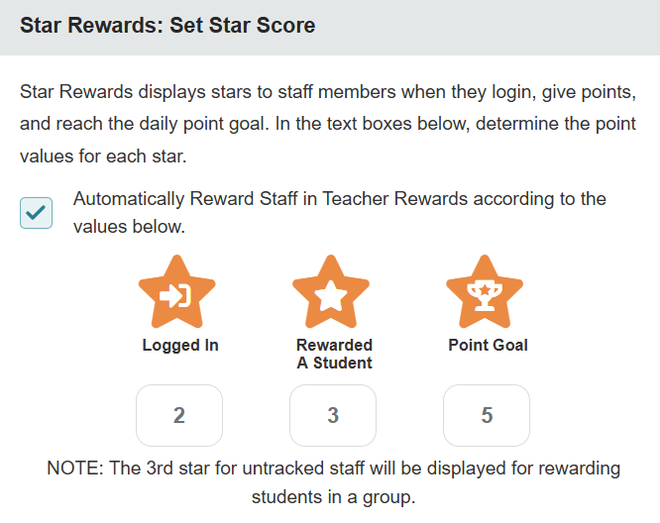
Staff Star Rewards
Notes:
This is what admin will use to decide how many points a teacher receives for each of these 3 categories.

Slide 35
Teacher Rewards
What Can Administrators Do?
Give teachers points like students.
Have a special Teacher Store.
Control who can give points to staff and who can earn points.
Track teacher purchases electronically.
Post encouraging messages on The Wall.
Host Raffles, Events, and Auctions.
What Can Teachers Do?
See their point totals.
Request points for themselves.
Recommend points for others.
Redeem their points in the Teacher Store.
Post encouraging messages on The Wall.
Participate in Raffles, Events, and Auctions.

Slide 36
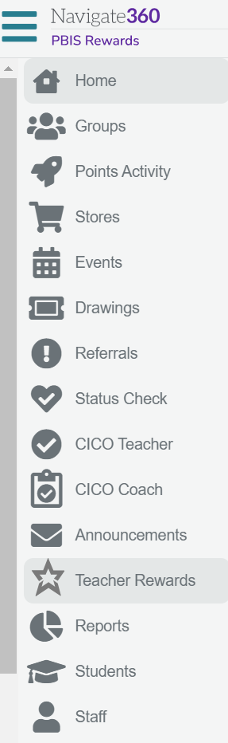
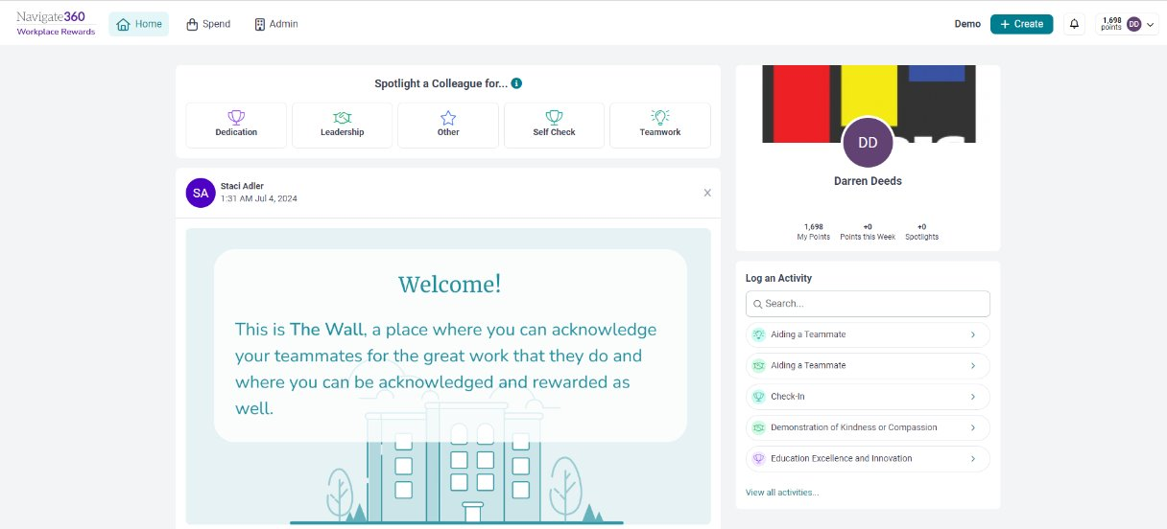
Accessing Teacher Rewards
Notes:
To access Teacher Rewards, teachers will select Teacher Rewards on the left side menu. All options are setup by administrators. (CLICK)
They can log activities for themselves in this section. Encourage your staff to use this. (CLICK)
Staff members can recognize or spotlight other staff members as well. These spotlights will be posted on the wall below after they have been approved. (CLICK)
Teachers can spend points in a variety of ways by select SPEND at the top. Options include Store, Events, Raffles, and Auctions. (CLICK)
Teachers can also create a post for the other teachers. For example, there is coffee in the breakroom or great job last night at the band concert.

Slide 37
Helpful Resources
Notes:
In this section, we will discuss how to utilize several helpful features.
This section may be saved to discuss at future trainings, trying not to overwhelm your staff.

Slide 38
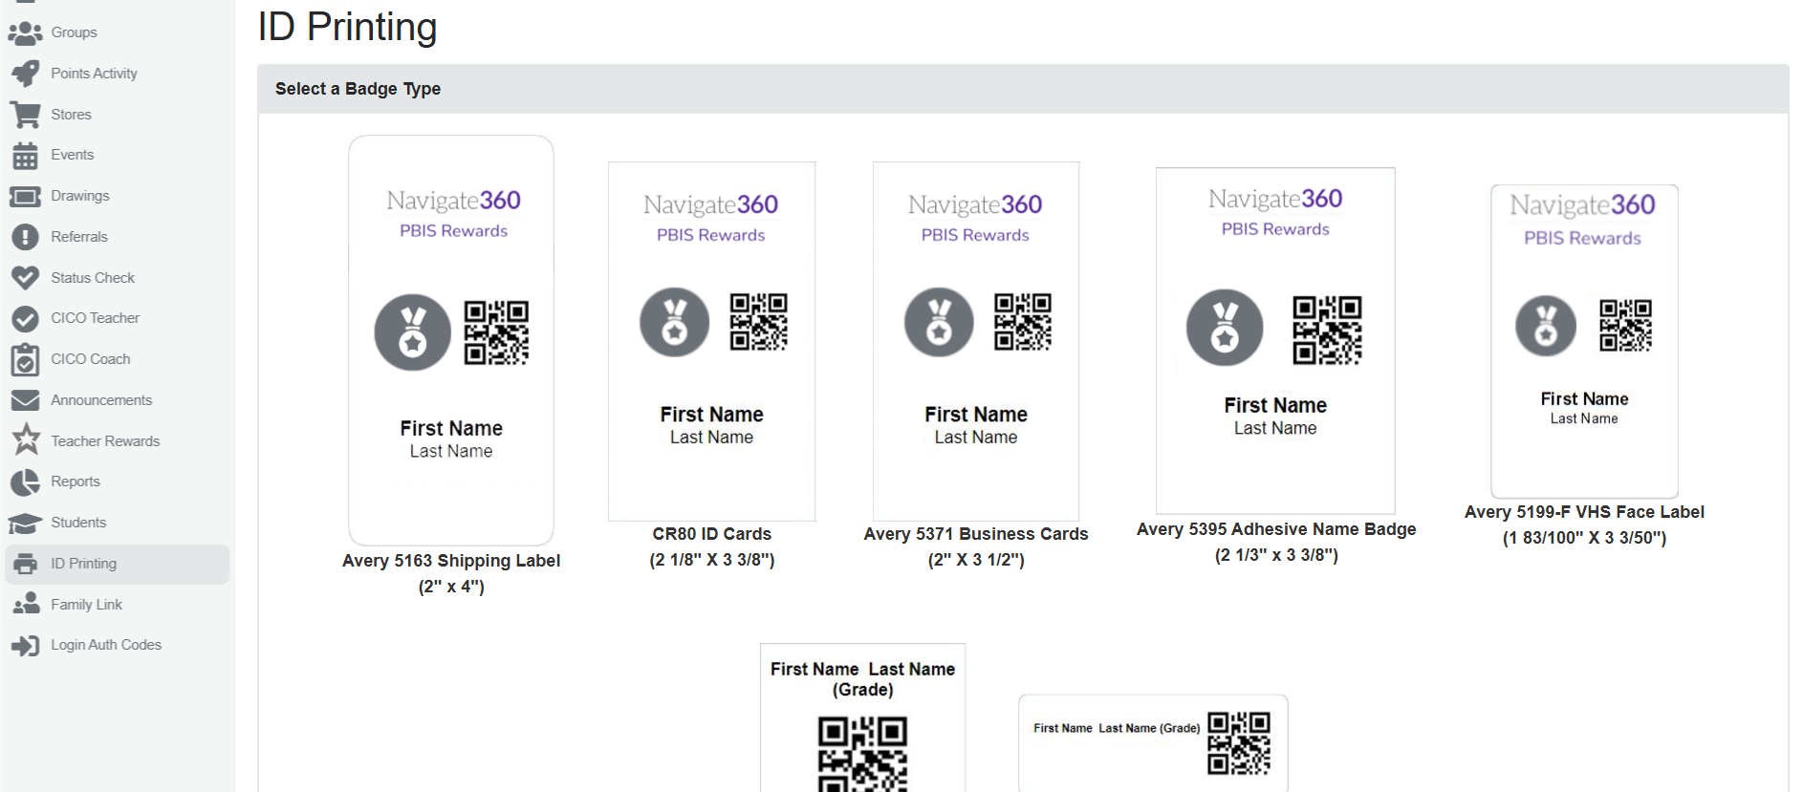
Printing Badges within PBIS Rewards
Notes:
There are many printing options for badges for schools. In the next slide, we will look at some creative places we can use these badges to support more fidelity and acknowledgment.

Slide 39



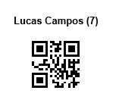
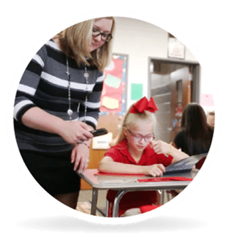
Think Outside the Badge
Use a QR sticker on a student’s folder or agenda for easy access to give points when they turn in homework and assignments.
Have IDs on students’ desks for easy scanning as you walk by, or have group QR codes posted inside or outside the classroom for easy access for others.
If your students are 1:1 with devices, use a label to identify the computer as well as give easy access for badge scanning while they are working.
Notes:
Go over the many ways we can use badges to make it easier for your teachers to reward on the go.

Slide 40
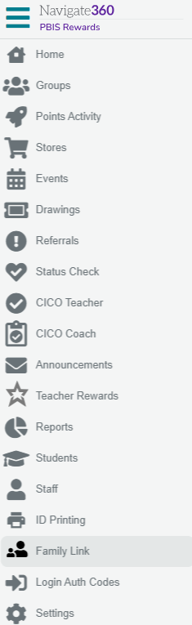
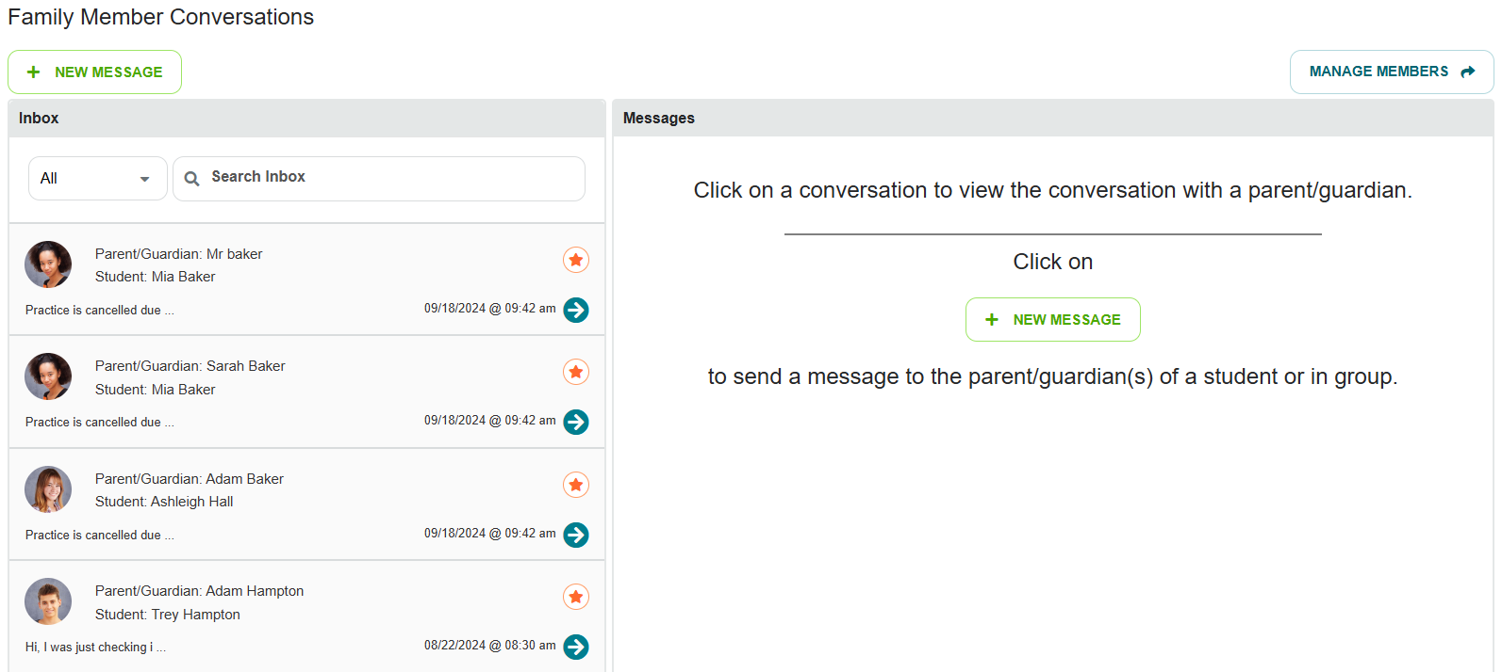
Family Link
Notes:
To message parents, first click on family link. {CLICK}
From here, you can easily message parents or check messages they have sent you by clicking here. {CLICK}
Your history will populate in this section as well. {CLICK}
To get parents access to the family app, select Manage Parents.

Slide 41
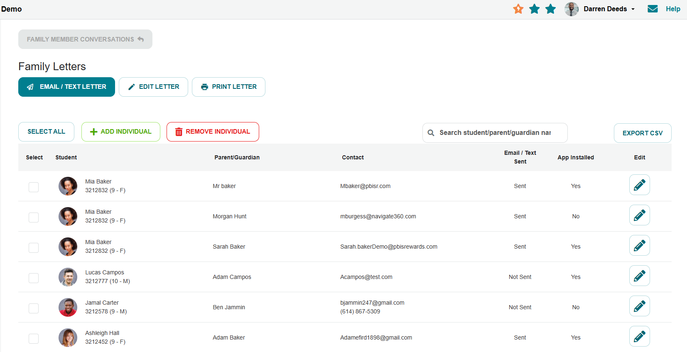
Family Link
Notes:
From here you can
Email/Text Letter to parents
Edit Parent Letter – make it specific to your school
Print letters out to distribute at open house (PREFERRED) or send home with students
Available in other languages
(CLICK)
This section shows which parents have connected with the school in PBIS Rewards and whether they have downloaded/linked the family app.
Parent Conversations Article Link: https://support.pbisrewards.com/guides/two-way-parent-communication/

Slide 42
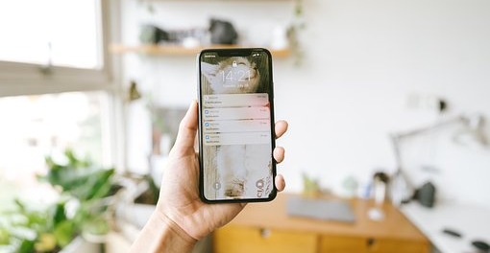
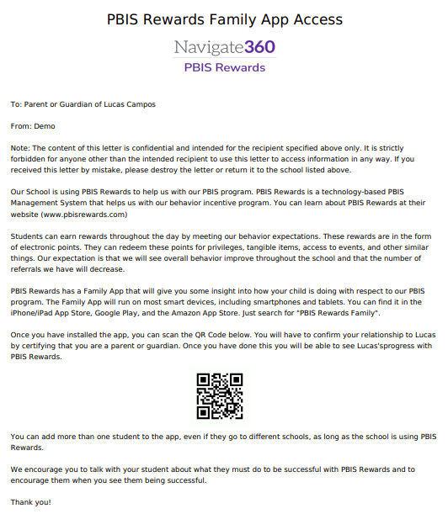
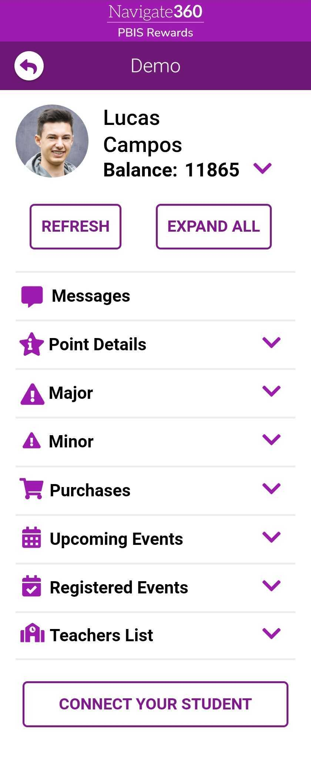
Family Access – App Only
The PBIS Rewards family app includes point details, referrals (if applicable), purchases, upcoming events, registered events, list of teachers with contact info, and parent messaging.
Notes:
How do families see their student’s info? From the family app.
Many parents downloaded the wrong app
Resources:
Parent App Access Article Link: https://support.pbisrewards.com/guides/send-parent-letters/
Parent PBIS Rewards Video: https://www.youtube.com/watch?v=j_1_yFUvXUA&feature=youtu.be

Slide 43

Questions

Slide 44
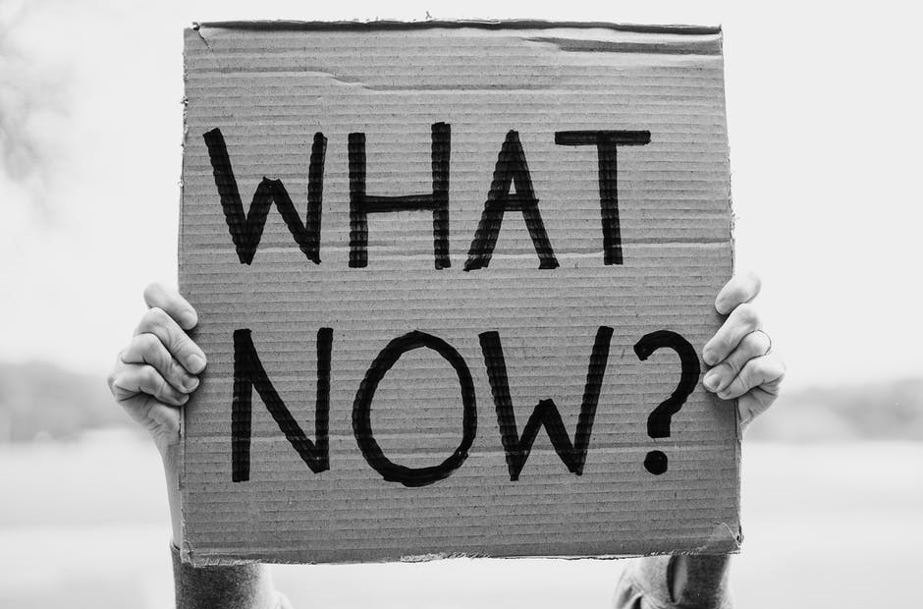

Slide 45
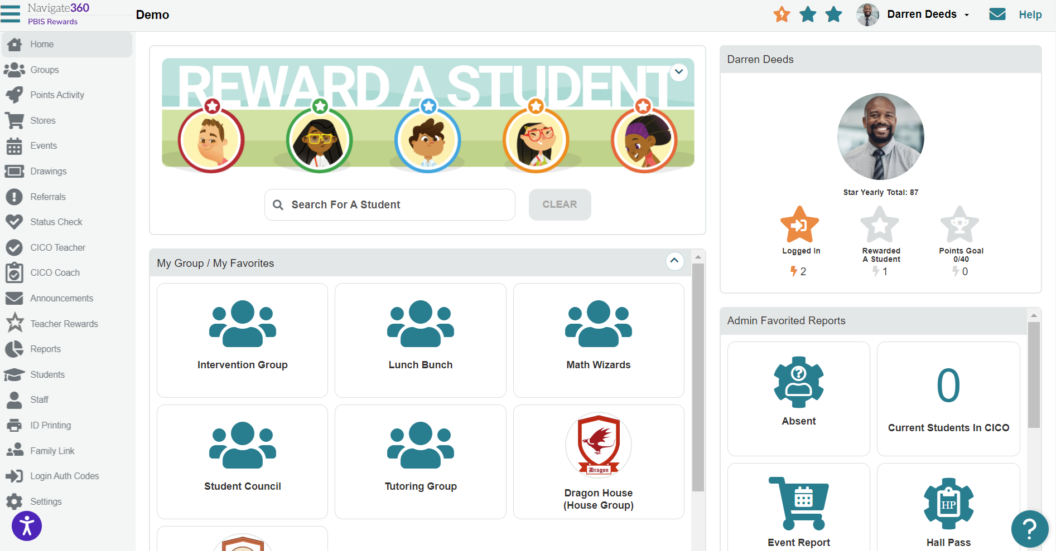
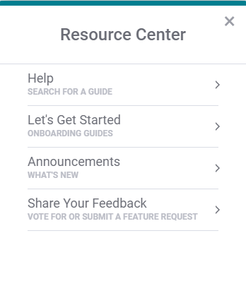
PBIS Rewards Resource Center
Notes:
If you ever need assistance within PBIS Rewards, you can check out our resource center by clicking the question mark (CLICK)​
You can easily search for help guides and onboarding guides here. Additionally, you can see any updates or announcements here as well. Finally, this is a place for you to share your feedback with our developers. They frequently use this feedback to make changes to our system. (CLICK)​
In the upper right hand corner, you may also click on the help button to go to the support page.

Slide 46



PBIS Rewards Support Page
Free Training Sessions,
1:1 Office Hour Sessions, and On-Demand Recordings!
Notes:
Here you will find lots of resources and getting started guides {CLICK}​​
There are videos, screenshots and additional resources on various topics in PBISR as well as access to our training calendar, which we will review in the coming slides. {CLICK}​​
You can also open a chat with our support team {CLICK}​​
If you prefer to speak with someone over the phone, you can also click Contact Us for a phone number and additional ways to reach out to our amazing support team. {CLICK}​​
If you are looking for more training or PD opportunities for your staff, click here! (CLICK)
We usually offer 2 free trainings and 2 days of office hours that your or your staff can register for. We provide a recording a PD certificate for attendees. There are also on-demand recoridngs available for past free trainings we have completed. ​

